Slide 1
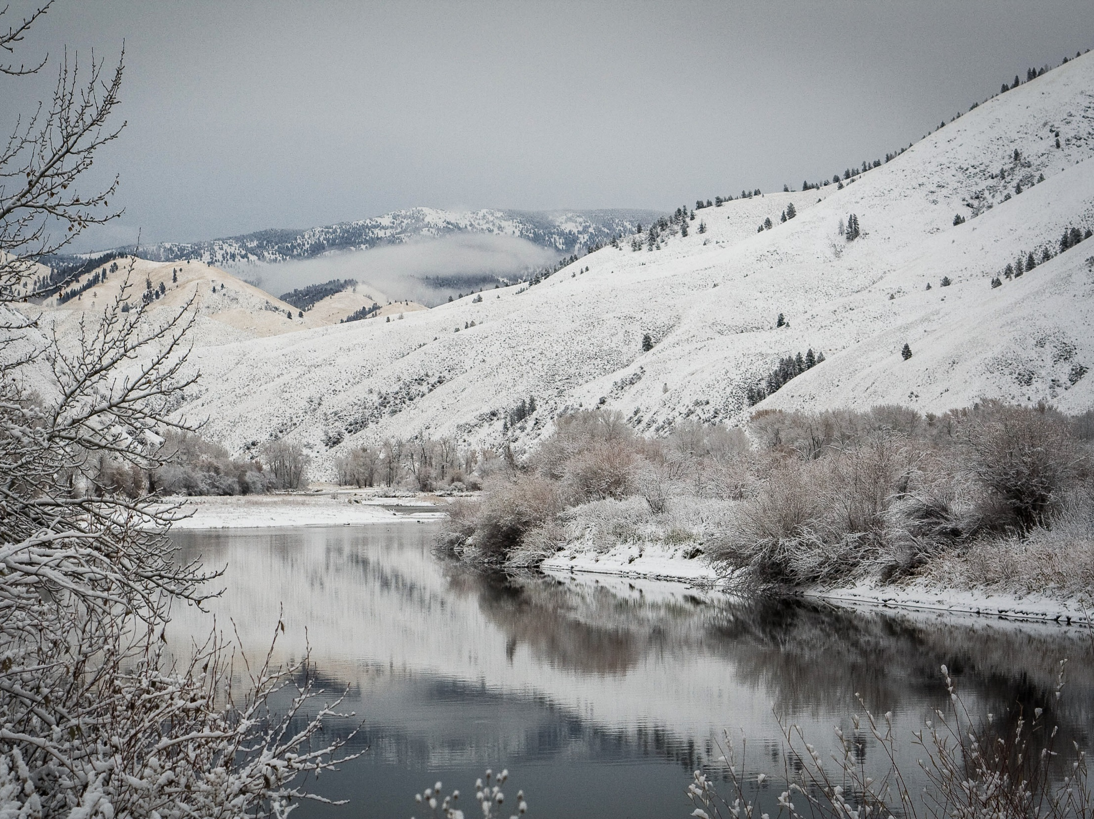
DEADWATER History and River Impacts

Slide 2
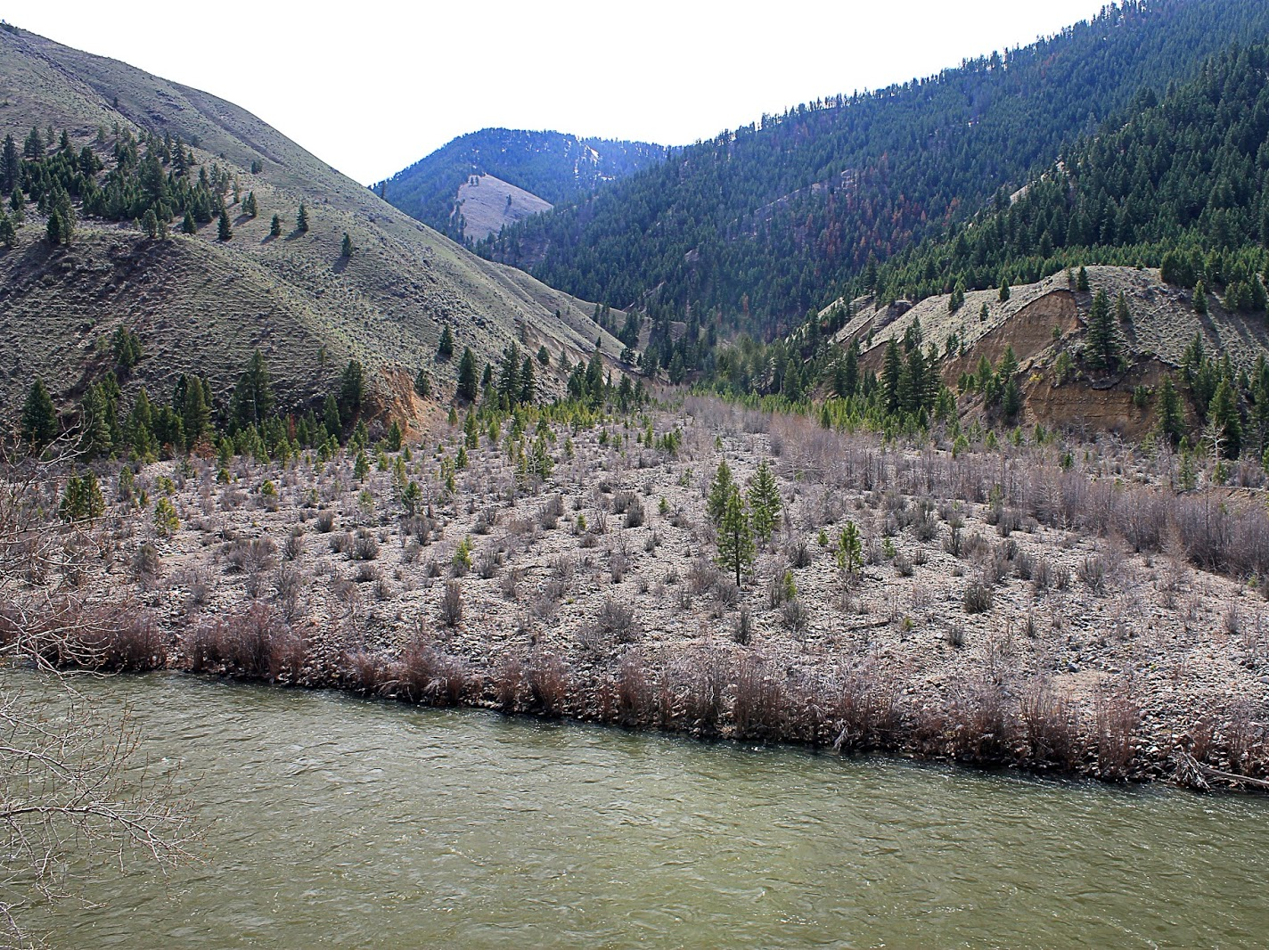
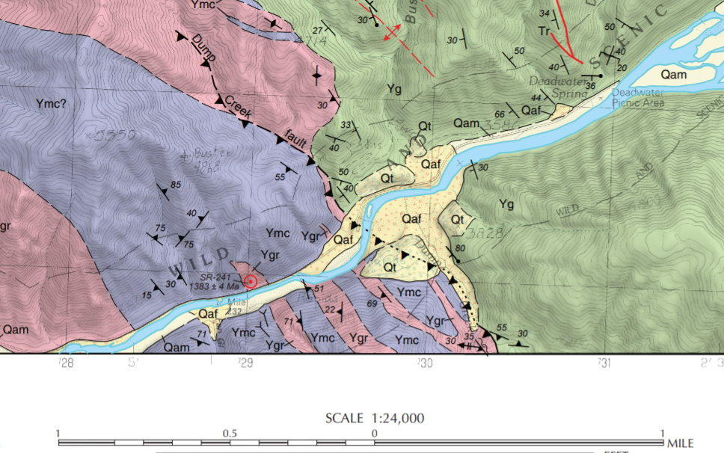
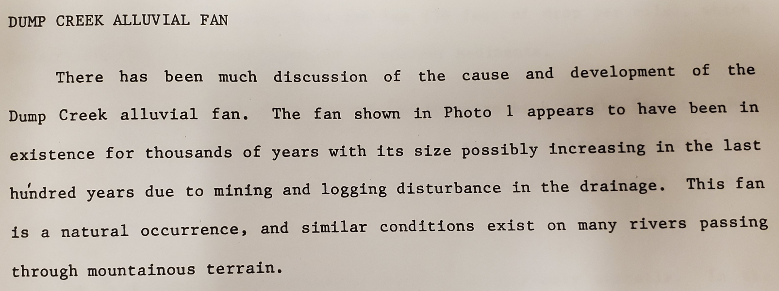
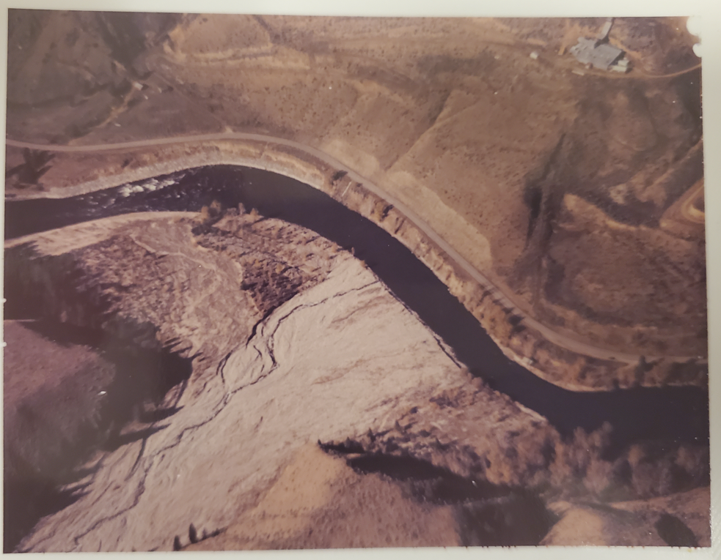
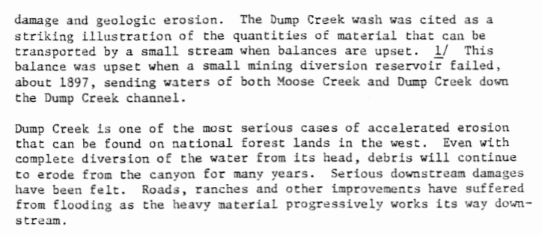
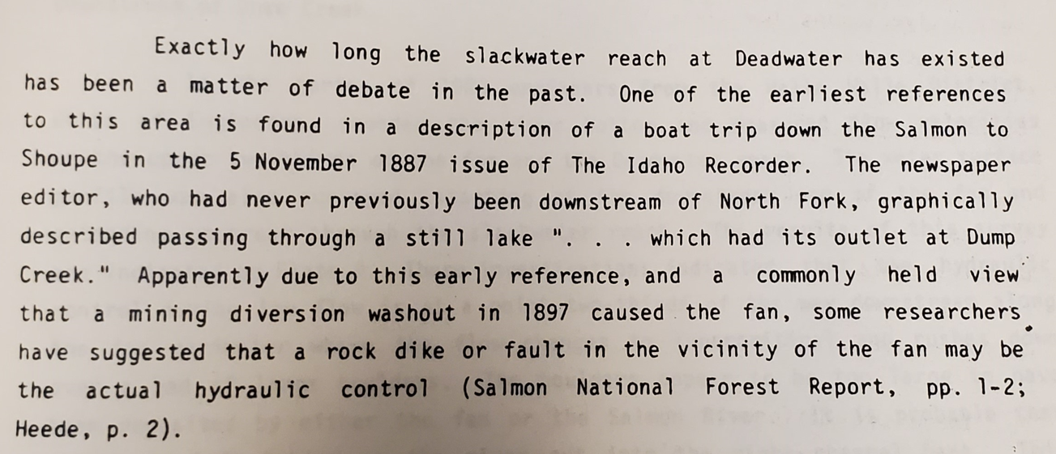
Origin
Alluvial fan creates the Deadwater reach...but what caused it?
No consensus
Local rumors and History of the Salmon-Challis N.F.
Army Corps reports
Geomax report
A History of the Salmon National Forest 1973
Reducing Ice Jams Along the Salmon River, Geomax 1985
Salmon River Ice Jams USACE 1984

Slide 3
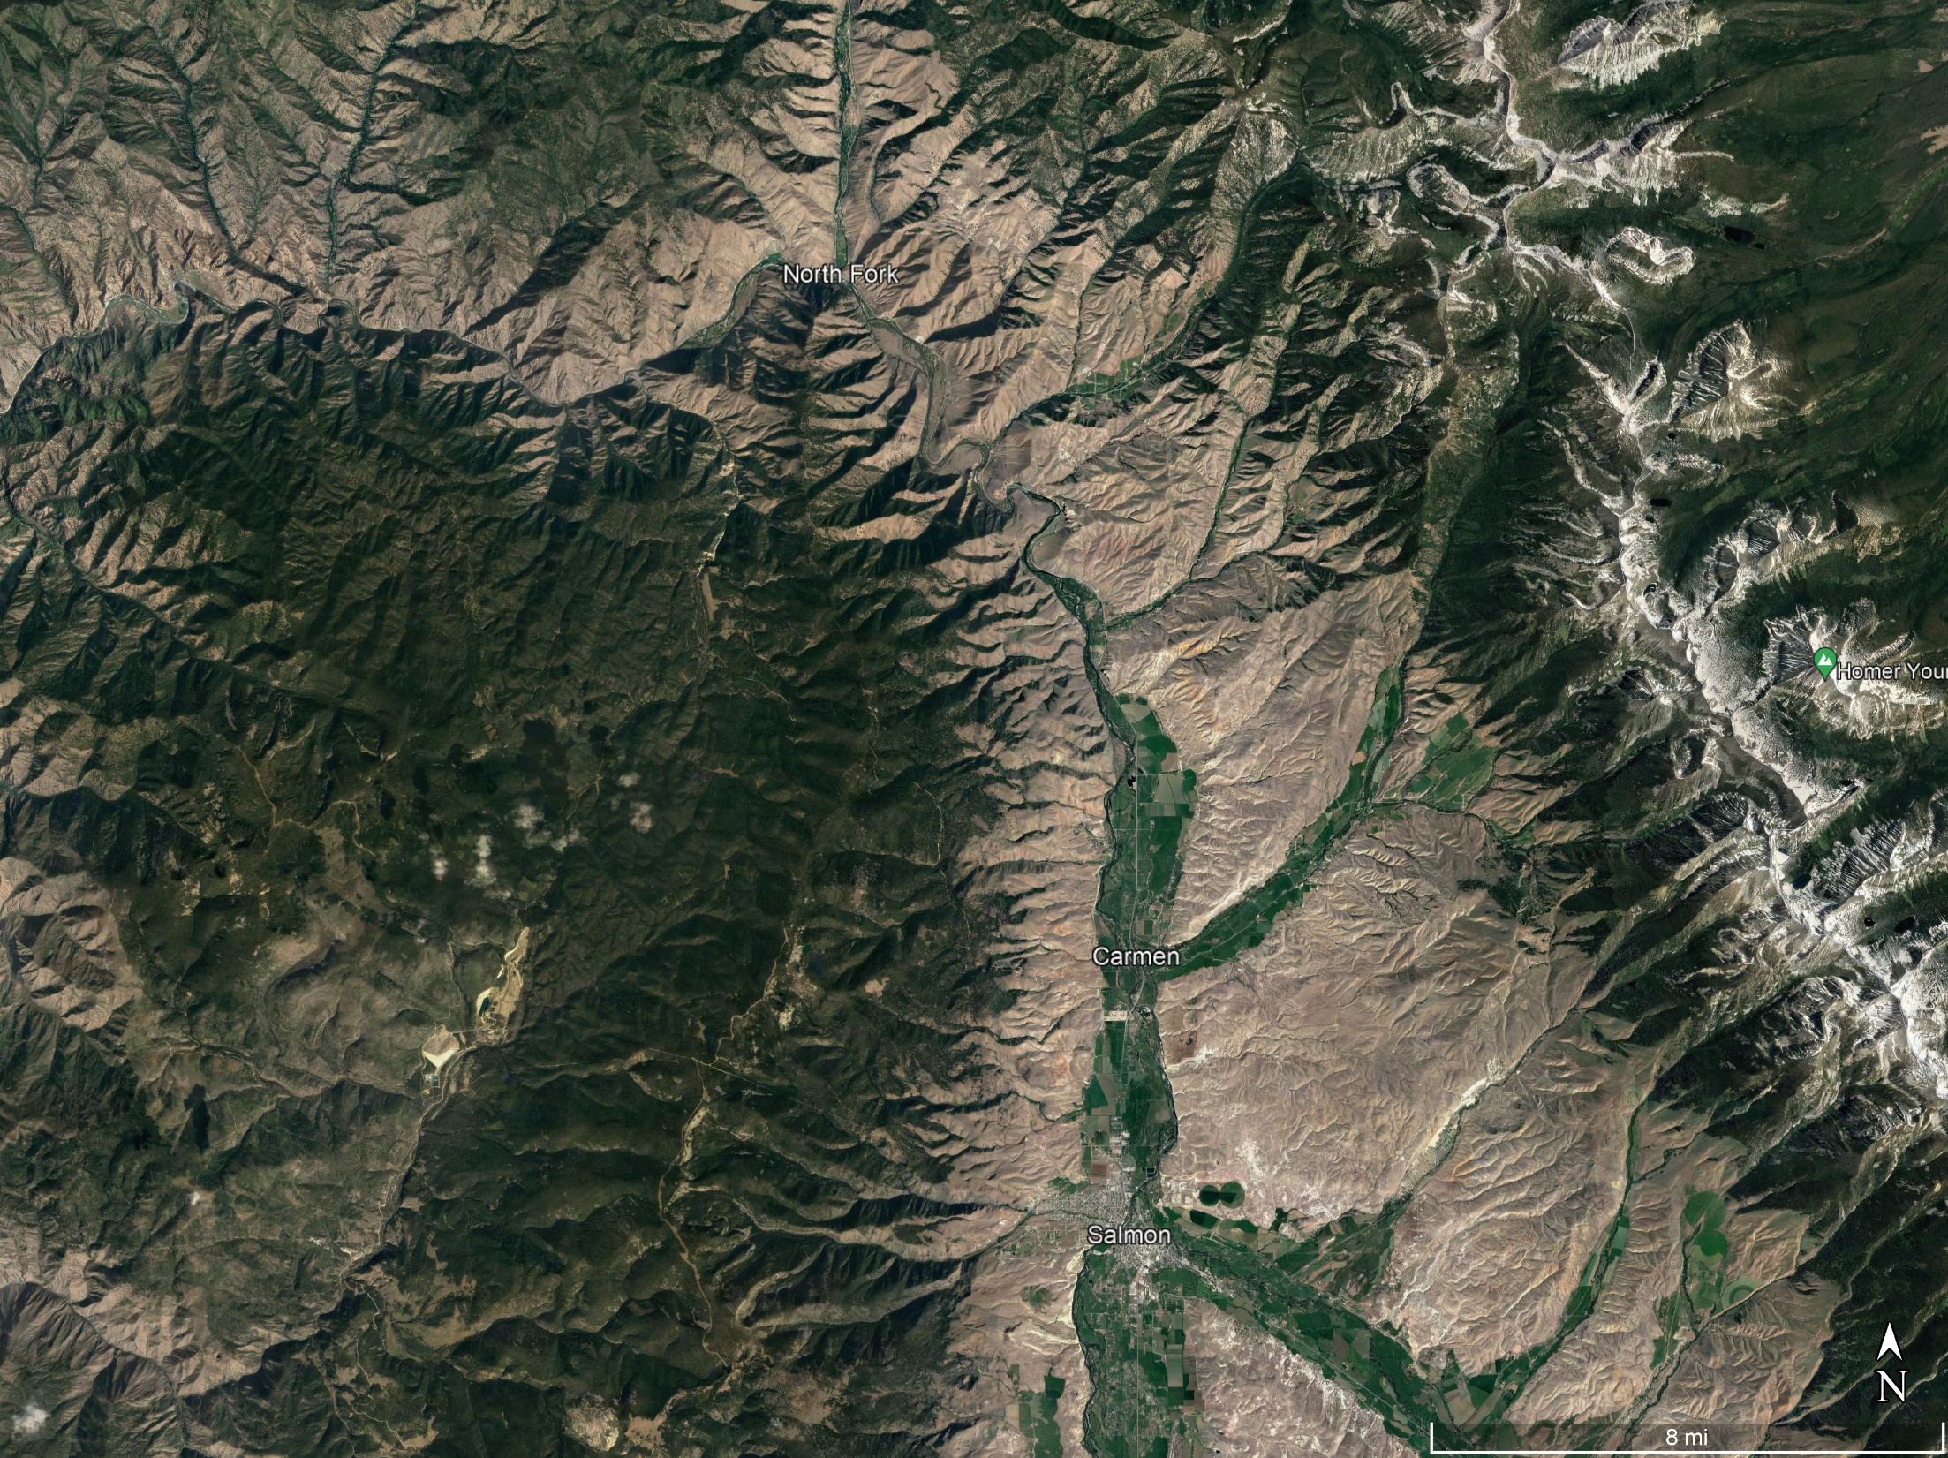
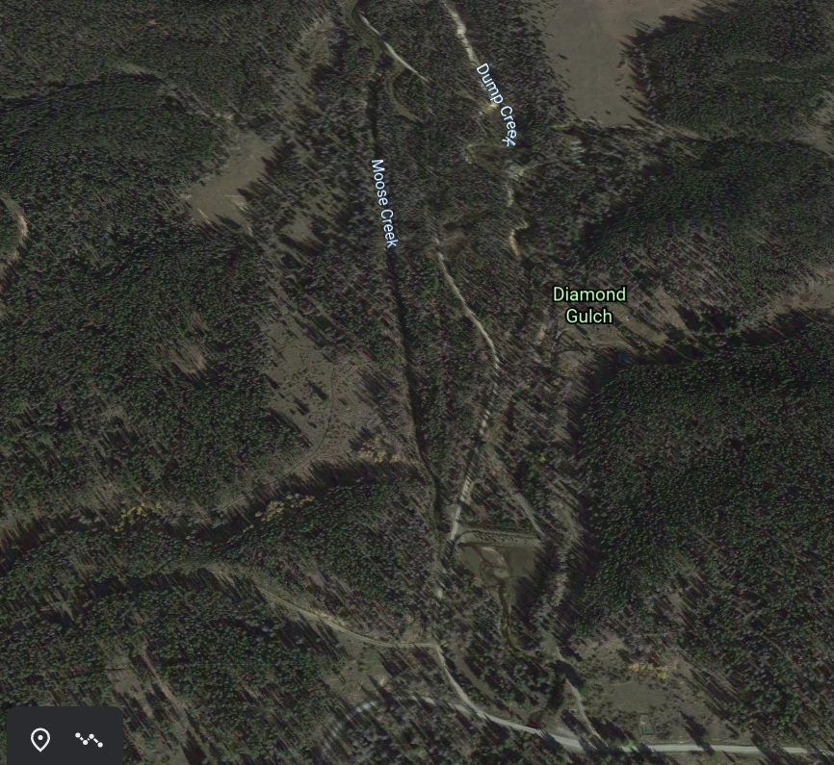
Dump Creek
High gradient (1,000' per mile)
Highly erodible
Challis volcanic
Ancient lake bed up to 200' thick
Close proximity with upper Moose Creek
Drainage area ~8 square miles
Flows ~ 0.5-10 cfs
Placer and dredge mining (needed to impound water)
200'

Slide 4
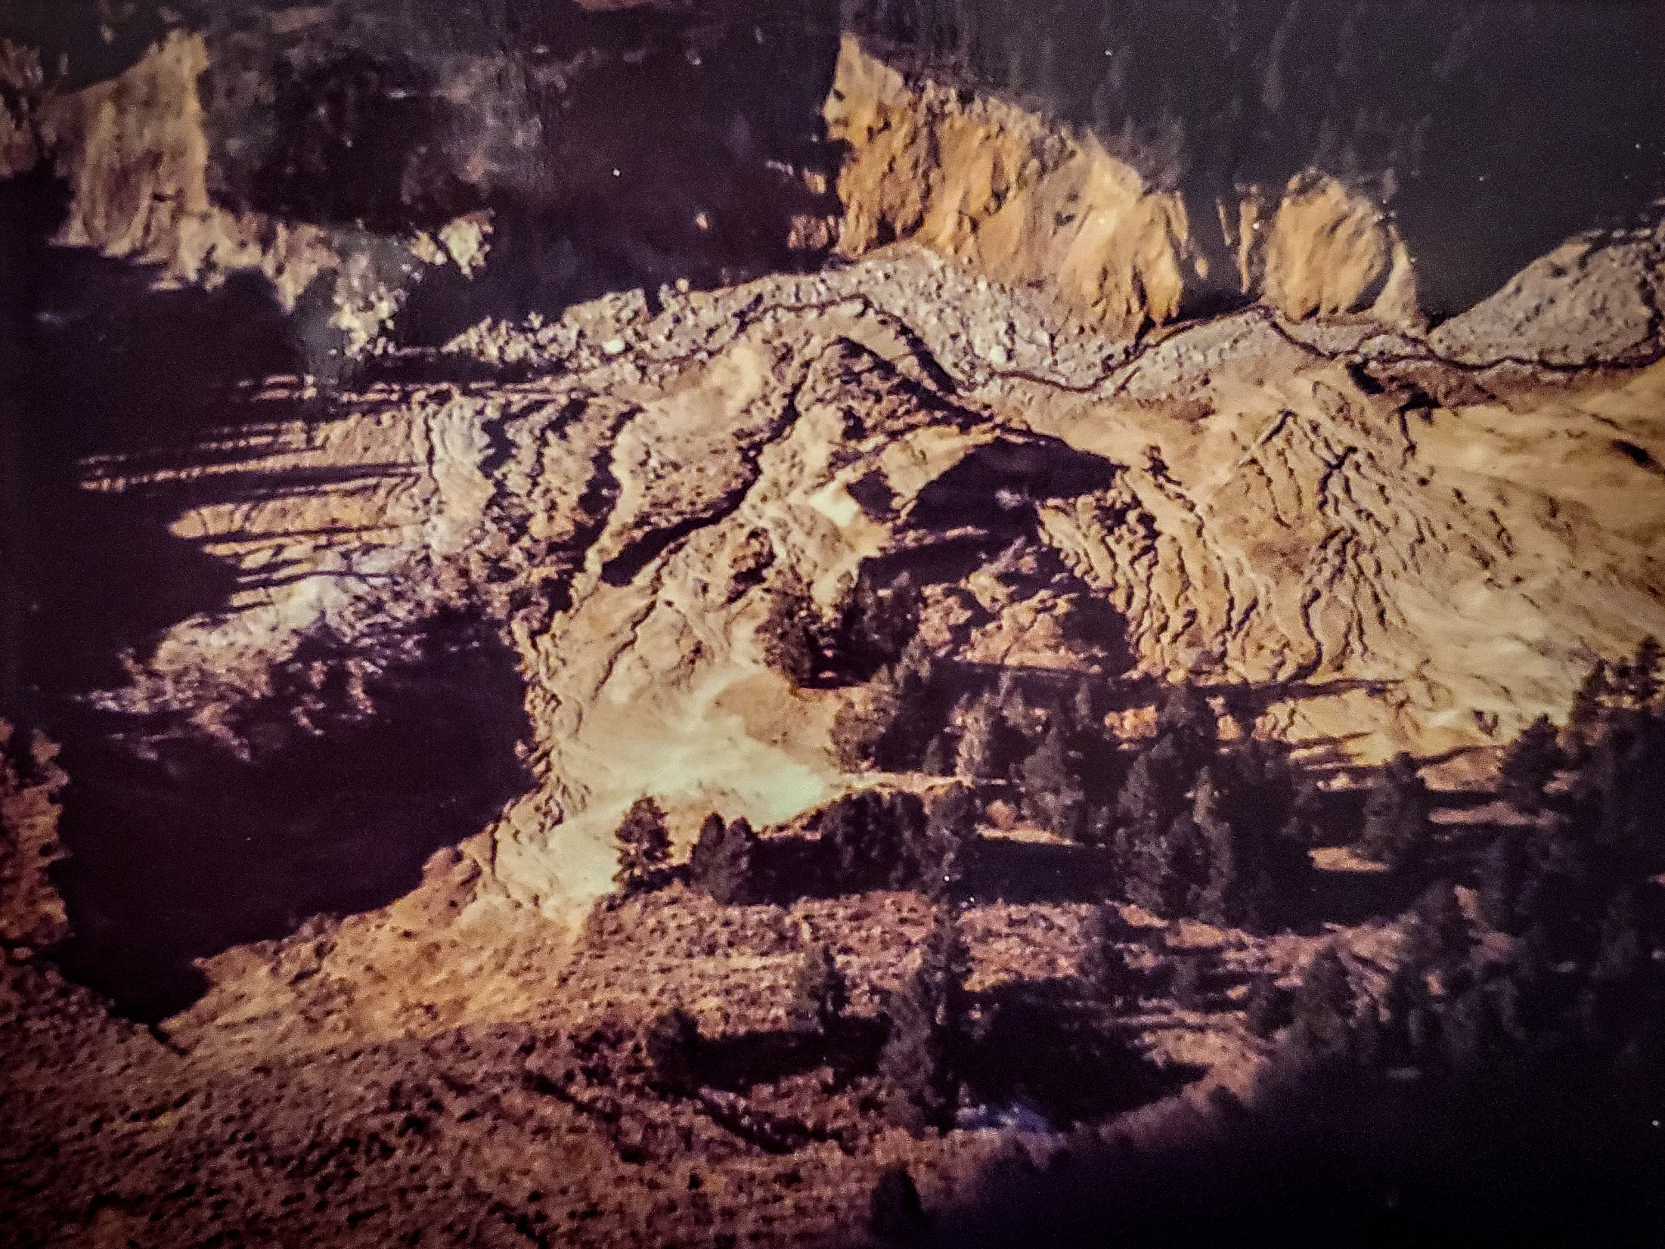
Mining Impacts
Placer mining made it impossible to determine locations of original channels
Diversion of Moose Creek into Dump Creek
Drainage area and spring flows increased to ~33 square miles and >100 cfs (flows in excess of 400 cfs recorded)
Downcutting created a deep chasm and undercut side slopes
slope failures
0.5 mile wide by 300' deep
1974 estimates
9,000,000 cubic yards of material transported into Salmon River
coarser bedload deposited in alluvial fan

Slide 5
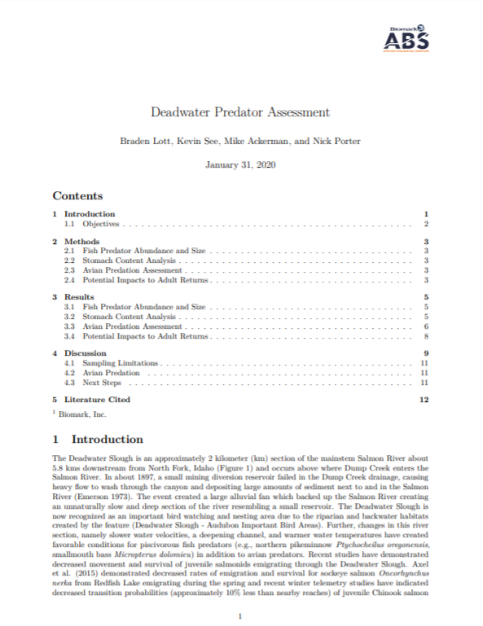
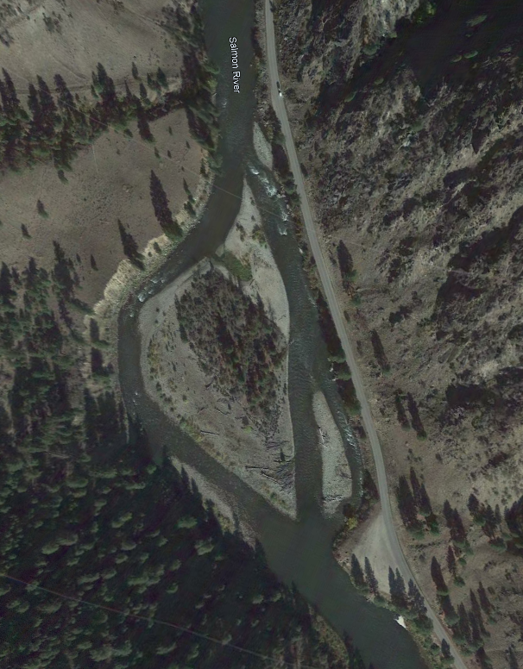
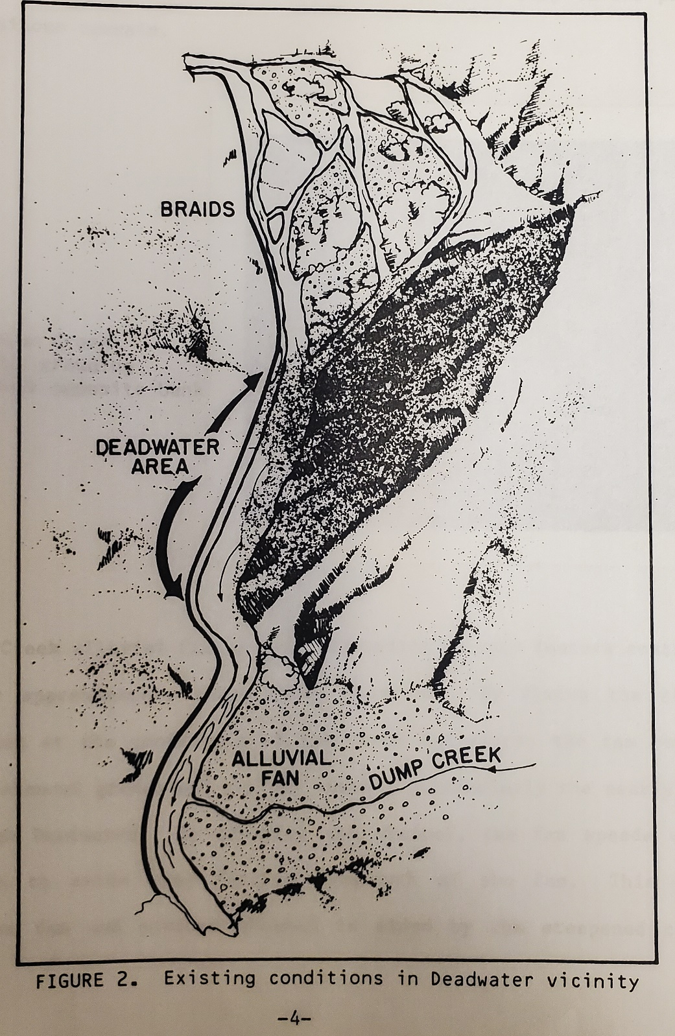
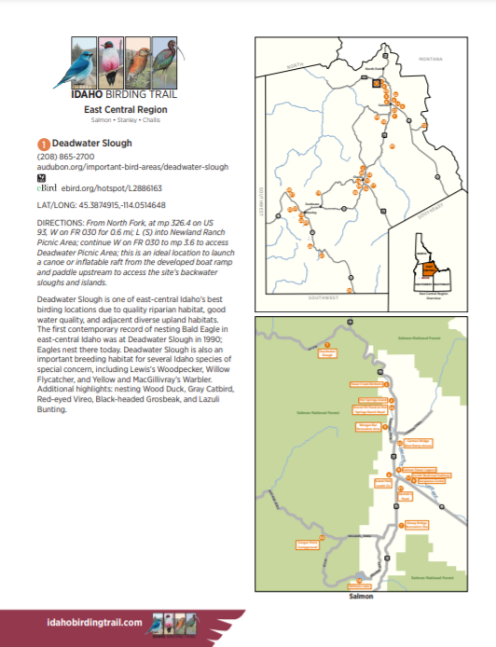
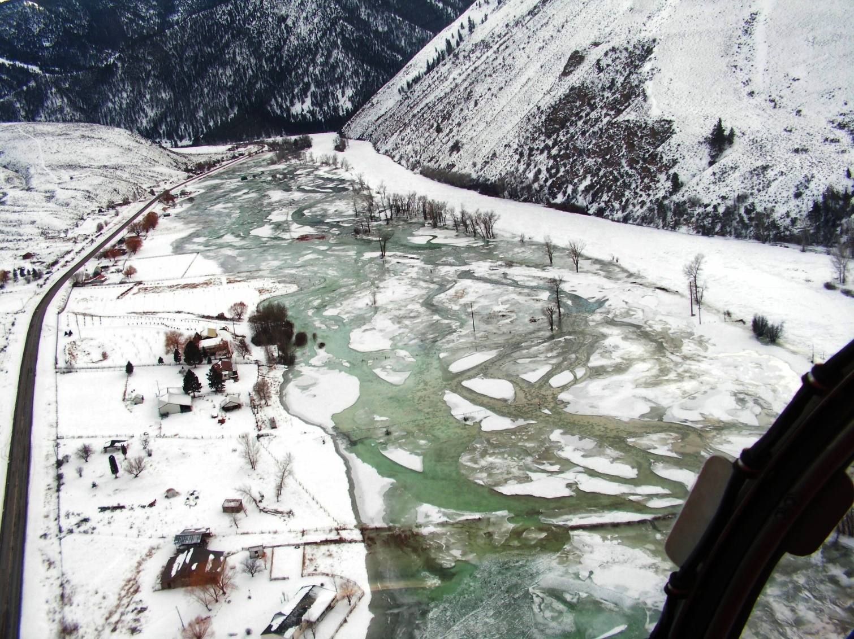
River Impacts
Downstream deposits
Deadwater reach
Ice jam initiation
Possible increase of predatory fish
Many others (some positive)

Slide 6
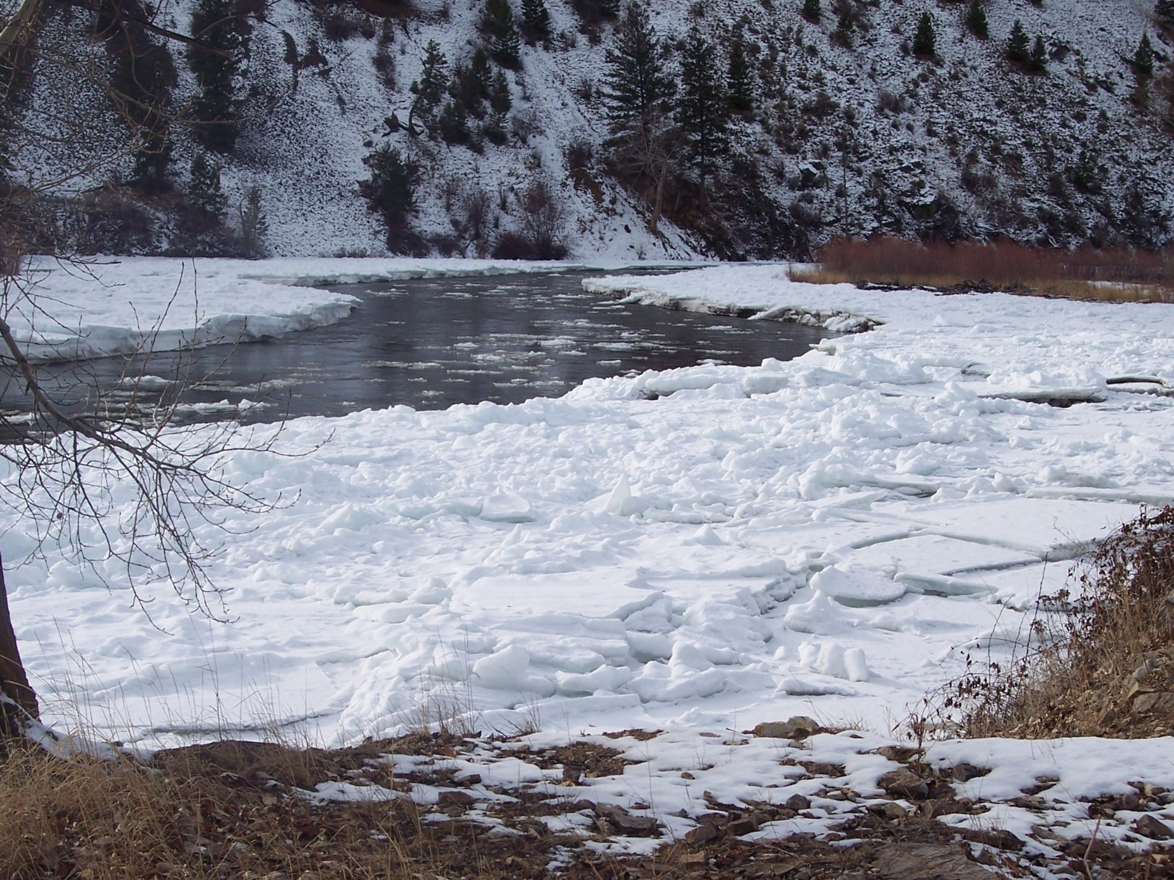
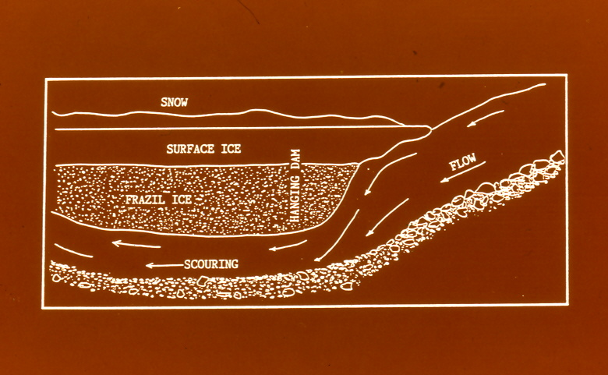
Deadwater Ice Jam
Why does it form?
low gradient and velocity (<1ft/sec)
highly shaded
results in surface freezing over
frazil ice collects underneath
creates "hanging dam" on the upstream end
can exceed 16' in thickness
Increased water velocity under the ice dam scours out any built up sediment within the Deadwater reach and maintains the ~19' depth
the increased velocity and turbidity likely moves fish upstream and downstream of the Deadwater reach

Slide 7
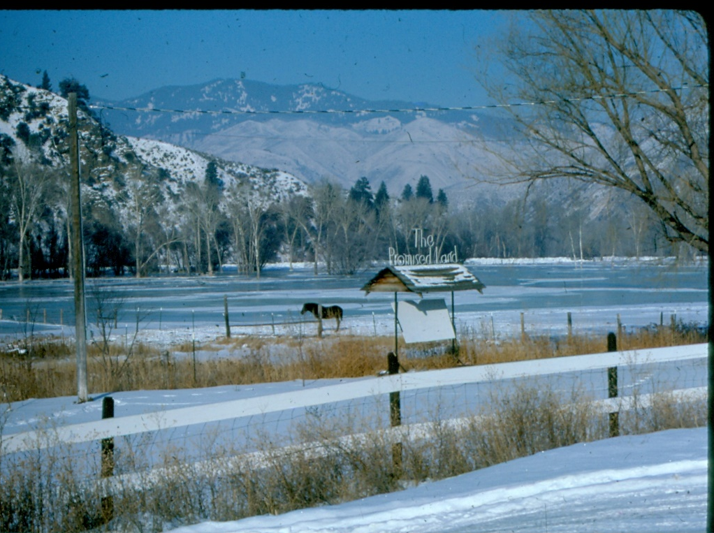
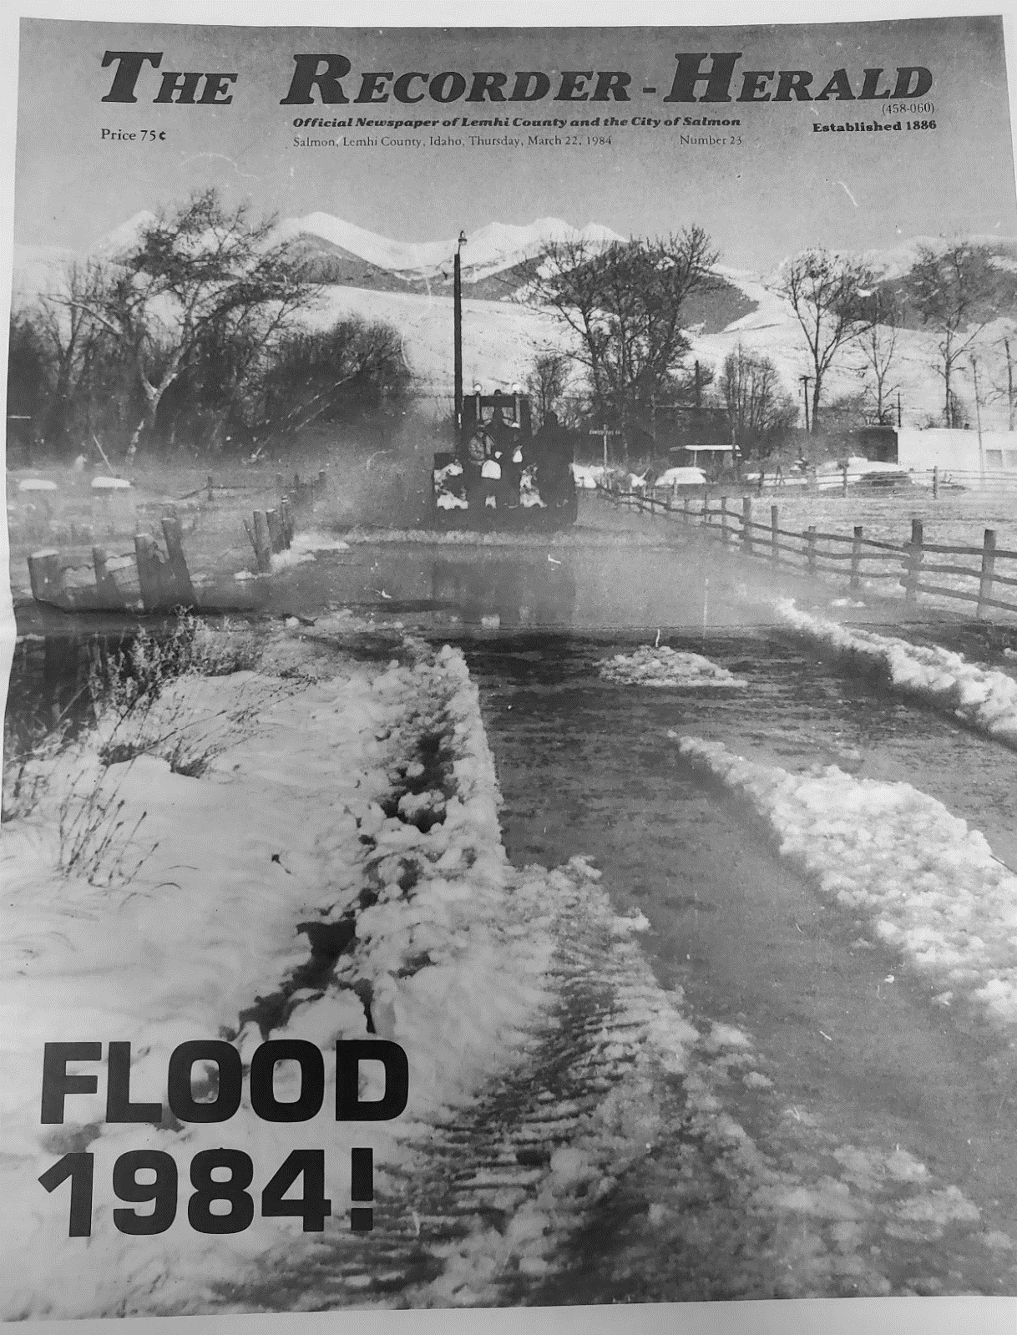
Ice Jam Problems
Increases river stage
Impacts many miles of river
occasionally to upstream of Salmon
Winter flooding
Public demanded action following winter floods in 1982 and 1984
1.0 and 1.8 million in damages
Lemhi River backed up with ice resulting in...

Slide 8
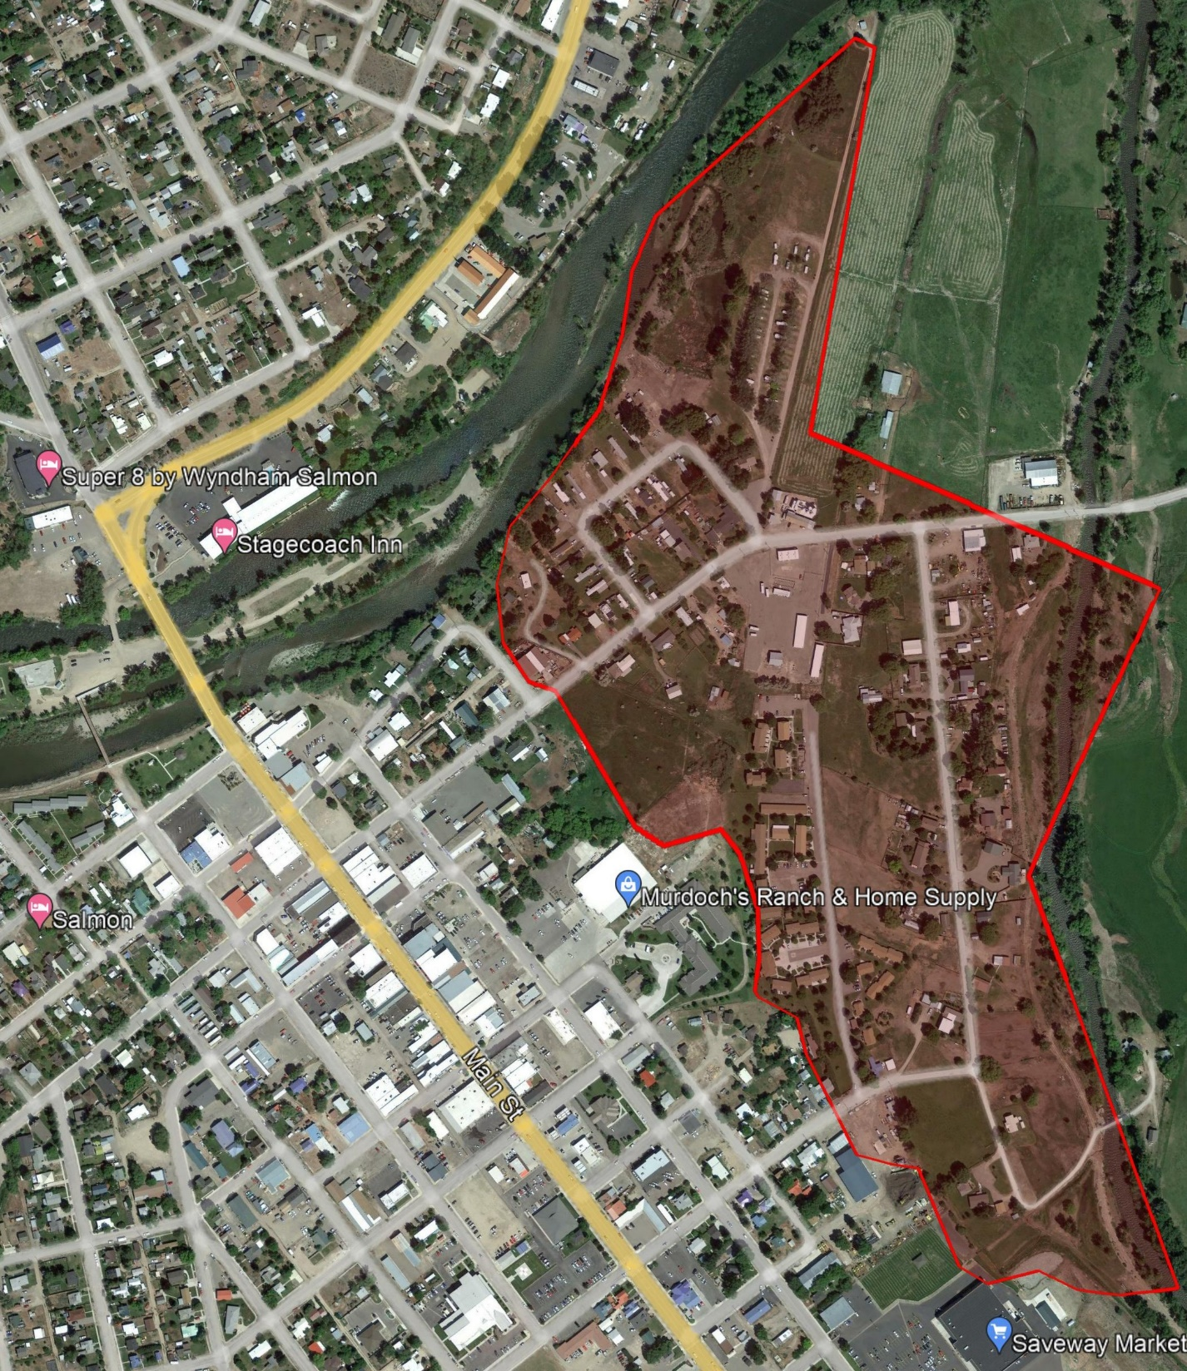
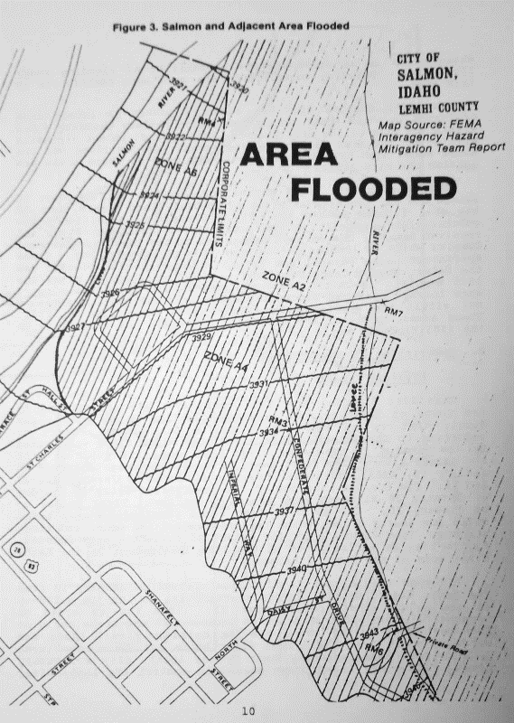
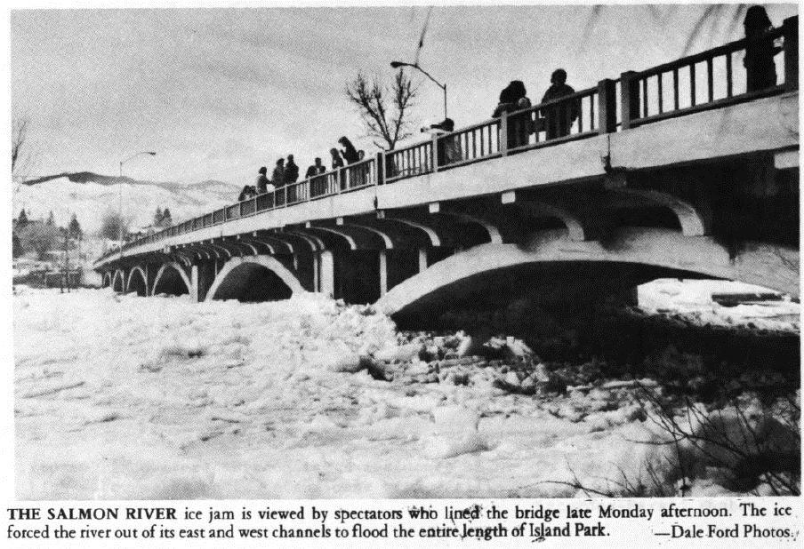
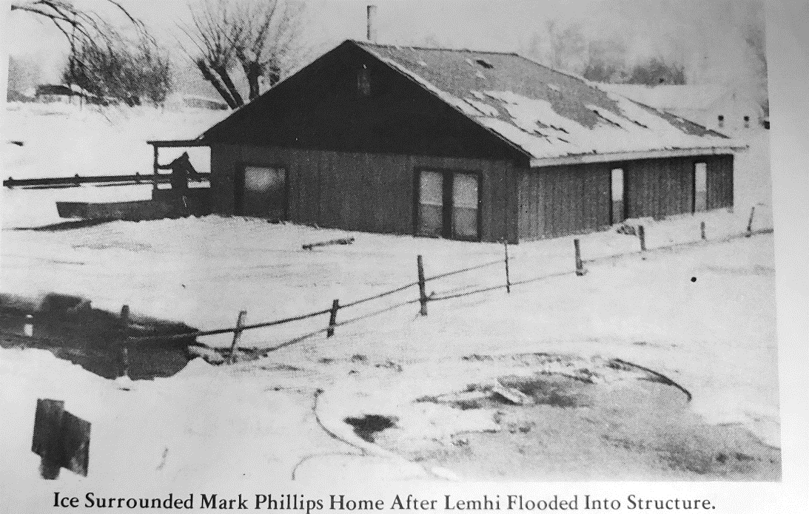
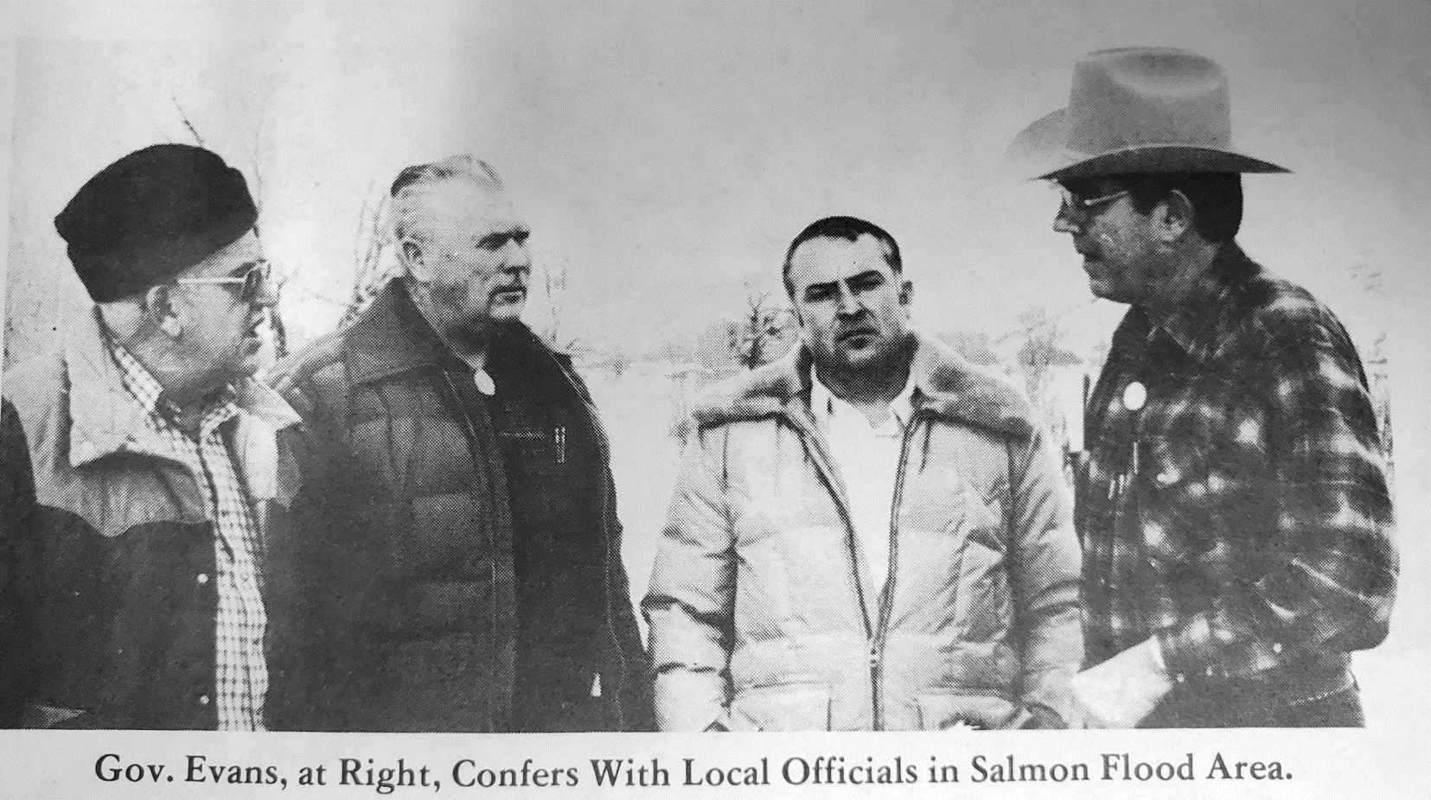

Slide 9
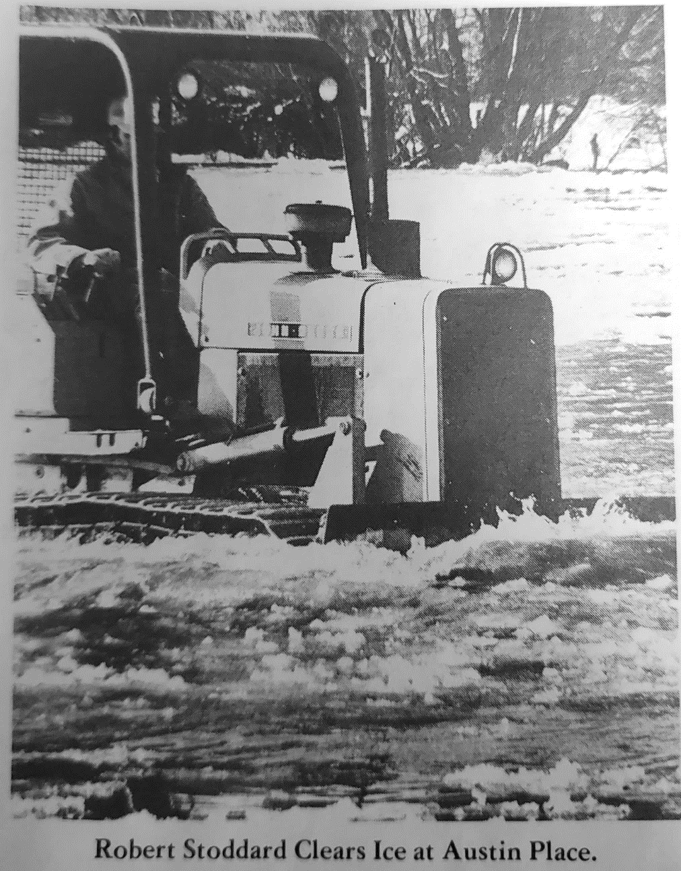
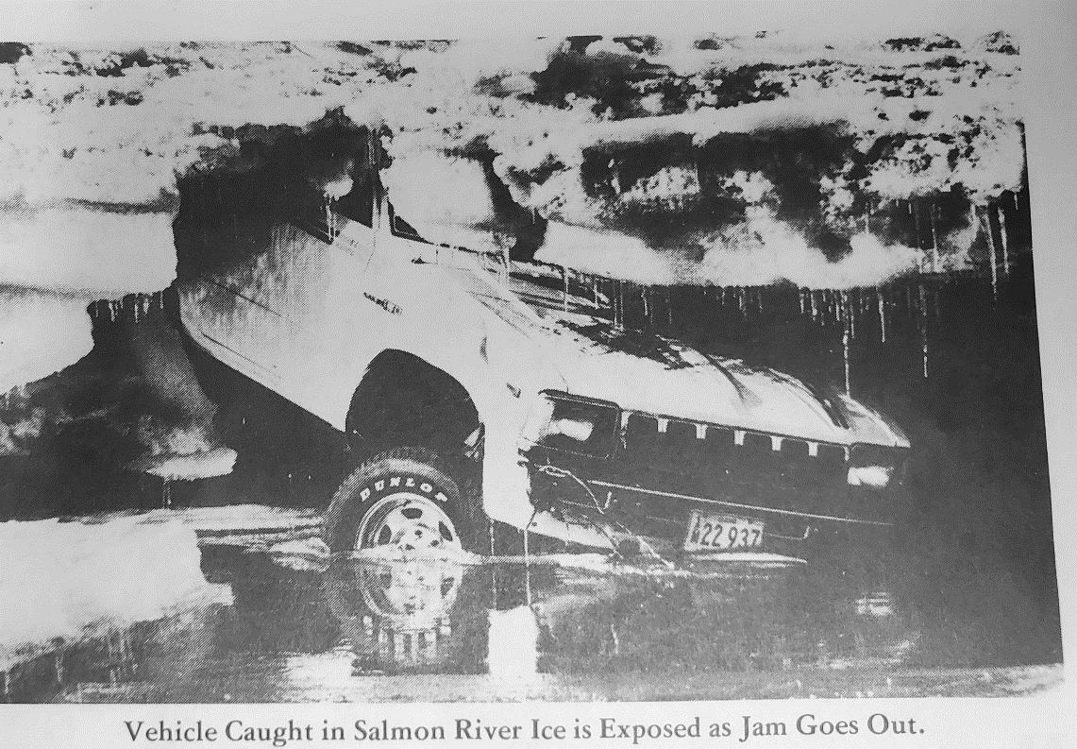
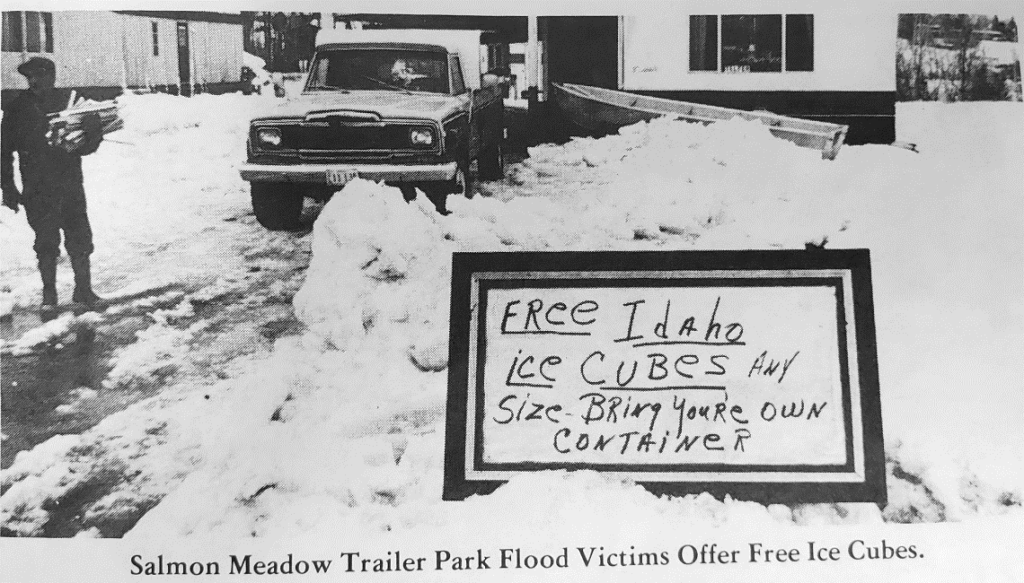

Slide 10
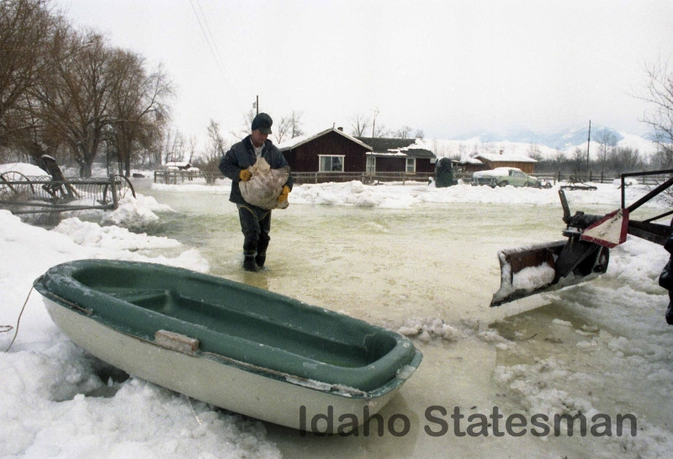
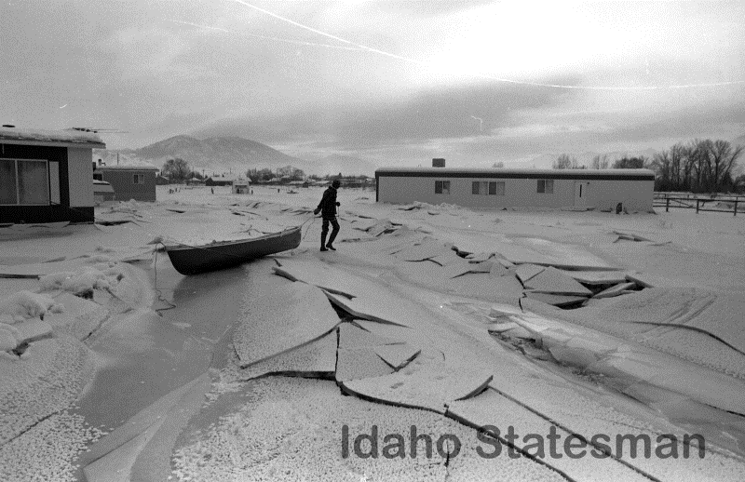

Slide 12
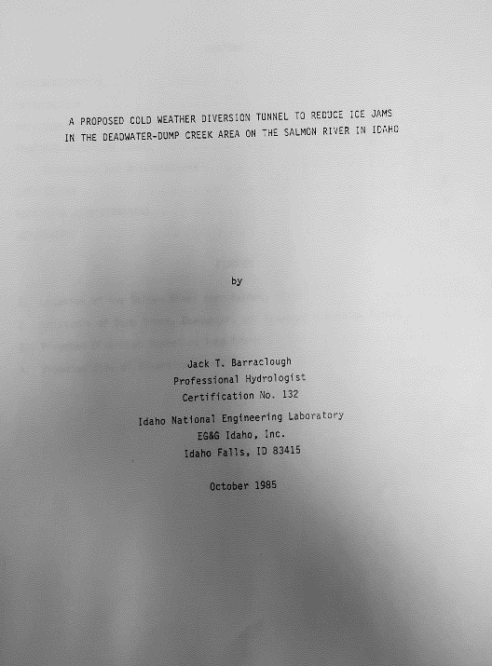
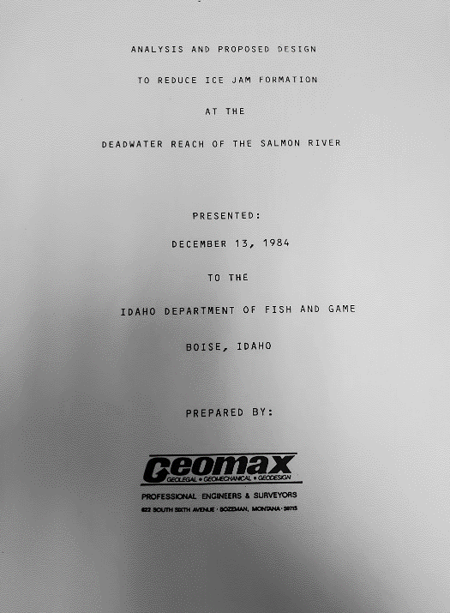
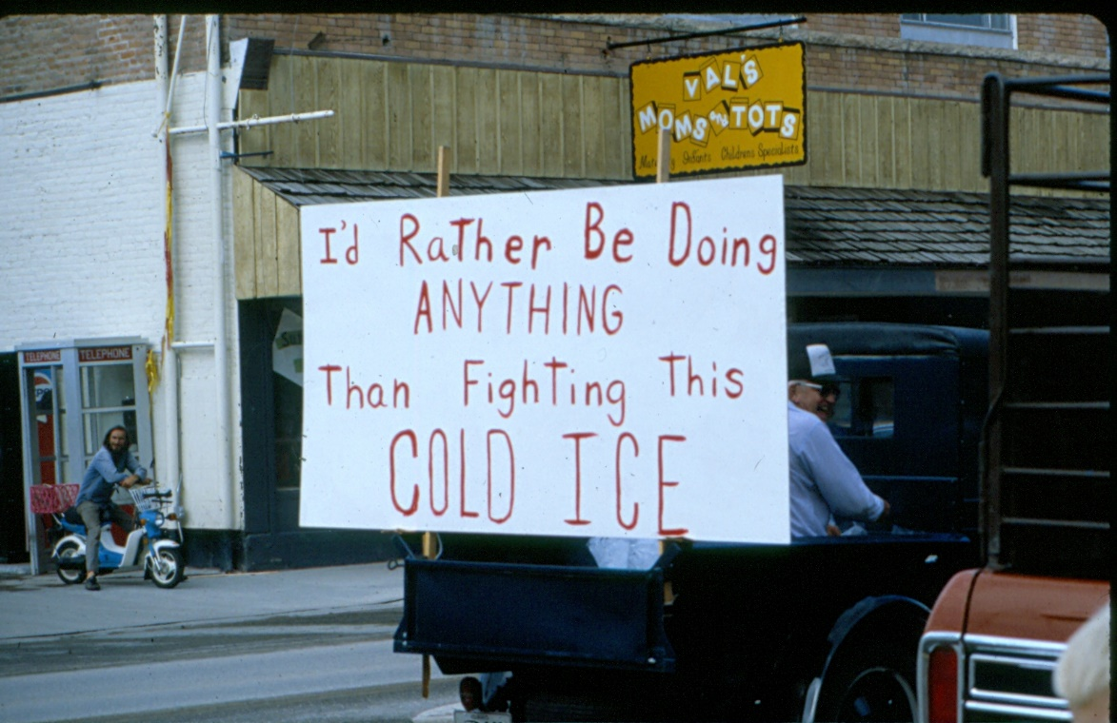
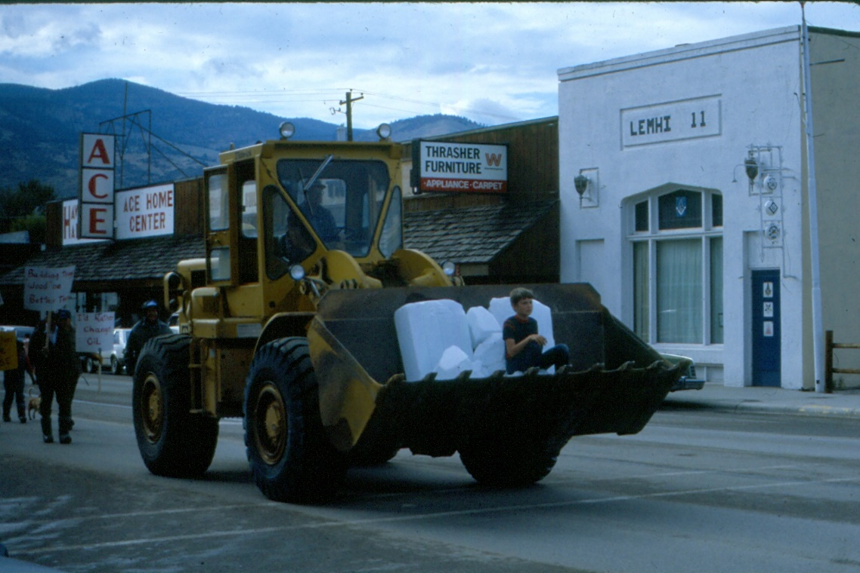
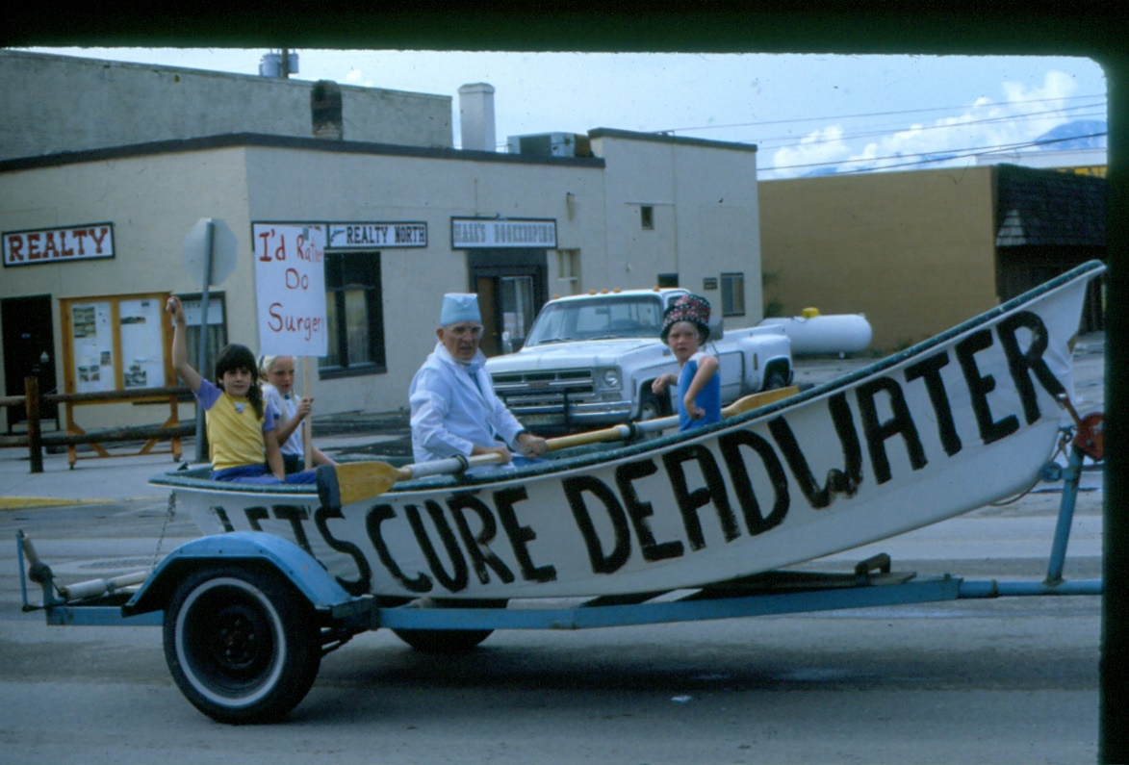
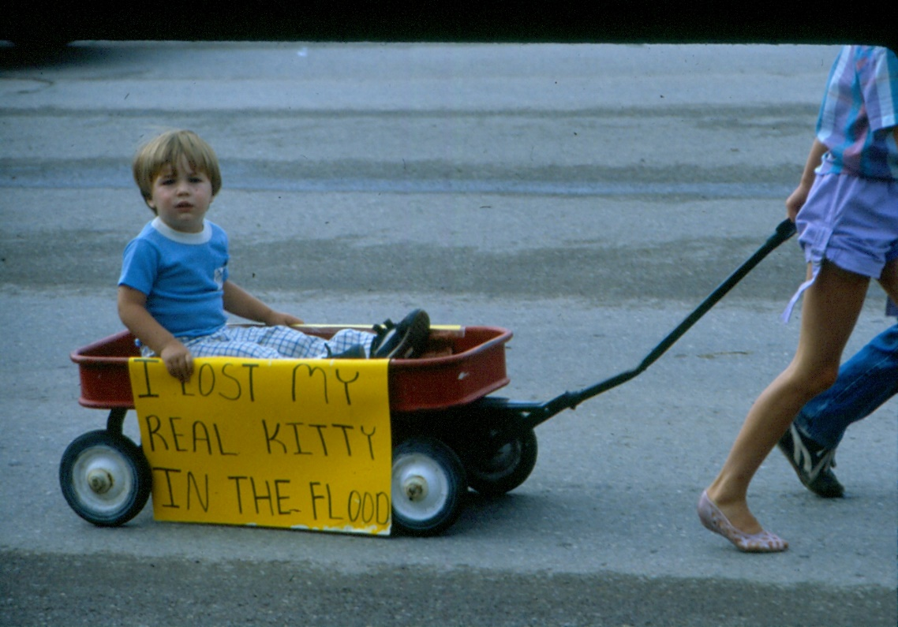
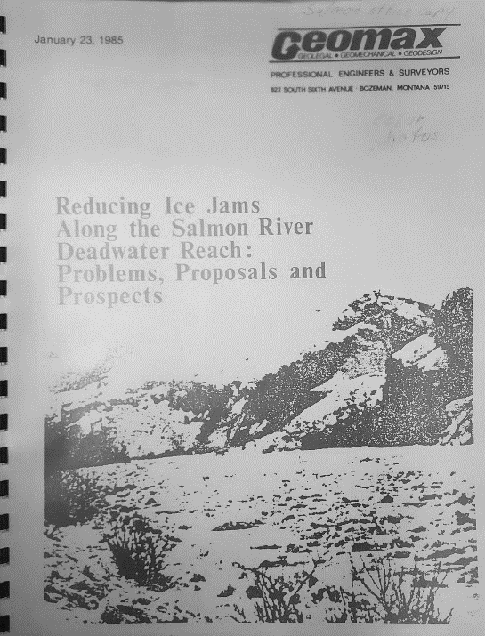
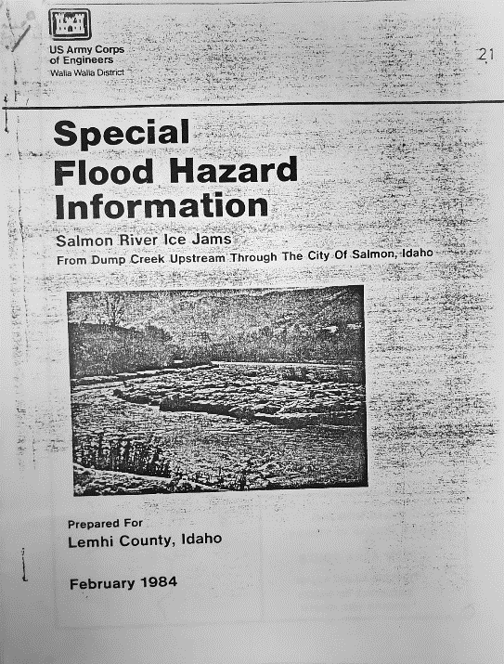
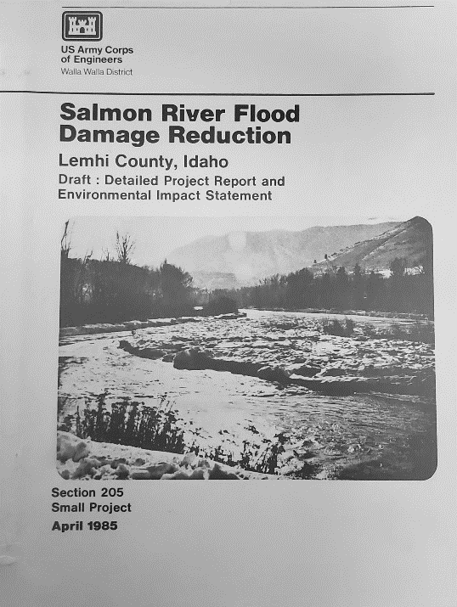
Call for action
and studies
quickly followed...

Slide 13
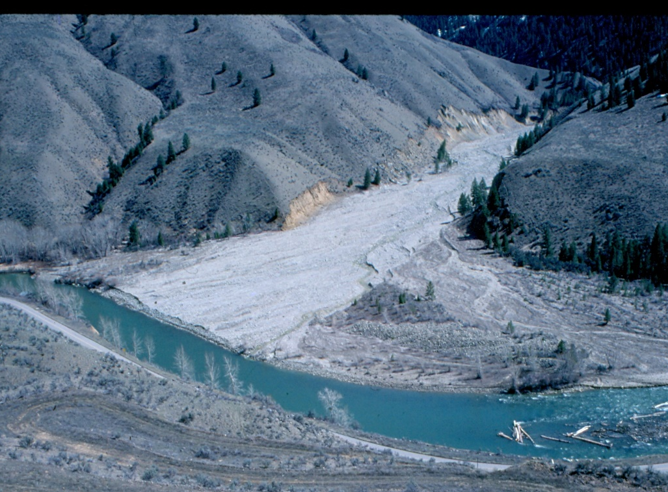
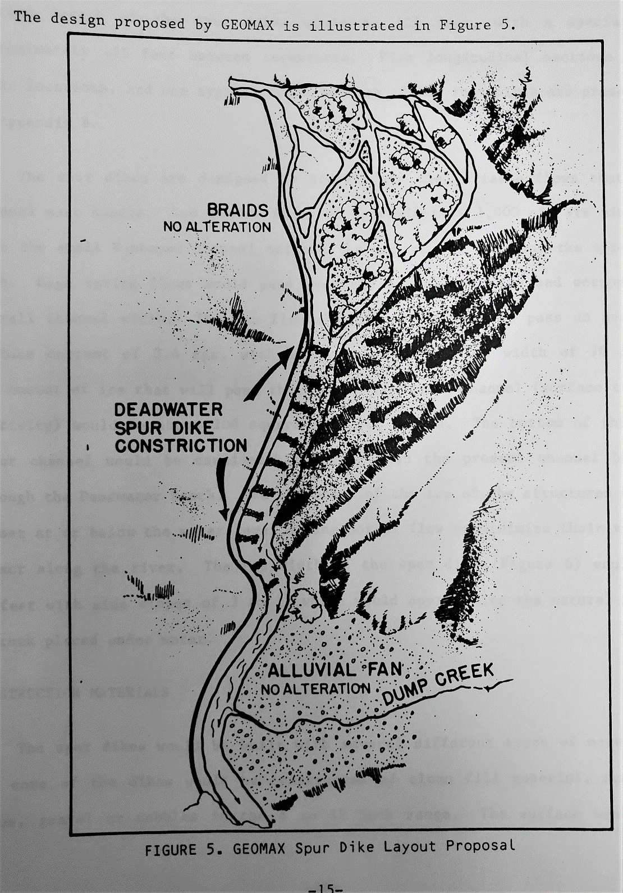
Previous work and proposed alternatives
Work prior to 1980s
USACE
1954
levee construction near Salmon
1956
removed 12,500 cubic yards from fan
spring flows from Dump Cr. filled in the work and even expanded the fan
USFS – late 1970s
restore flows into lower Moose Cr.
eliminate transport mechanism to Salmon River
water diversion structure / 6,000' new channel / vegetation removal from historical channel
1980s USACE Proposals
A) Channelization of Dump Creek-Deadwater (multiple proposals)
B) Levee construction along Lemhi River
C) Levee construction along Salmon River
D) Permanent floodplain evacuation
Geomax Proposal (IDFG funded)
Spur Dikes
New channel
Diversion
Rieffenberger 1991
200'

Slide 14
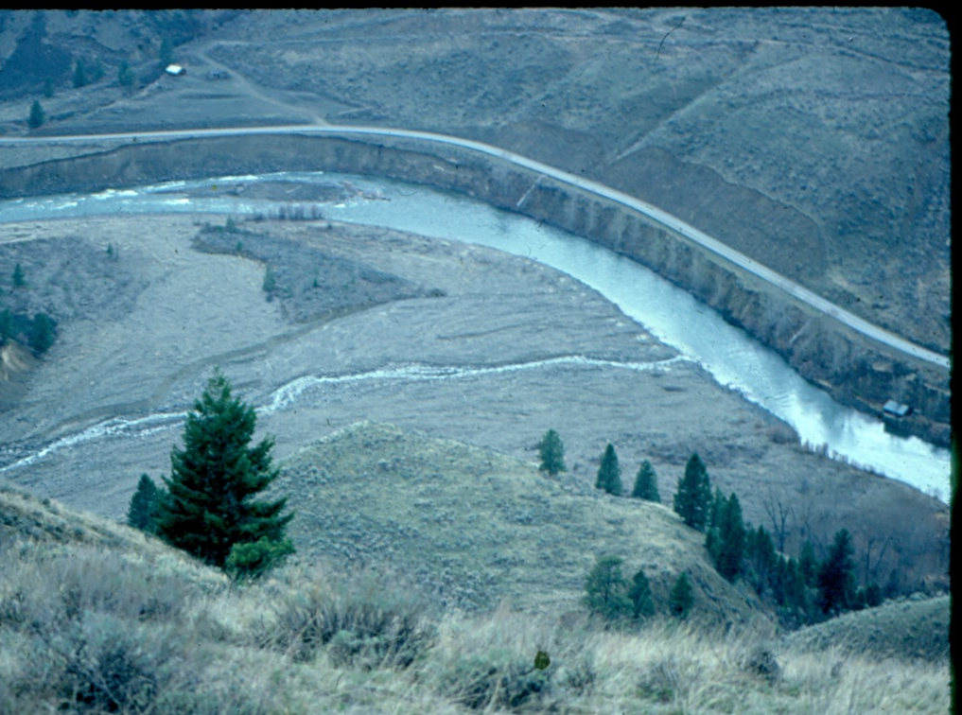
USACE Salmon River Flood Damage Reduction Project Report
Eliminated alternatives
Levee system for Salmon, ID
Flood proofing structures in Lemhi floodplain
Ice barrier upstream of Salmon
Fill the Deadwater reach
Air-bubbler system in the Deadwater reach
Icebreaker boat in the Deadwater reach
Dynamite ice jams in the Deadwater area
Heat Deadwater reach using a wood boiler
Dusting ice cover to stimulate melting
Diverting the Lemhi R into the old power ditch
Spur dikes in the Deadwater reach (Geomax proposal)
low benefit to cost ratio
stranding/access
$8,000,000
Not guaranteed to eliminate ice jams
too low of water temps
lots of problems...
too large of an area
too much water/area
low sunlight/large area/rough surface
could flood new areas
same reasons as filling the reach + higher maintenance costs – quickly dismissed

Slide 15
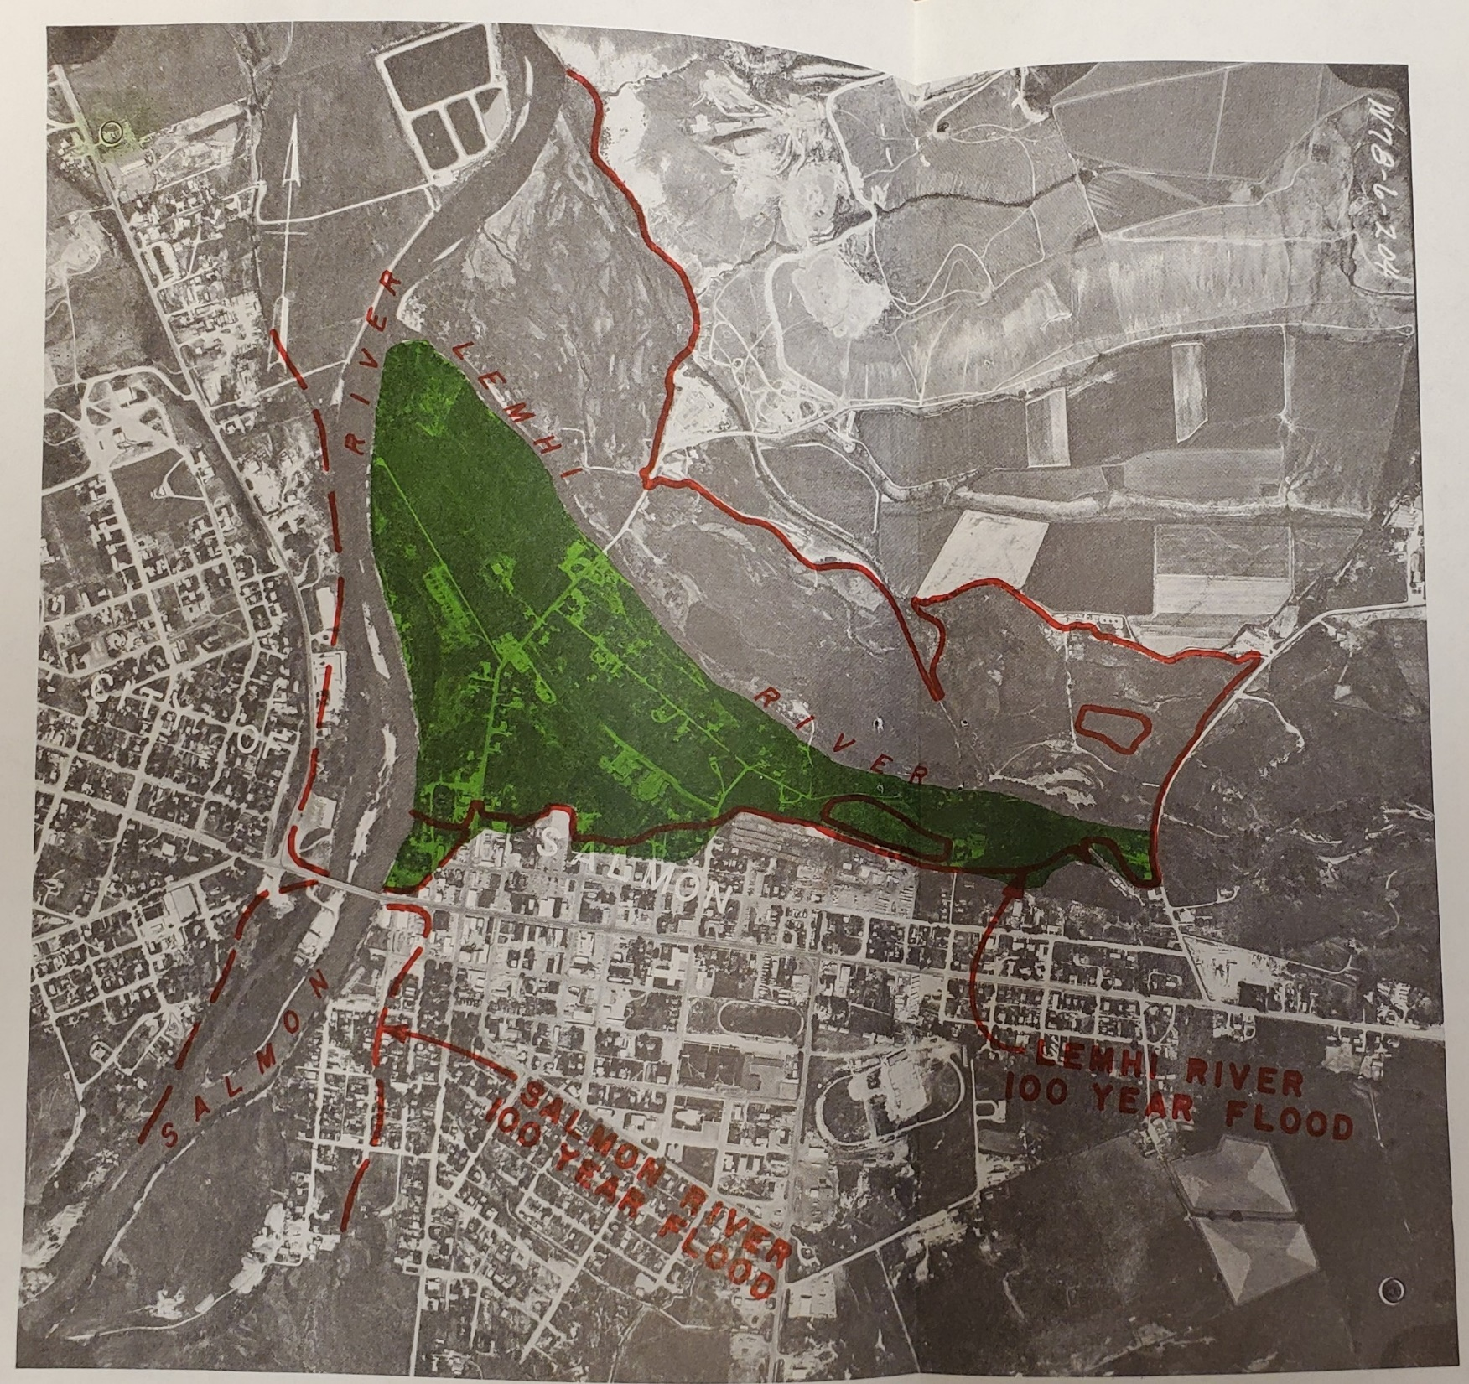
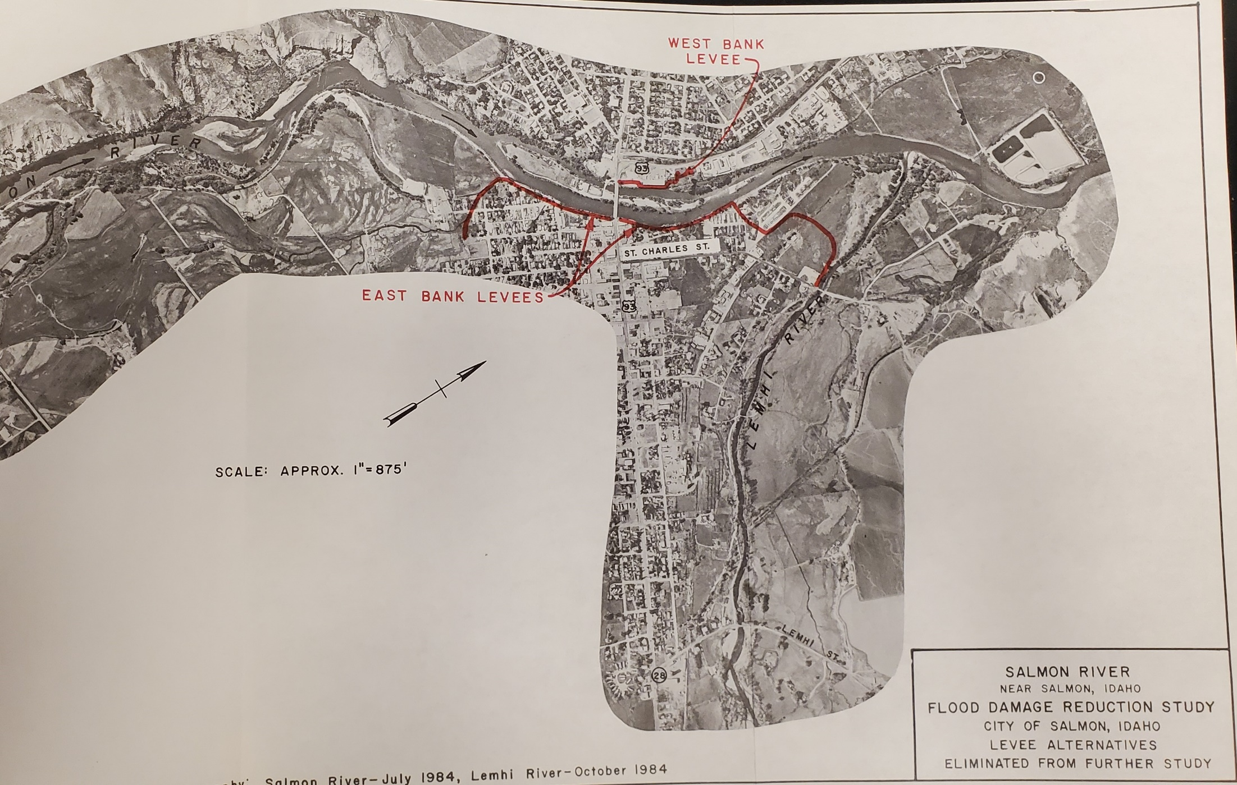
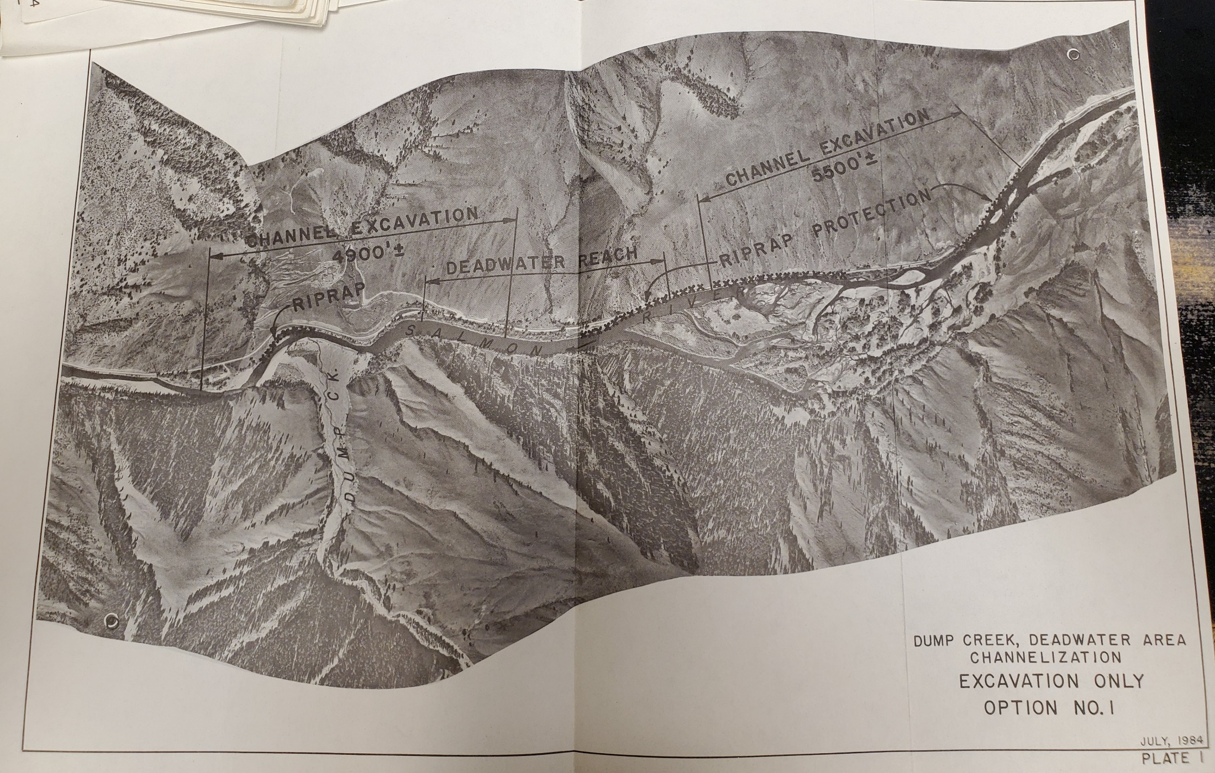
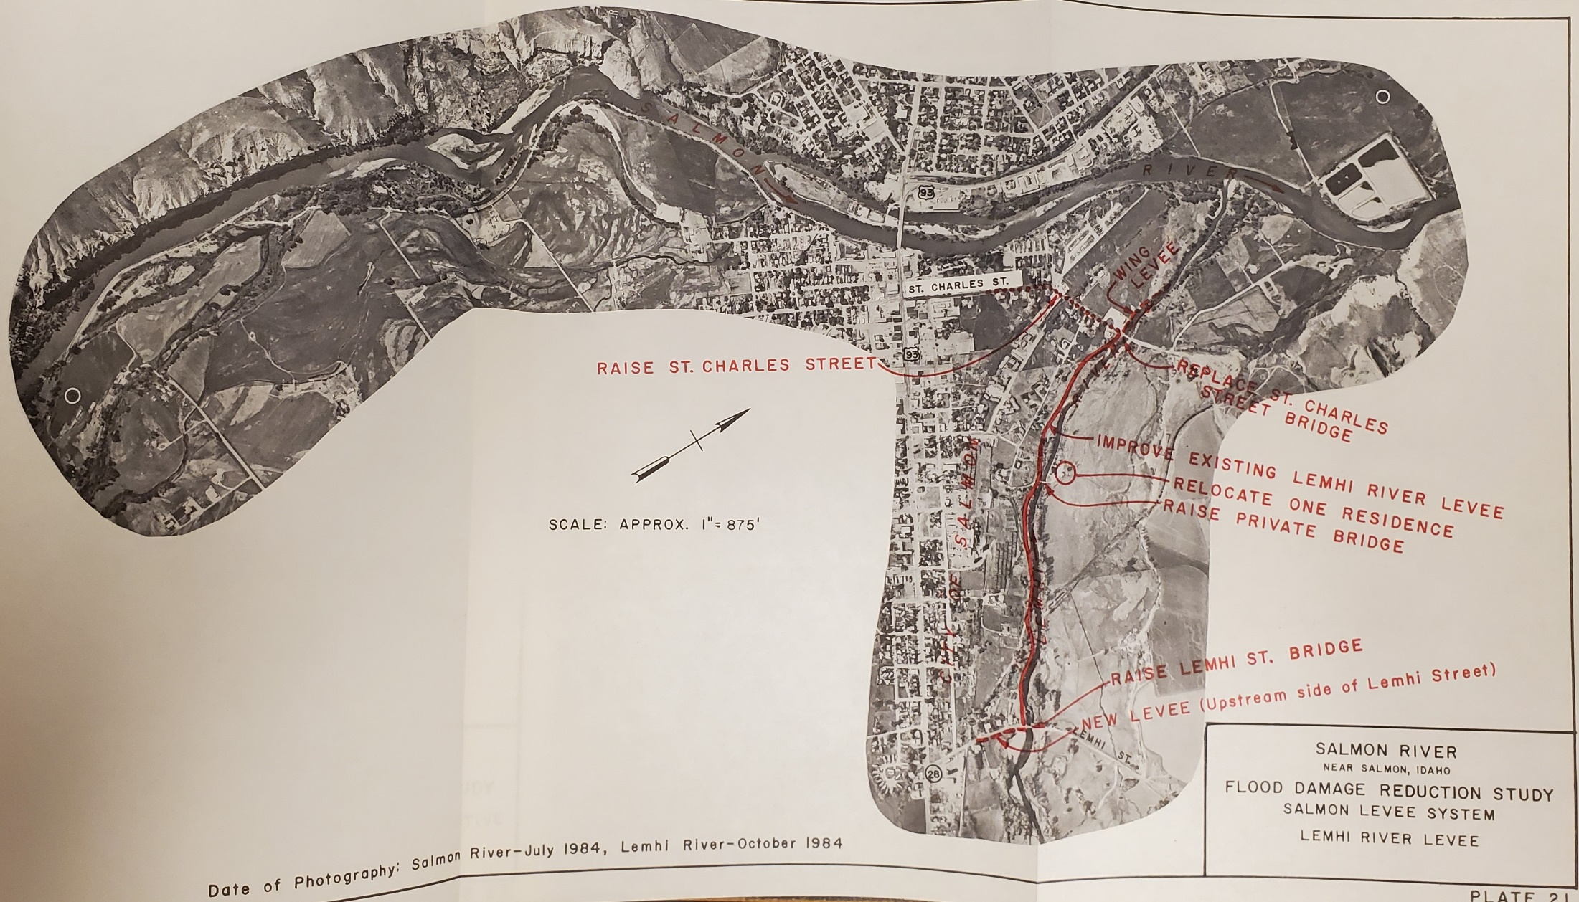
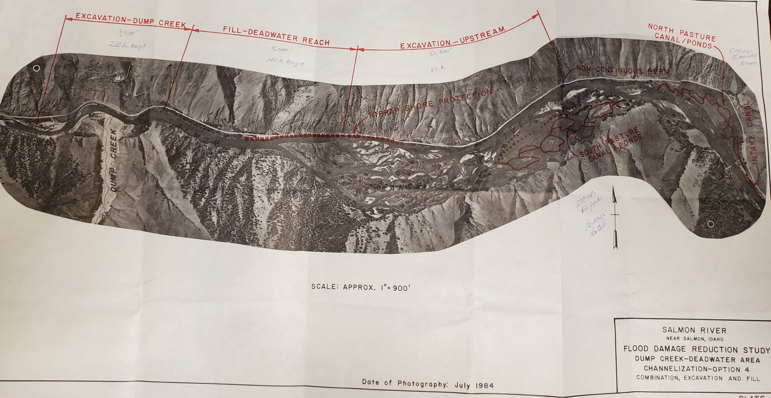
Considered Alternatives
Channelization of Dump Creek-Deadwater (multiple proposals)
Full excavation
Partial excavation and fill of Deadwater reach
Partial excavation
Excavation at Dump Cr and partial fill of Deadwater reach
Levee construction along Lemhi River
Levee construction along Salmon River
Permanent floodplain evacuation
~ 90 residences
No action
All excavation options would lower the river level and drain the upstream wetlands
Channel excavation around the permiter of the fan, partial filling of the Deadwater reach, and channel excavation upstream of Deadwater
Excavation near fan: ~3,900', average depth 9', 260,000 cubic yards
~140,000 cubic yards of fill into Deadwater reach, averaging 5'
would require haul roads on both banks and a temporary bridge downstream of the fan
Deepen existing channel around the alluvial fan and excavate material in the existing channel upstream of Deadwater
~ 375,000 cubic yards near fan and 150,000 cubic yards upstream

Slide 16
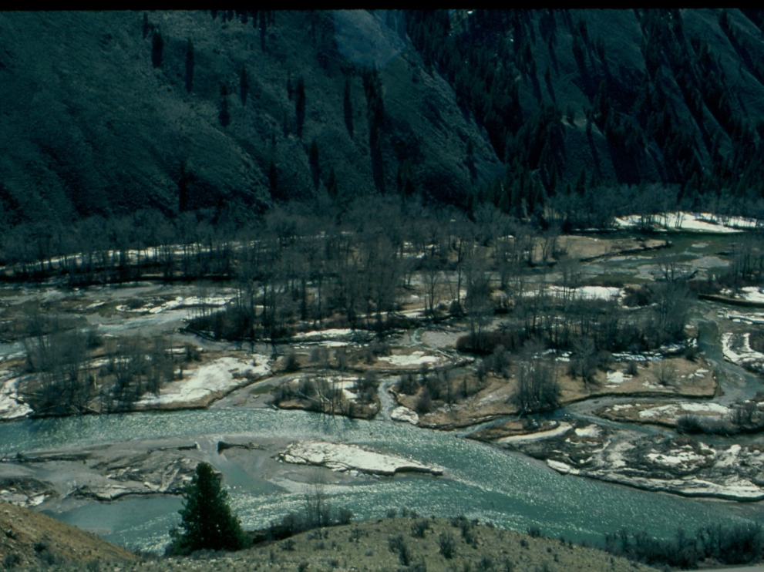
USACE Plan Development
Draft EIS (May 1985)
IDFG pushed for fair consideration of Geomax plan
Public meetings and comment period (summer 1985)
political (state and local) support for channelization alternative #4
mixed public support - many comments against channelization published in final report
no agency (federal or state) support for channelization alternative

Slide 17
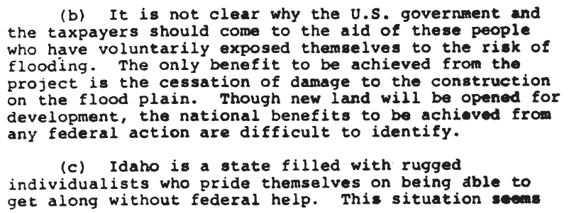
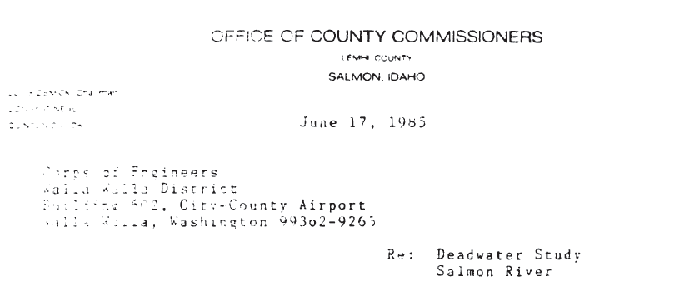
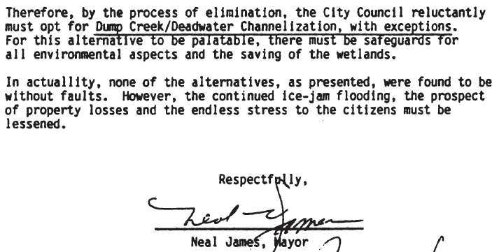

Slide 18
Final Selection
700 page report

Slide 19
USACE Cold Regions Research and Engineering Laboratory
Studied ice jam formation near Salmon
Tested an experimental ice boom upstream of Salmon, ID
reduce the amount of frazil ice making it to Deadwater
reduce the growth of the Deadwater ice jams

Slide 22
What now?
Status quo
less frequent jamming
no flooding
little public pressure
Issues are still lurking
No easy solutions
Any attempt to alter Deadwater would likely face the same challenges
Shoup Bridge, January 2017

