Slide 1
Lemhi River Watershed Summary
Rob Richardson
Geomorphologist

Slide 2
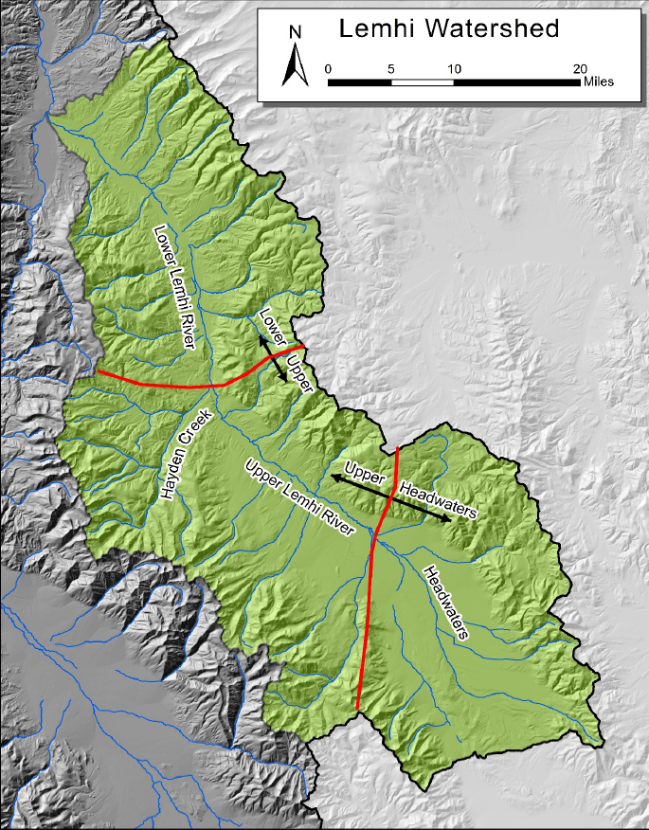
Upper Lemhi
Lower Lemhi
Salmon
Baker
Lemhi
Leadore

Slide 3
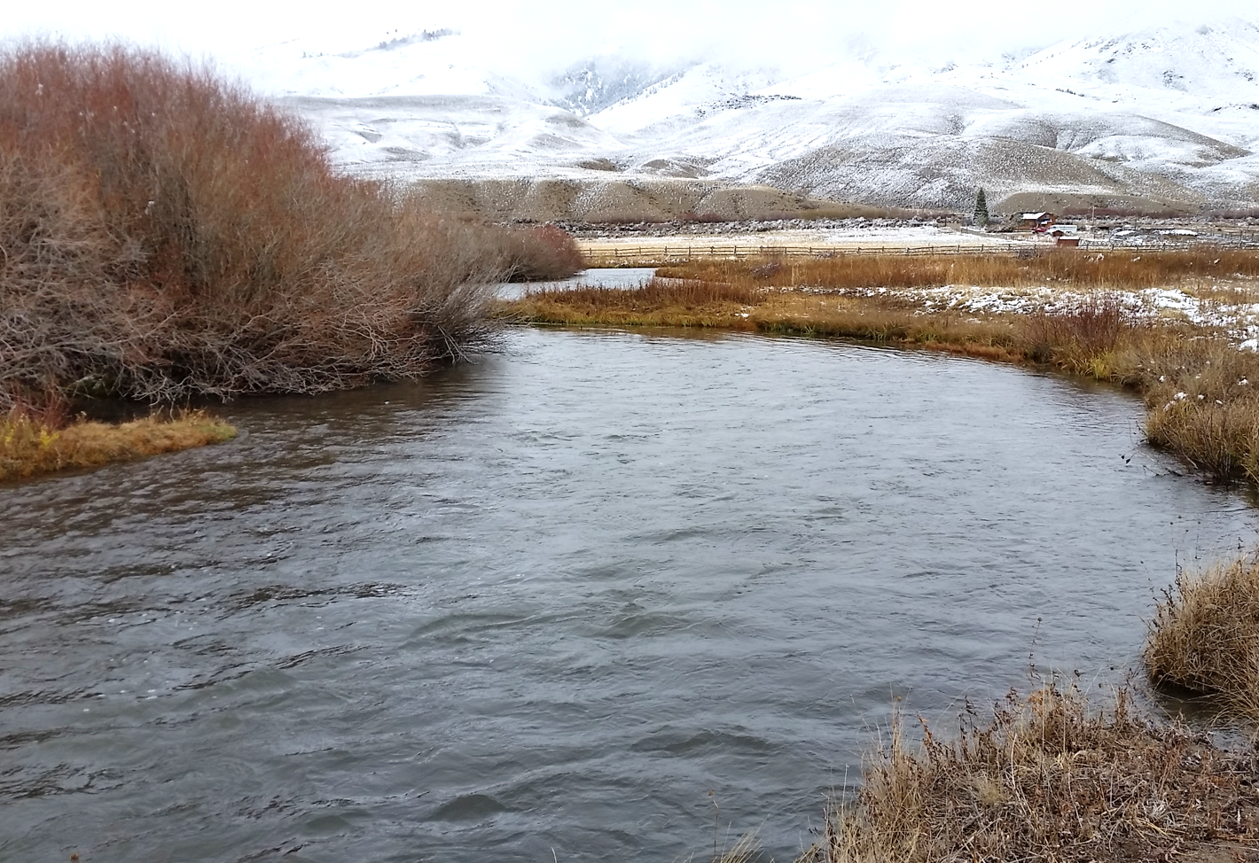
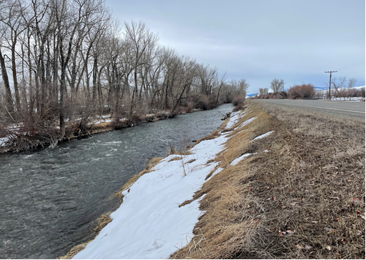
Upper Lemhi
Lower Lemhi
Salmon
Lower gradient
Sinuous/meandering
Calmer water
Less gravel
Significant groundwater
High winter flows
Steeper gradient
Relatively straight
Turbulent water
More gravel
Less groundwater
High winter flows
Baker
Lemhi
Leadore

Slide 4
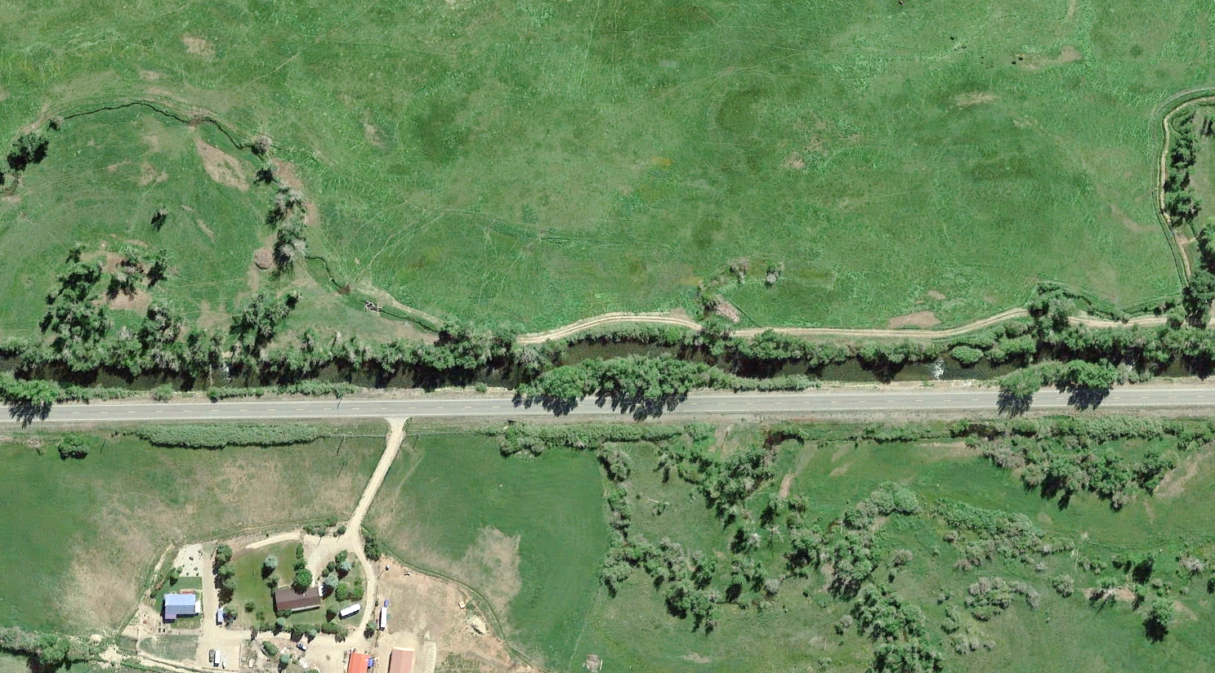
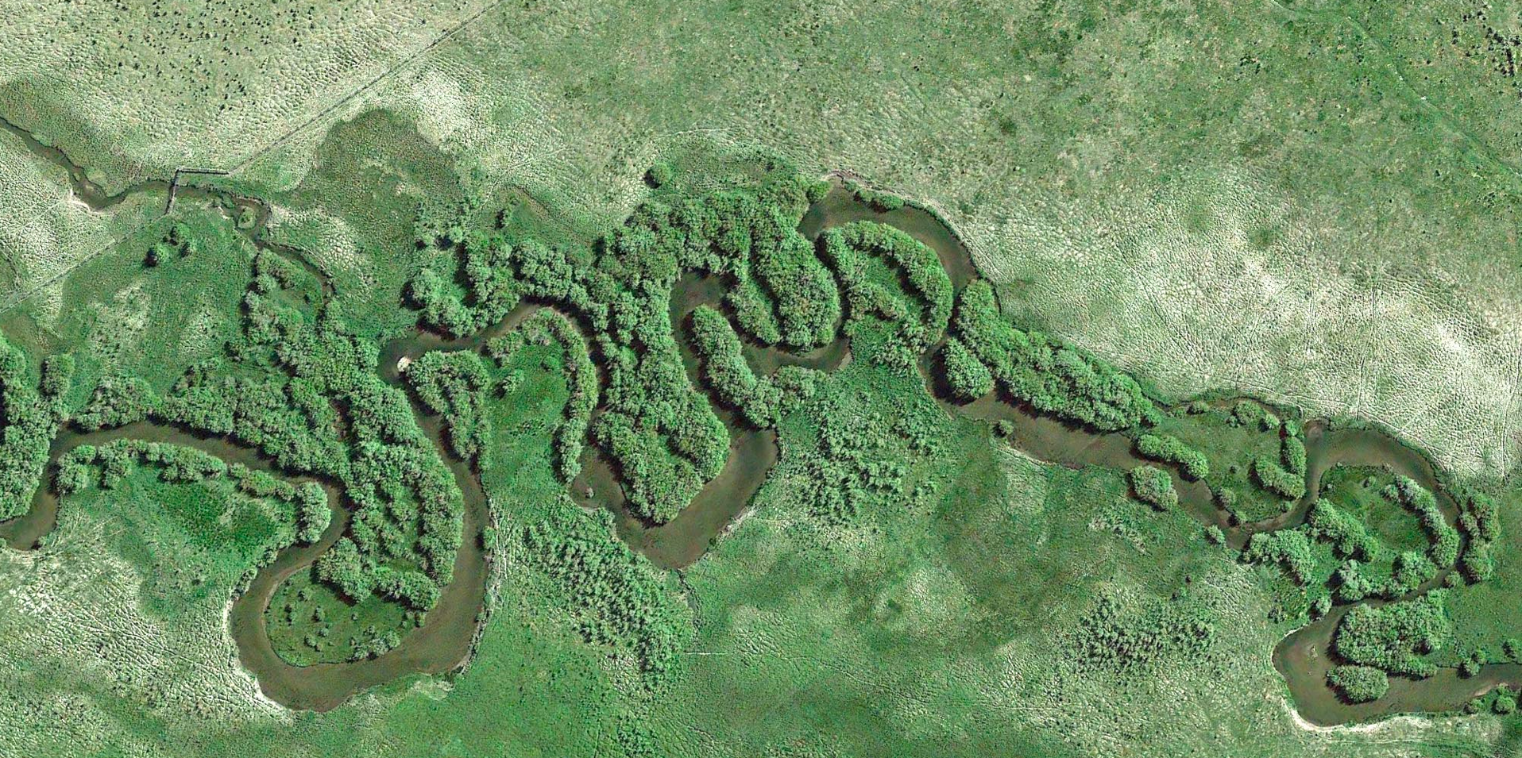
Upper Lemhi
Lower Lemhi
Lower gradient
Sinuous/meandering
Calmer water
Less gravel
Significant groundwater
High winter flows
Flow
Steeper gradient
Relatively straight
Turbulent water
More gravel
Less groundwater
High winter flows
Flow

Slide 5
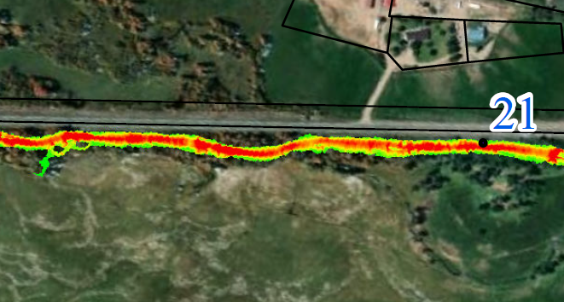
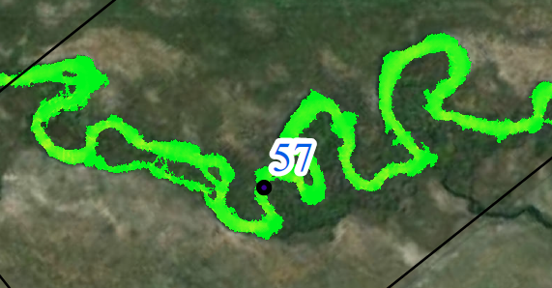
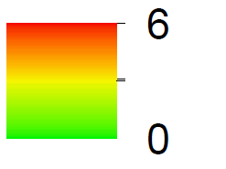
Upper Lemhi
Lower Lemhi
Lower gradient
Sinuous/meandering
Calmer water
Less gravel
Significant groundwater
High winter flows
Flow
Moderate flow (441 cfs at Salmon)
Flow
Steeper gradient
Relatively straight
Turbulent water
More gravel
Less groundwater
High winter flows
Moderate flow (300 cfs at Lemhi)

Slide 6
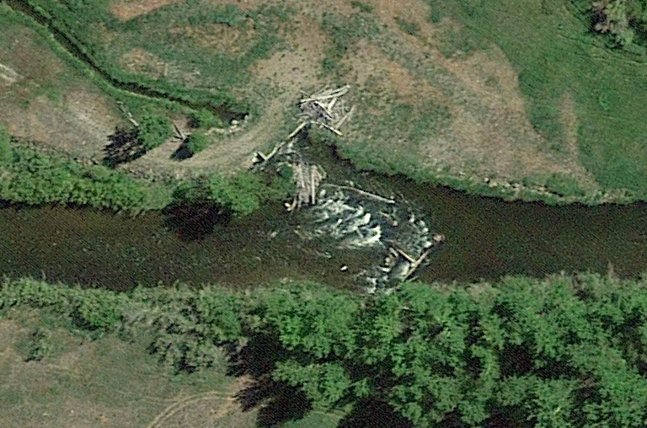
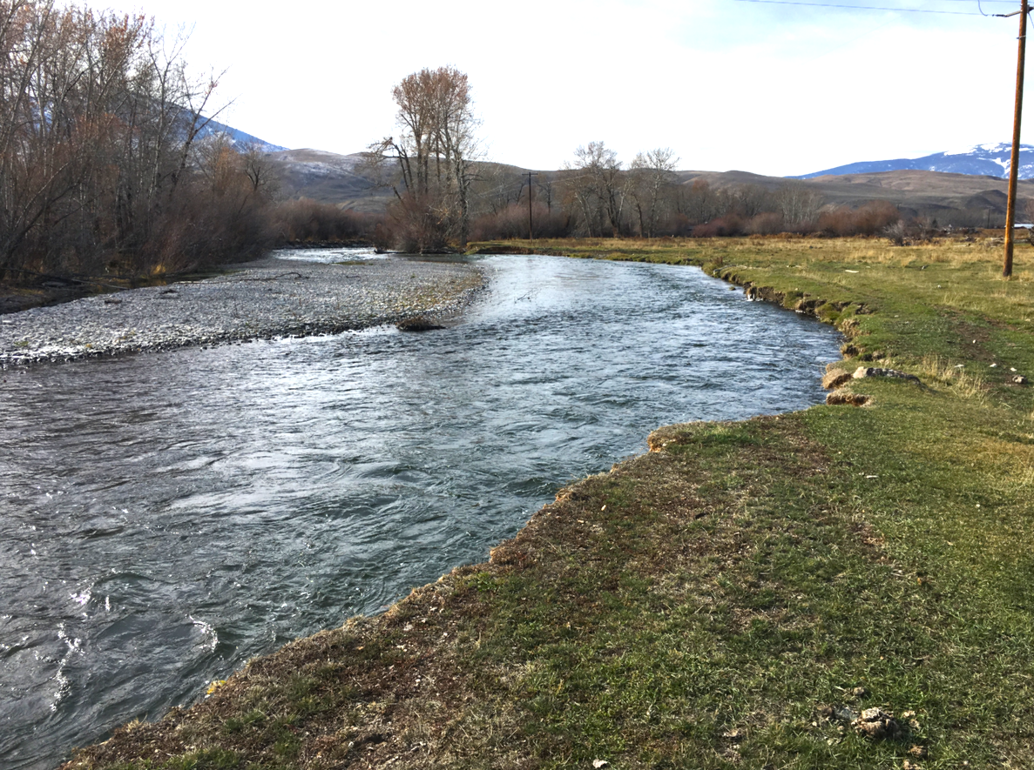
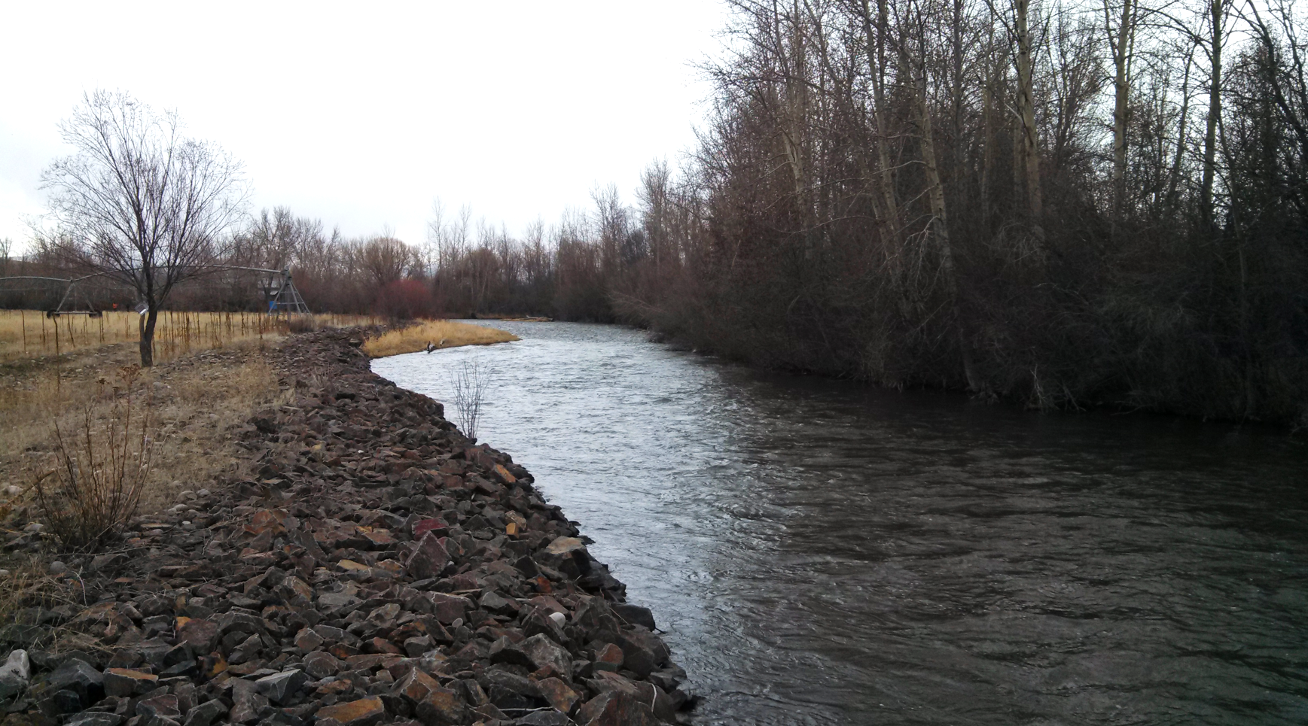
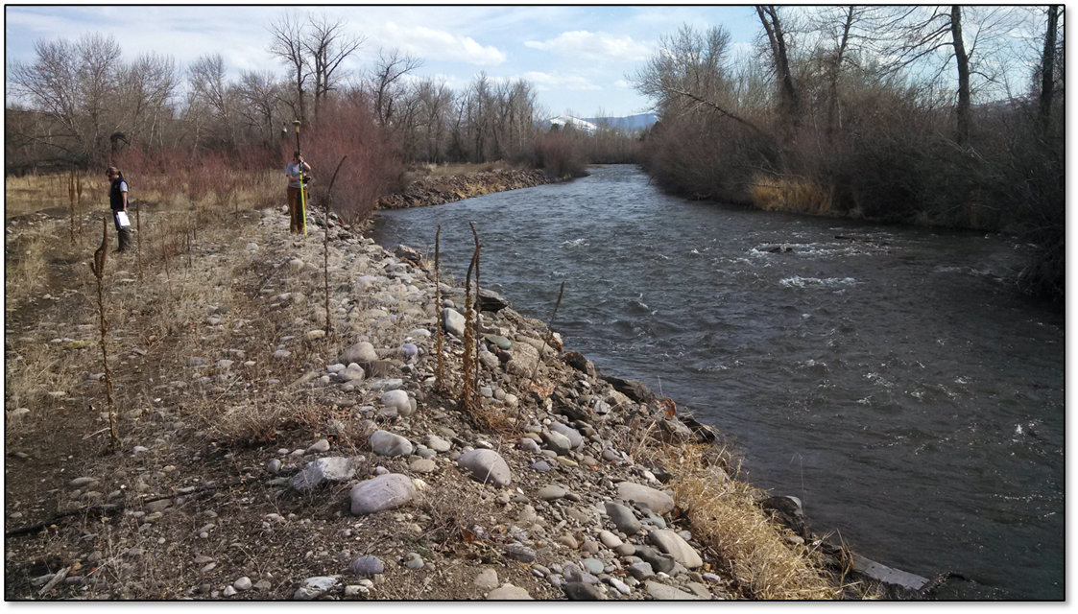
Lower Lemhi Impacts
Channel confinement/straightening
Channel simplification
Disconnected floodplain
Vegetation Removal
Levees
Riprap
Roads and development
Irrigation diversions

Slide 7
Lower Lemhi Impacts
Channel confinement/straightening
Channel simplification
Disconnected floodplain
Vegetation Removal
Levees
Riprap
Roads and development
Irrigation diversions
Increased velocity
Greater erosion potential (lateral and vertical)
Increased flood stage
100yr
100yr

Slide 8
Lower Lemhi Impacts
1.3 Miles
Straightened River / Abandoned Channels

Slide 9
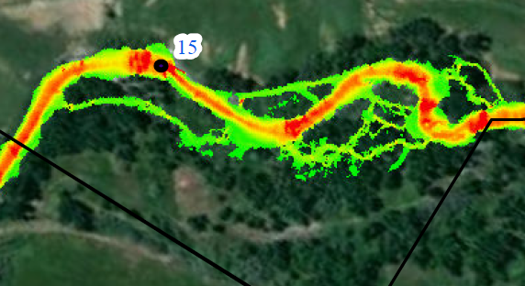
Lower Lemhi Impacts
Hydraulic modeling
Impacted
Flow
Moderate flow (441 cfs at Salmon)
Over 6 ft/s during moderate flow
Over 12 ft/s at 1.5yr flood (777cfs)
Flow
Relatively unimpacted
Moderate flow (300 cfs at Lemhi)

Slide 10
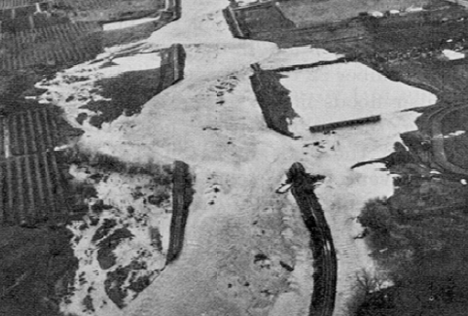
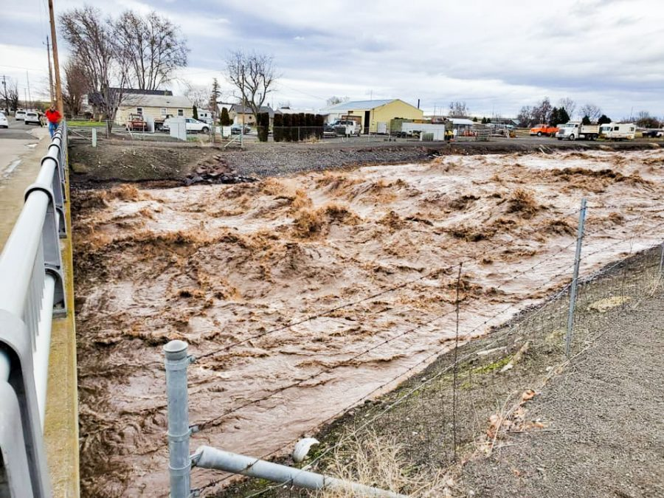
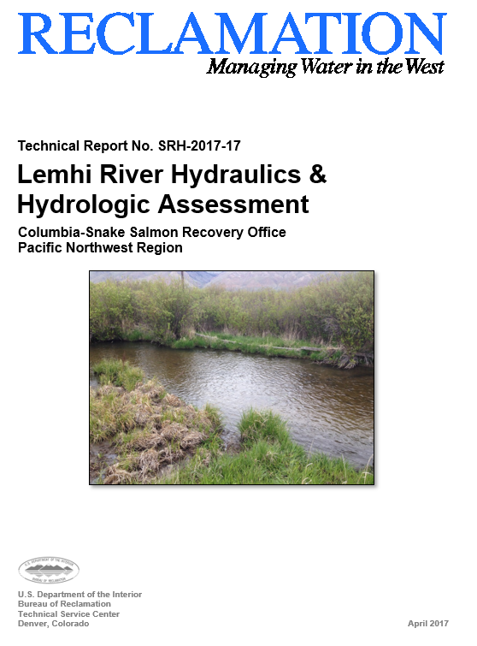
Floods
Largest Recorded Floods in the Lemhi:
2,110 cfs (June 9, 1942) – Gage in Salmon (1928 – 1943)
2,920 cfs (June 6, 1995) – Gage below L5 near Salmon (1992 – 2017)
2,430 cfs (June 21, 1984) – Gage near Lemhi (1956 – 2023)
1946
2020
Example:
Walla Walla River
Confined Channel
100-yr Flood

Slide 11
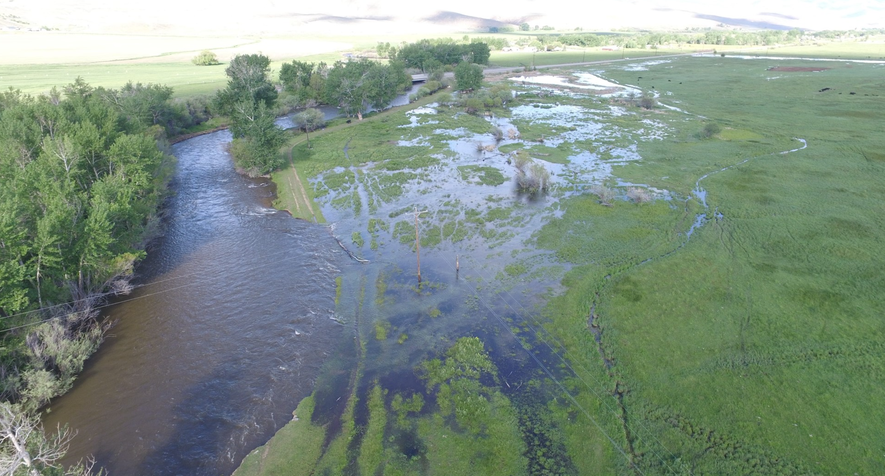
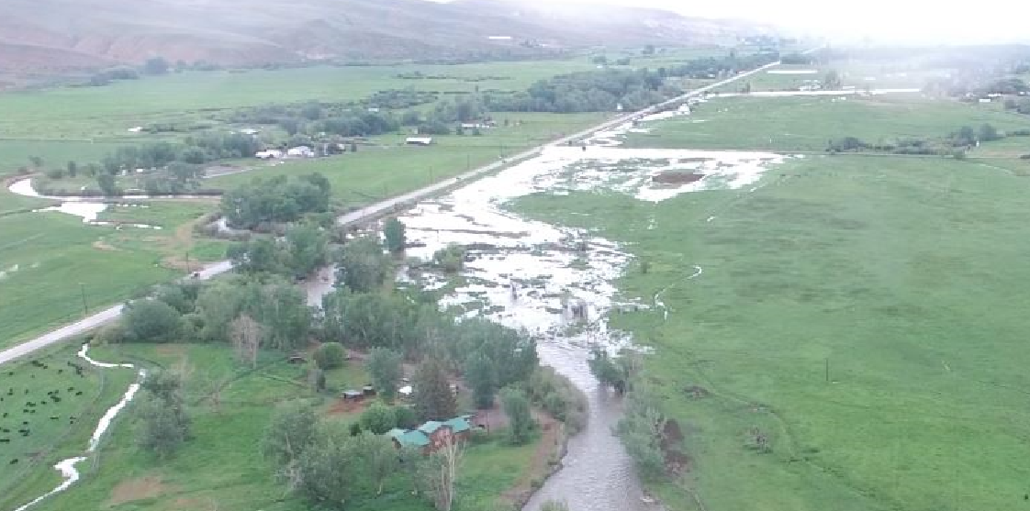
Floods
Largest Recorded Floods in the Lemhi:
2,110 cfs (June 9, 1942) – Gage in Salmon (1928 – 1943)
2,430 cfs (June 21, 1984) – Gage near Lemhi (1956 – 2023)
2,920 cfs (June 6, 1995) – Gage below L5 near Salmon (1992 – 2017)
Barracks Ln.
Lower Lemhi River
1,680 cfs
Spring 2018

Slide 12
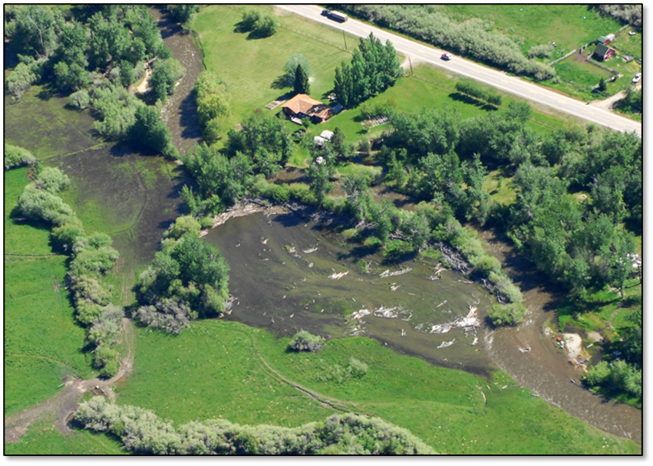
Why Floodplains are Important
Belt Width = Maximum amplitude
Allow channel space to meander
Stabilization from vegetation
Capture sediment and debris
Reduce flood energy (less erosion)
Store flood water / lower flood stage
Improve water quality
Amplitude
Wavelength
568ft Max Amplitude in Lower Lemhi
= Minimum Meander Belt Width

Slide 13
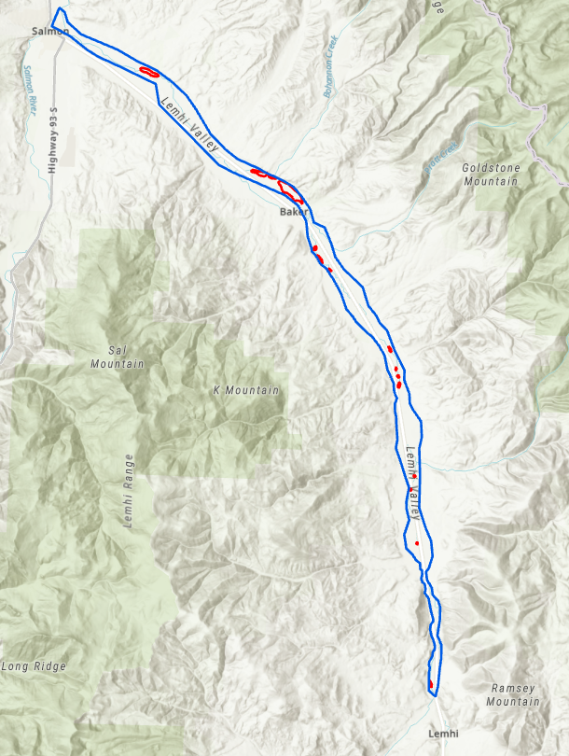
Why Floodplains are Important
Allow channel space to meander
Stabilization from vegetation
Capture sediment and debris
Reduce flood energy (less erosion)
Store flood water / lower flood stage
33 Miles of the Lower Lemhi (downstream of Hayden Cr)
8,298 acres of historical floodplain
345 acres of existing floodplain (4% of historical)
Historical
Floodplain
Existing
Floodplain

