Slide 1
Lemhi Basin Groundwater and Surface Water Interactions
Presented by Ryan McCutcheon, Hydrogeologist
02/05/2020

Slide 2
Problem
Need to understand the impacts of changes to climate, water management, and irrigation practices on:
Streamflow
Water temperature
Sedimentation rates
Water quality

Slide 3
Solution
Data Collection
Groundwater, surface water, and soil moisture
Analyses
Groundwater levels, temperature, and tracers
Seepage Investigations to characterize gaining and losing in streams
Numerical Modeling
Evaluate potential impacts of changes to
Climate
Water Management
Irrigation Practices
Land Use
Stream Channel

Slide 4
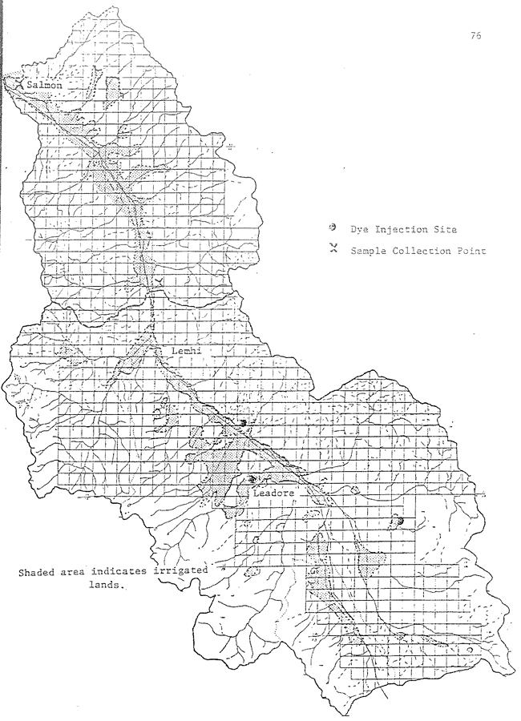
Background
Haws et al., 1977
Rhodamine dye was applied to the ditches on three farms.
Monitored the Lemhi River near Lemhi, ID and Salmon, ID for the next few months.

Slide 5
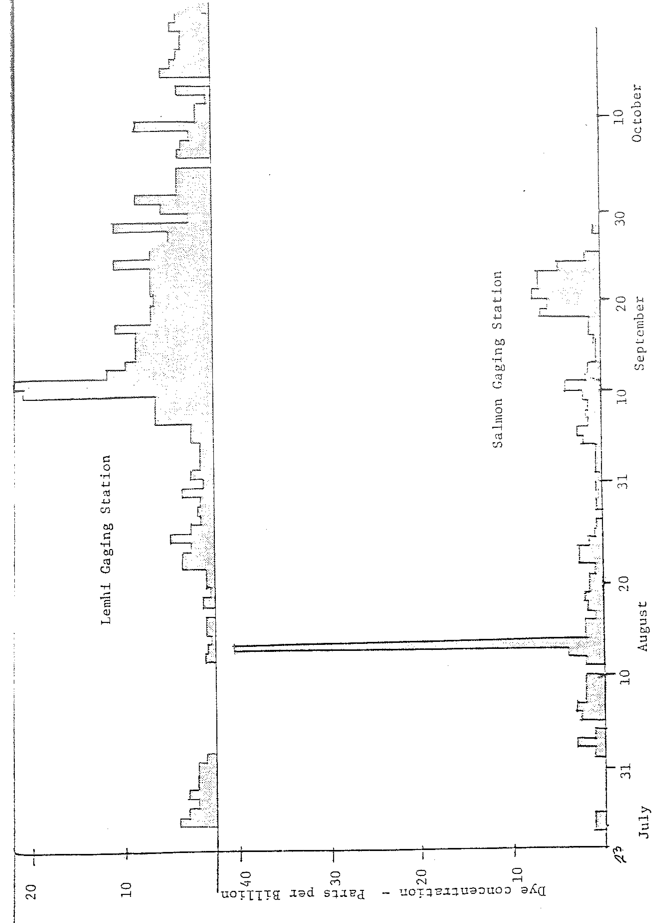
Background
Haws et al., 1977
The first traces of dye appeared in the Lemhi River after two days and continued to appear intermittently through October.
Peak dye return after six weeks.

Slide 6
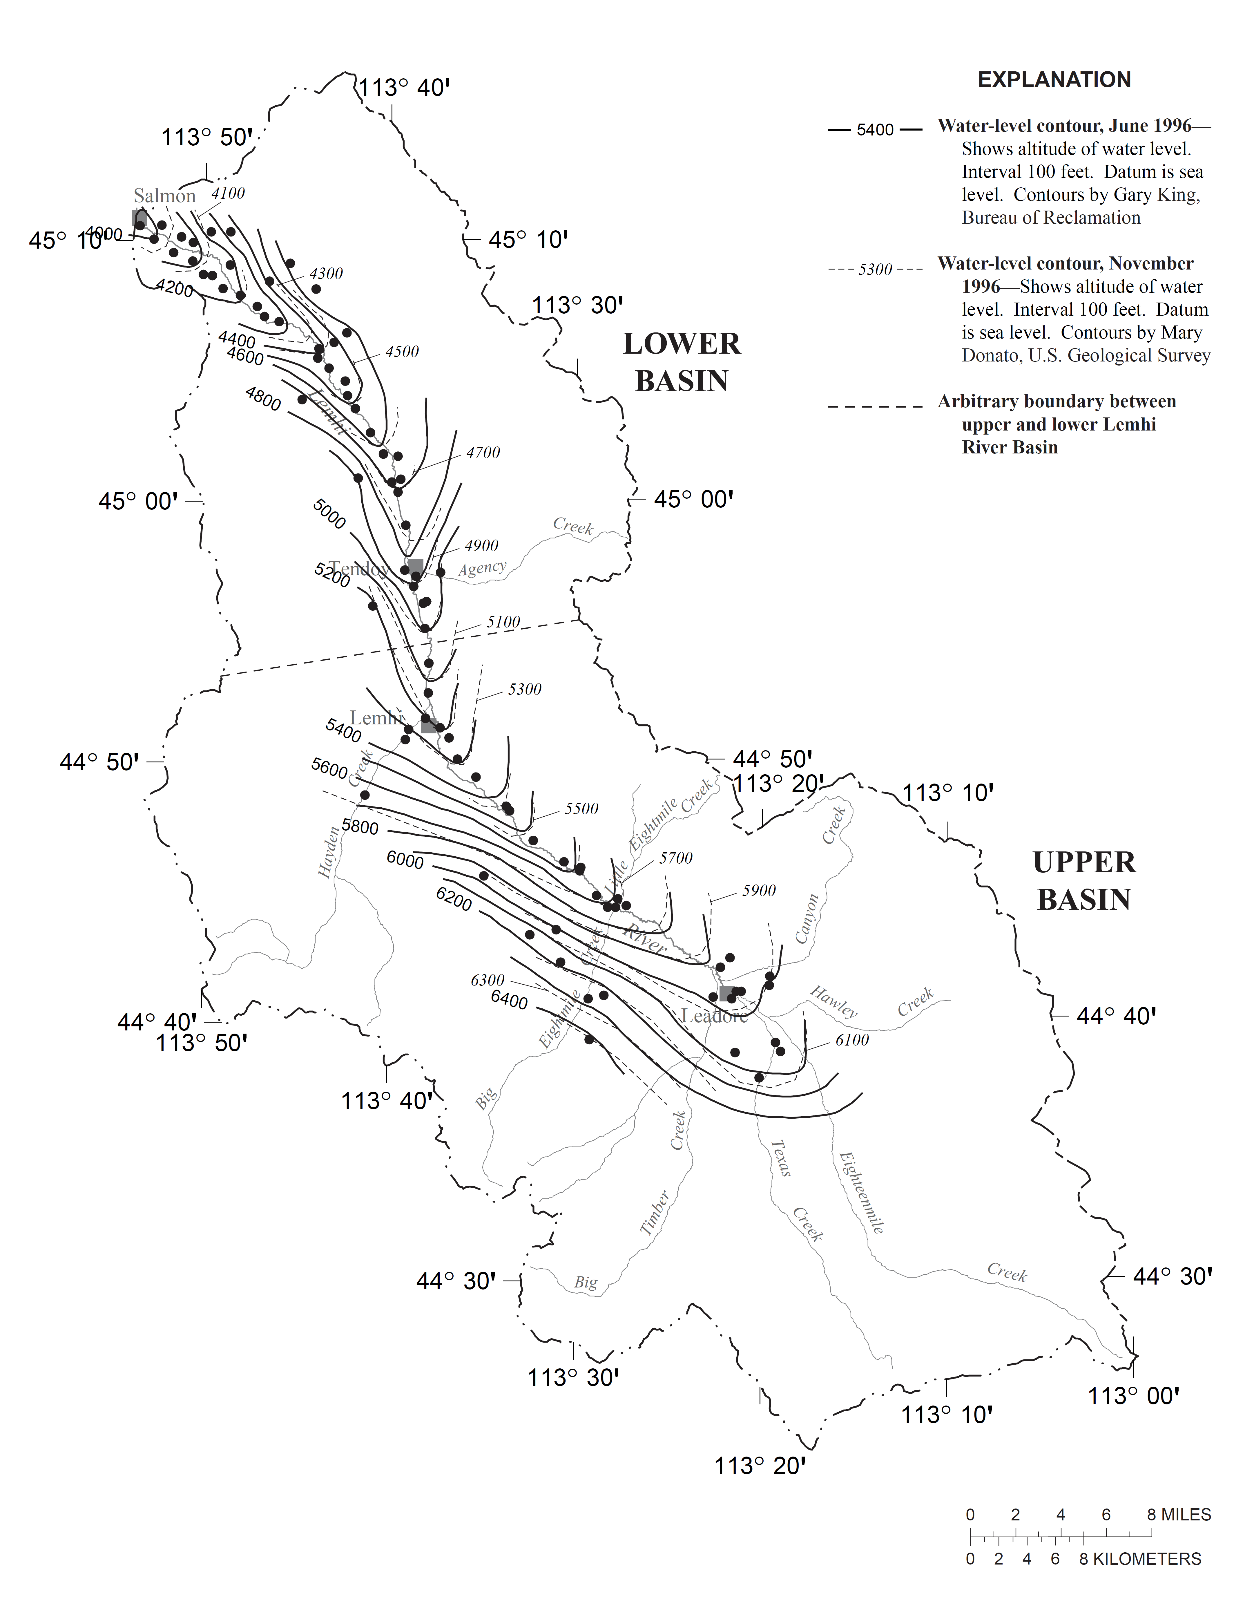
Background
Donato, 1998
Notes:
Donato Results
During the August seepage run, 650 cfs was being diverted, inflows totaled 428 cfs, and net river gain was 510 cfs.
In October, 48 cfs was being diverted, inflows totaled 314 cfs, and net river gain was 165 cfs.

Slide 7
Background
CH2M Hill, 2014

Slide 8
Background

Slide 9
Background
Donato (1998) and CH2M Hill (2014) Discussion
Streamflow gains and losses are governed by the hydraulic gradient between the aquifer and the river.
In August, the hydraulic gradient was toward the river at most locations.
Water table is raised by groundwater recharge from flood and sprinkler irrigation during the summer.
When irrigation stops, groundwater levels drop, and the hydraulic gradient between the aquifer and the river decreases.
Estimated that effectively all groundwater is gained by the Lemhi River between the Snyder and Kesl wells, just before the constriction.

Slide 10
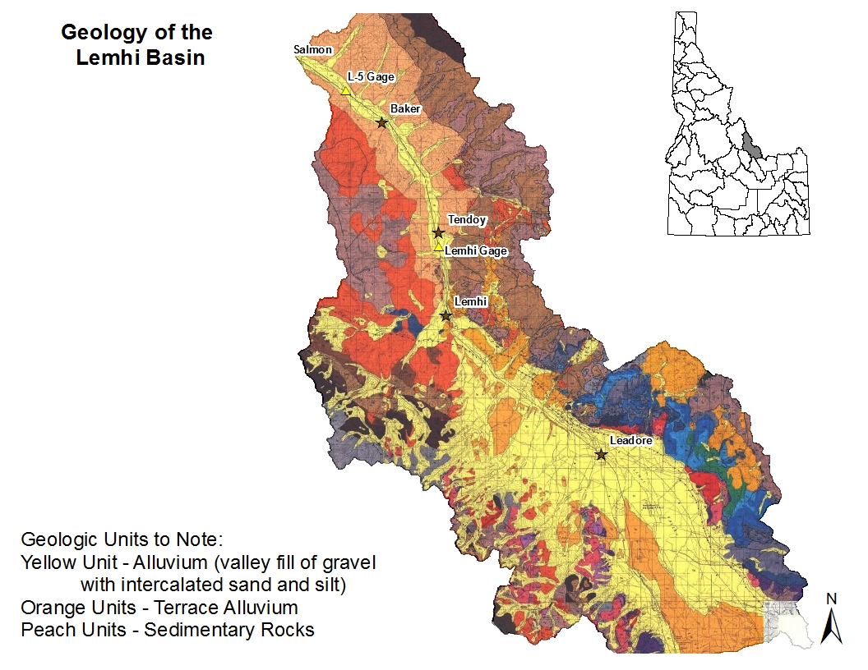
Background

Slide 11
Background
IDWR, 2012: Optimizing Streamflow Enhancement Phase IV
Notes:
McRea Well near Big Eightmile Creek, Upper

Slide 12
Background
IDWR, 2008: Optimizing Streamflow Enhancement Phases II and III
Big Timber Creek
Bohannon Creek
Canyon Creek
Eighteenmile Creek
Hawley Creek
Kenney Creek
Lemhi Big Springs
Lemhi River, Upper
Lemhi River between Big Springs Creek and McFarland
Little Eightmile Creek
Little Lemhi Springs
Texas Creek

Slide 13
Background
CH2M Hill, 2014
If, at a given POU, the majority of the discharge due to irrigation recharge occurs within the first 30 days (May/June), then river flows during the late-summer and fall low-flow period do not benefit much from recharge at those POUs.
However, if at a given POU, the discharge is distributed over a longer time period, then stream discharge due to recharge that occurs early in the season contributes a significant amount of water to streamflow during the critical late-summer period.
Management actions that increase the amount of groundwater recharge at POUs with longer residence times will result in increased streamflows during the critical late-summer/early fall time period.

Slide 14
Recent Work
IDWR, 2019: Groundwater and Surface Water Interactions Phase III
Pratt Creek Drainage Flood to Sprinkler Conversion
Installed 4 soil moisture stations and three shallow wells to monitor soil moisture and groundwater level changes as Snook farm converted from flood to sprinkler irrigation at the beginning of the 2018 irrigation season.
Impact to groundwater from converting to sprinkler is not evident in either the water-level or soil moisture data.
When the old Pratt Creek channel was migrated, water levels in both nearby monitoring wells responded immediately.

Slide 15
Recent Work

Slide 16
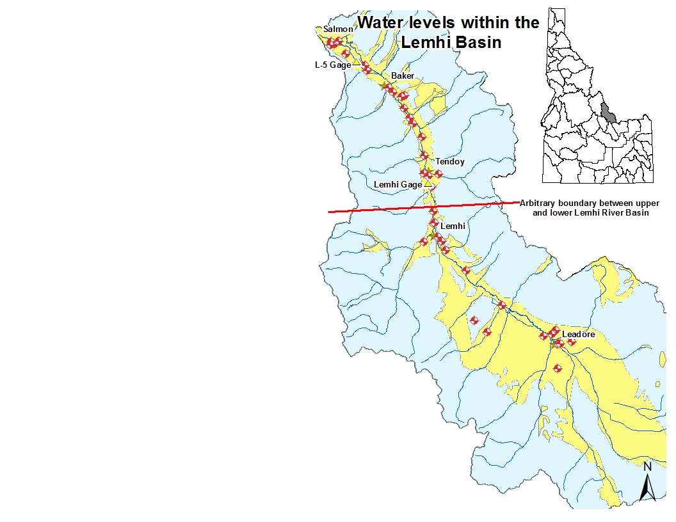
~12-13 ft variability

Slide 17
~6 ft variability

Slide 18
~22 ft variability

Slide 19
~4-5 ft variability

Slide 21
~15-17 ft variability

Slide 22
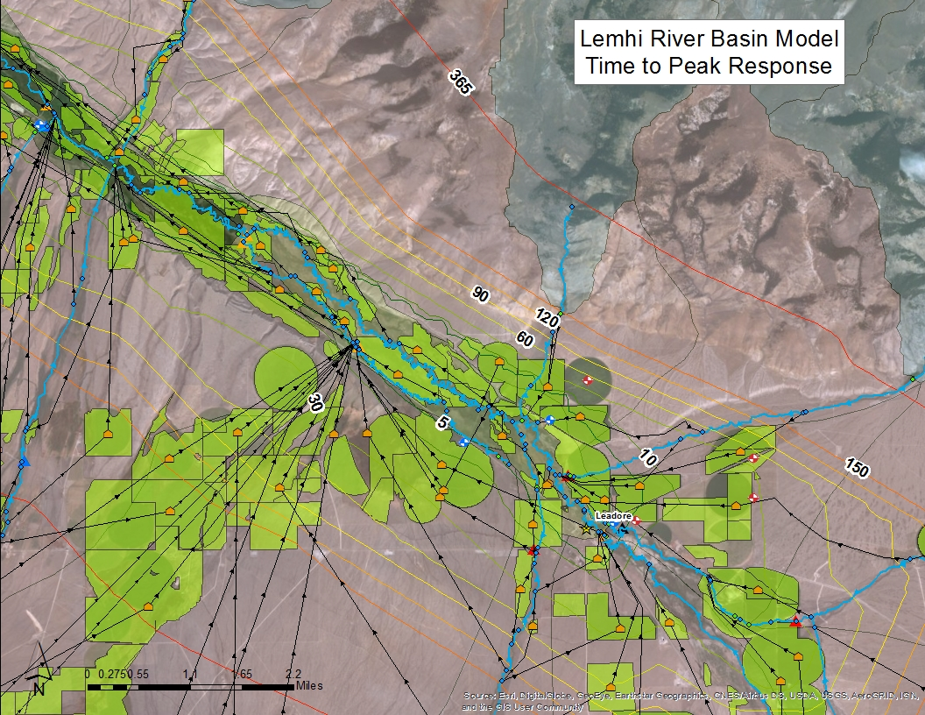

Slide 23
Future Work
Where and when do spring runoff and irrigation-induced groundwater recharge contribute to streamflow?
Stable isotope analysis
Grondwater mounding analyses at POUs
Coupled surface water and ground water model

Slide 24
Future Work
Analysis of stable isotopes of water

Slide 25
Future Work
What are the hydrologic impacts of conversion from flood to sprinkler irrigation?
Continued soil moisture and groundwater level monitoring and analysis at the Snook and Mulkey agricultural fields.
Analyze aerial imagery from 1992 to present
Assess the groundwater impacts of changes to irrigation methods by comparing well water levels before and after changes.
Use the Lemhi River Basin Model to assess streamflow impacts of irrigation changes.

Slide 26
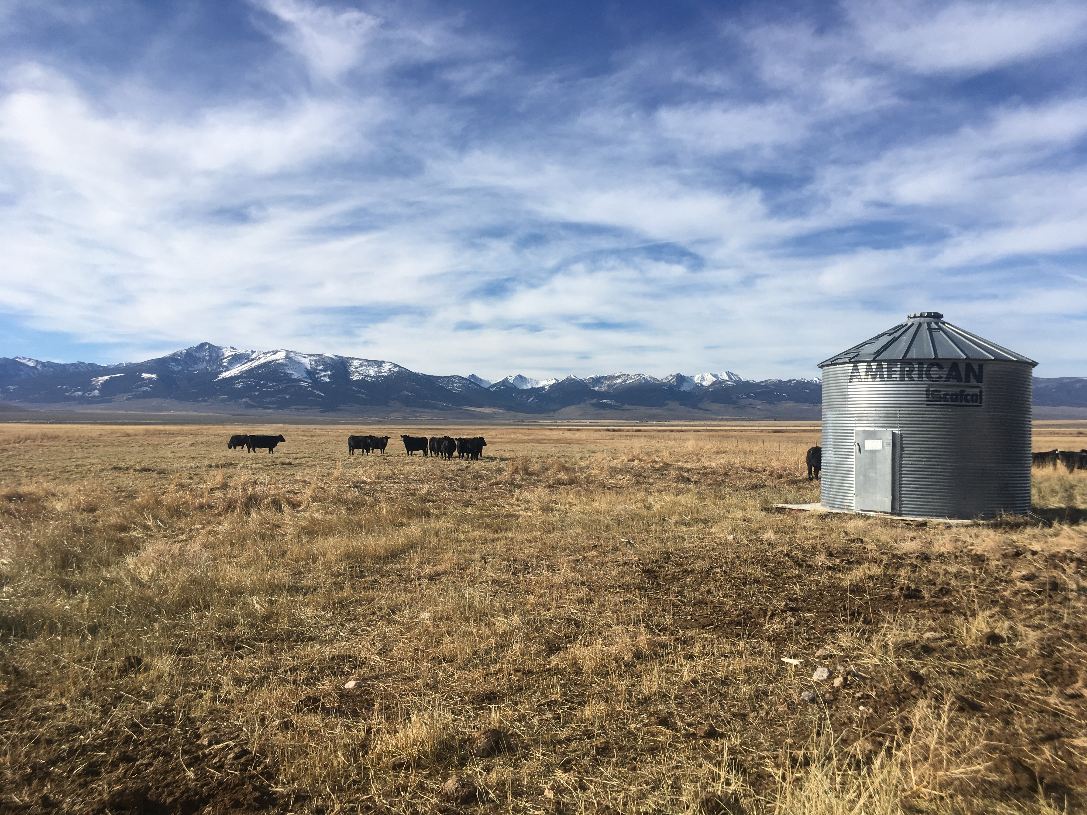
Questions?

Slide 27
Data Collection
Groundwater Levels
25 continuously monitored wells with hourly data
18 wells with bi-weekly discrete measurements
New data published quarterly

Slide 28
Data Collection
Streamflow
21 active gages in the Lemhi Basin
15-minute and daily mean data published monthly

Slide 29
Data Collection
Soil Moisture Concentration
5 active soil moisture stations with hourly data
New data available upon request or in project reports

Slide 30
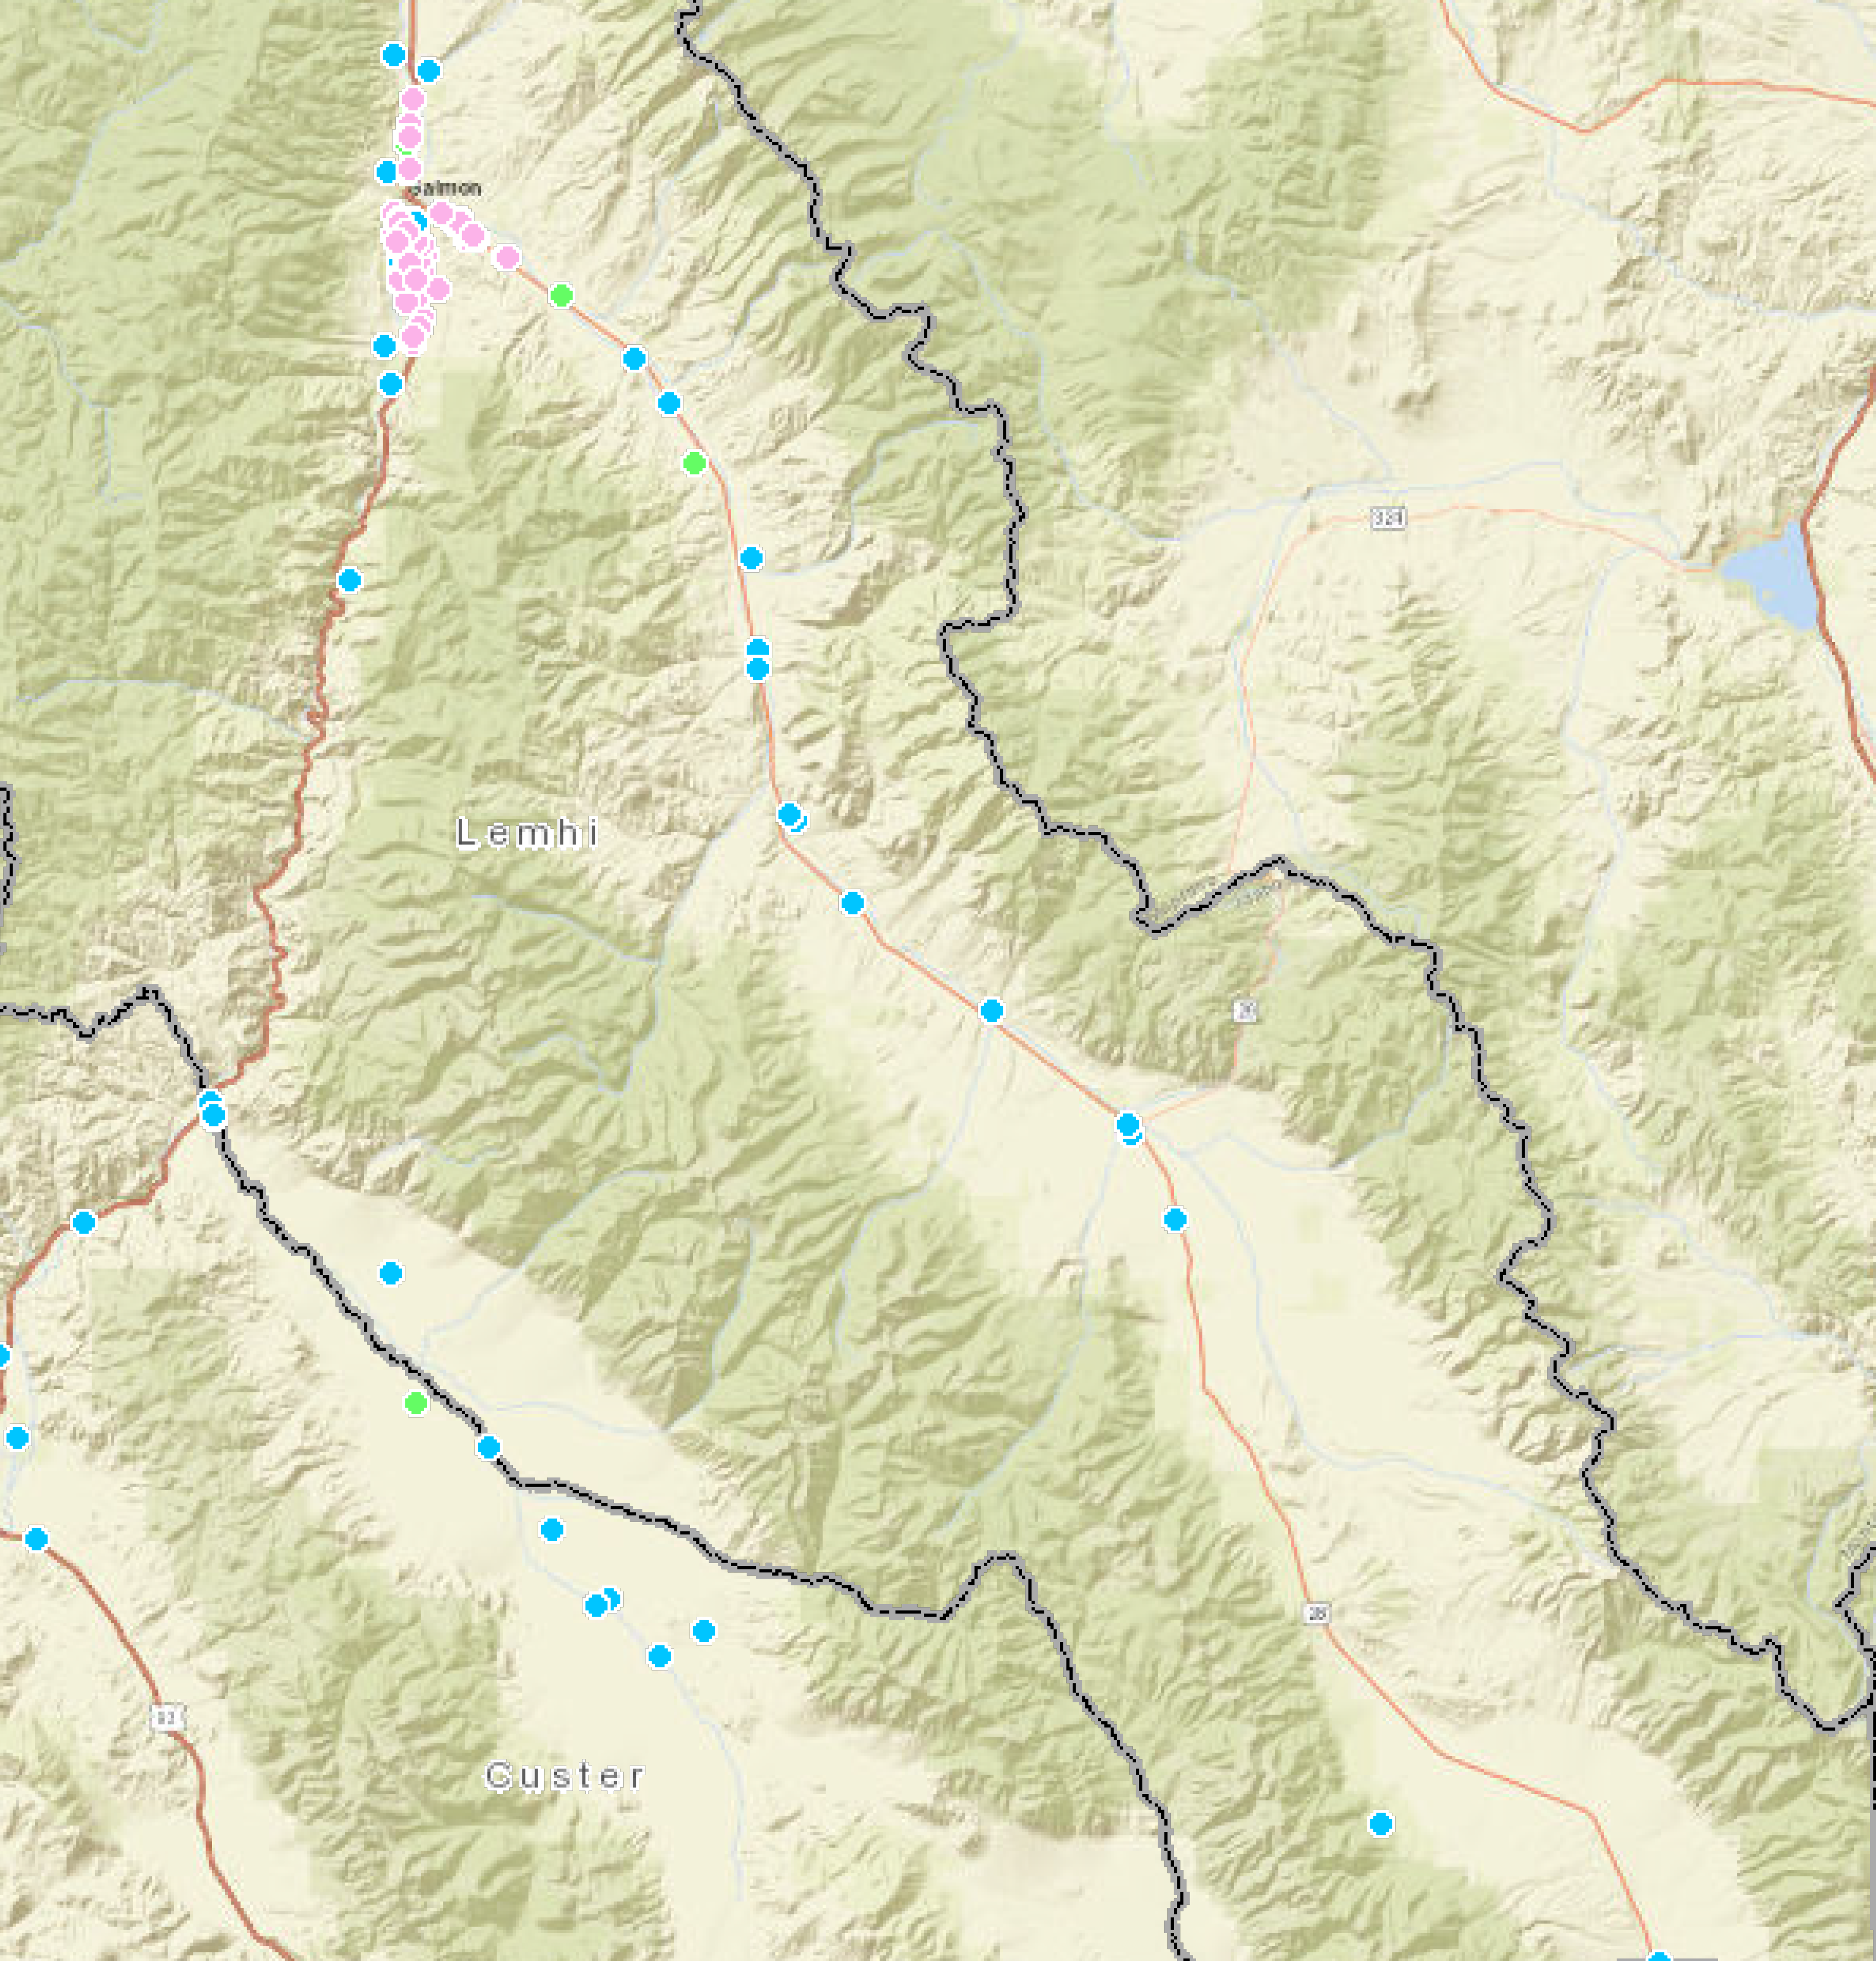
Data Collection
Groundwater Quality
25 wells with a wide variety of water quality constituents analyzed for varying lengths of time and at varying intervals

Slide 31
Data Collection
Surface Water Quality
Analytes: Temperature, turbidity, SC, pH, and DO
21 gages with continuous 15-minute temperature data
Discrete Measurements
10 gages with monthly water quality measurements
11 gages with quarterly water quality measurements

