Slide 1
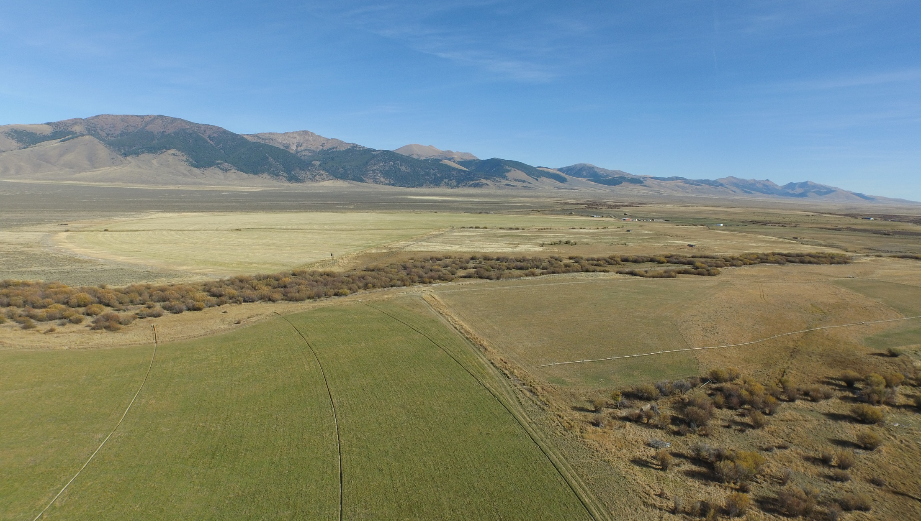
Middle Eighteenmile Creek
Habitat Improvement Project
June 7, 2018
USBWP Advisory Committee

Slide 2
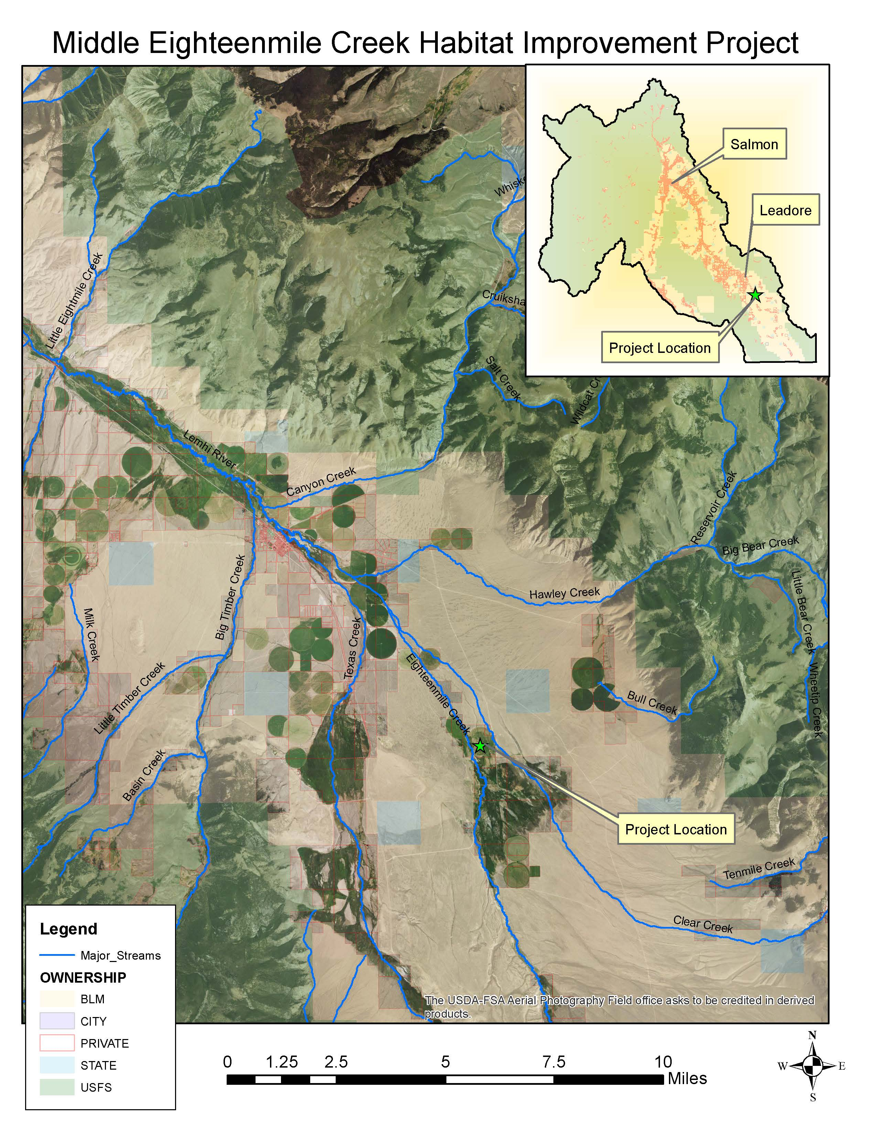

Slide 3
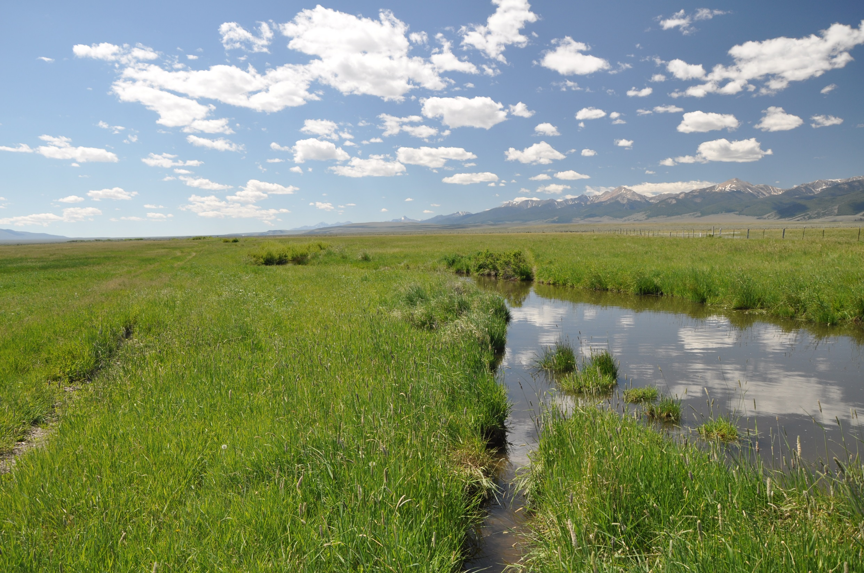
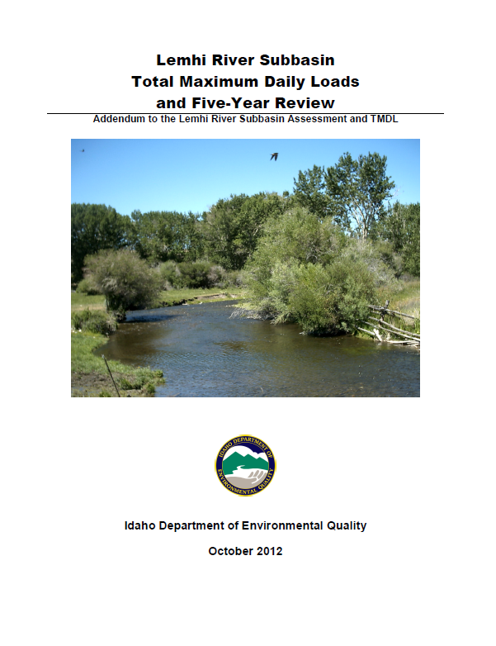
1999 Subbasin Assessment and TMDL
Eighteenmile Creek Sediment
2012 Addendum
Eighteenmile Creek Temperature

Slide 4
78 – 47 Degrees
August Temperature High and Lows
75 – 45 Degrees
52 – 43 Degrees
65 – 45 Degrees
60 – 45 Degrees

Slide 5
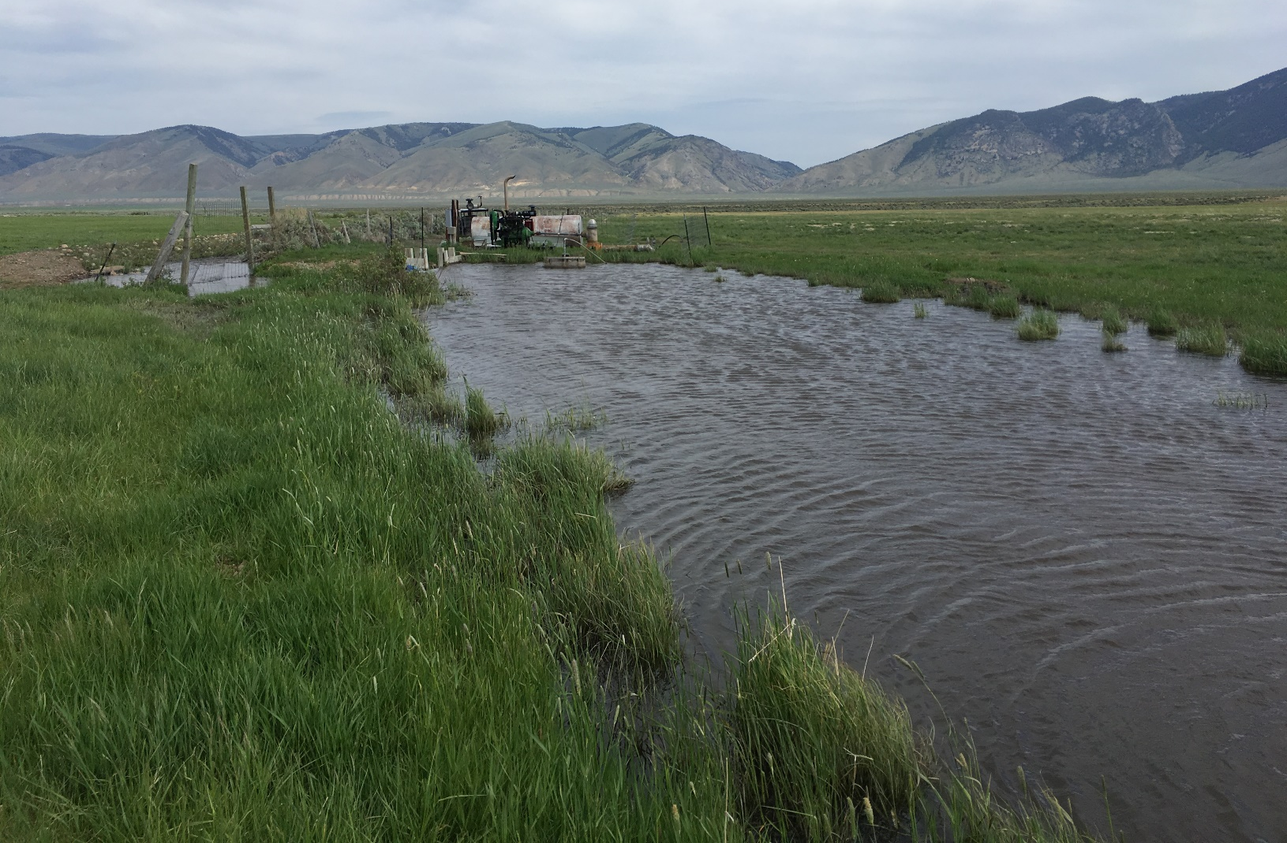
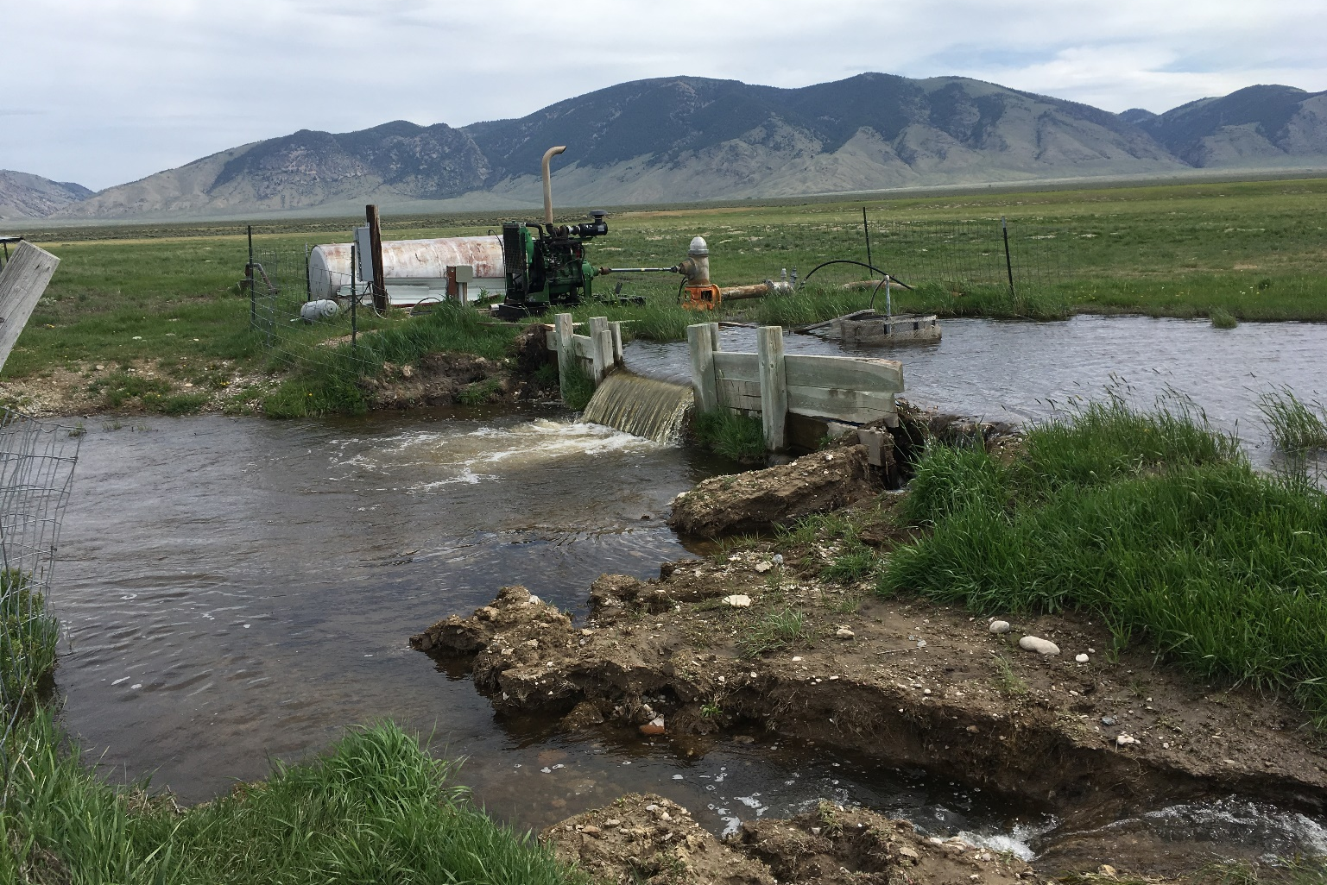
Current Conditions

Slide 6
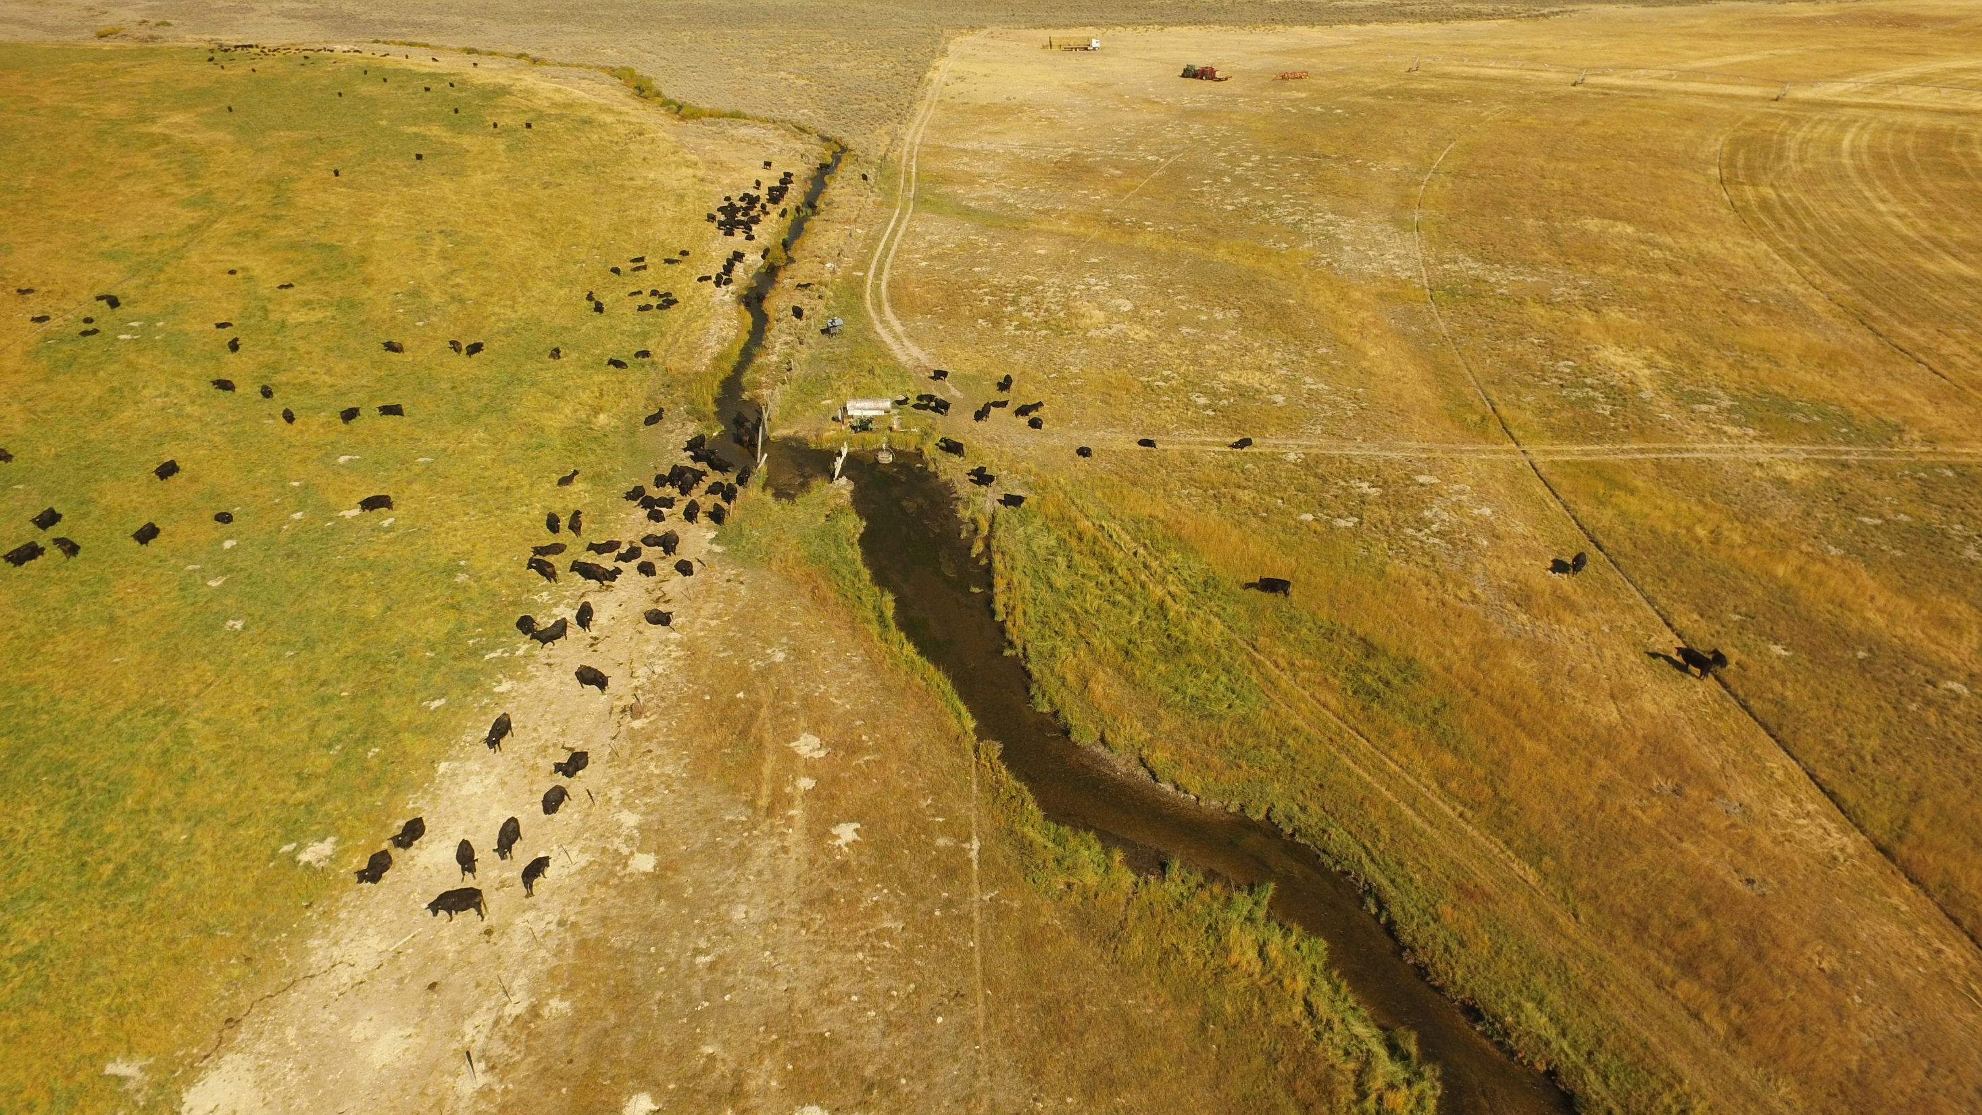

Slide 7
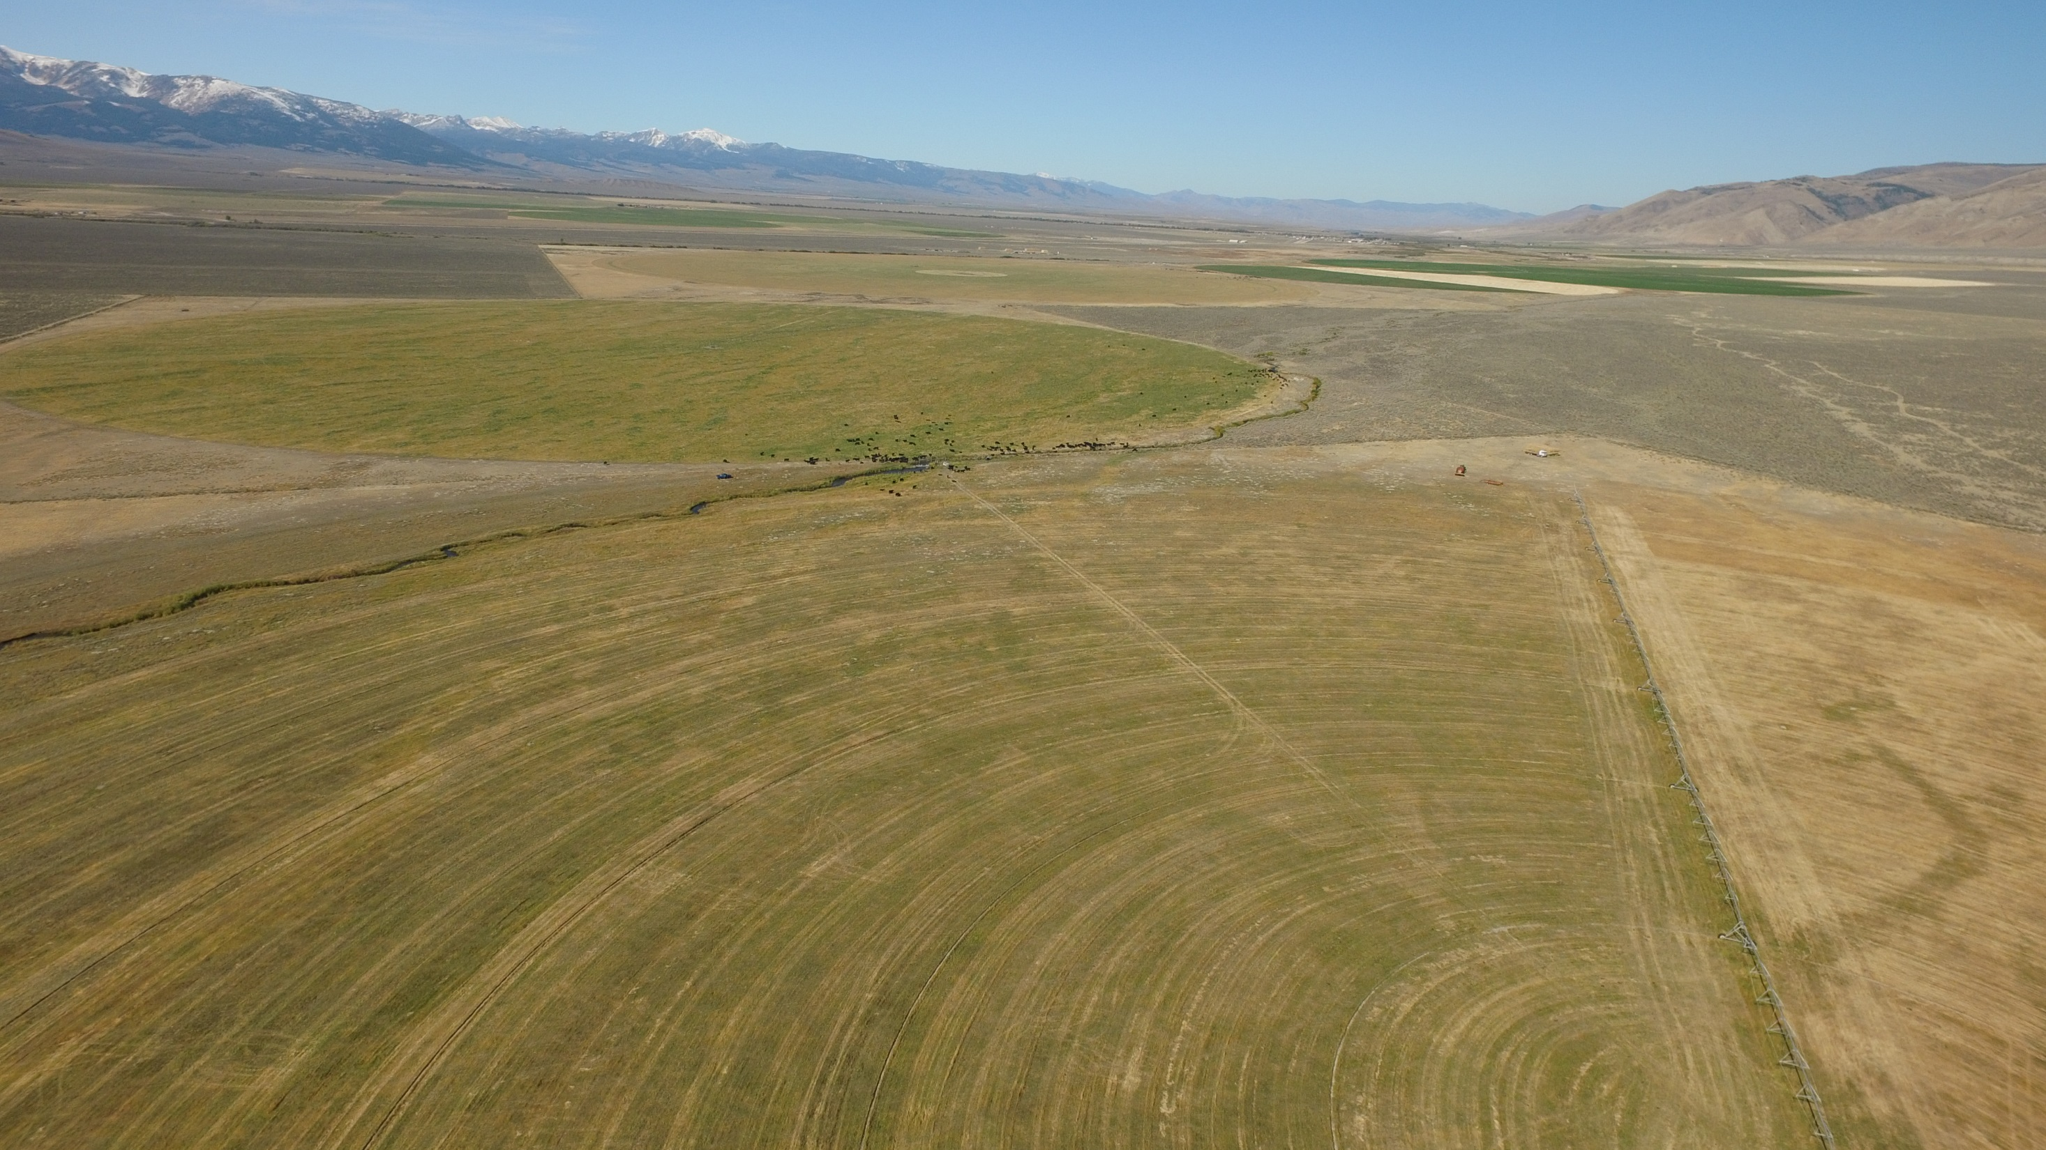

Slide 8
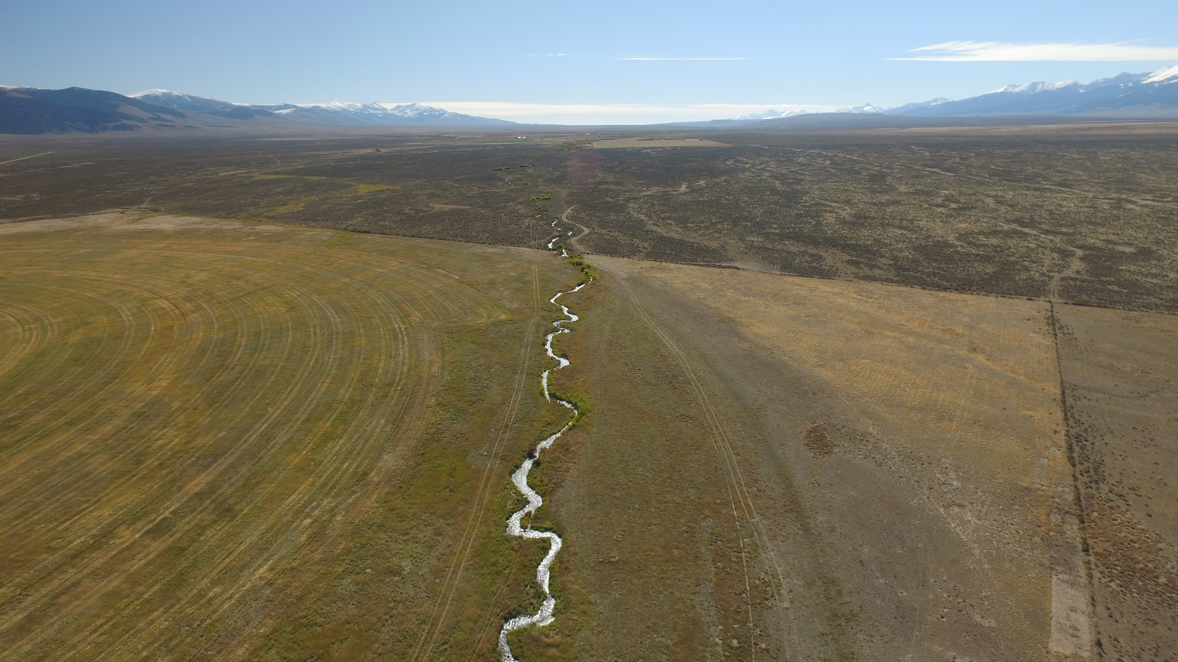

Slide 9
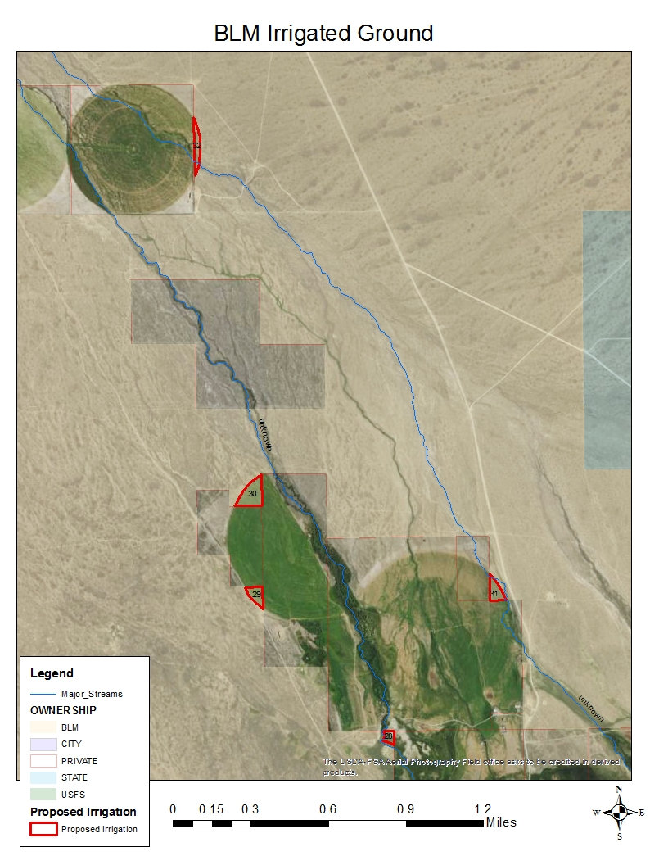
13.1 Total Irrigated Acres of BLM

Slide 10
Two Prong Approach: Irrigation and Restoration
Irrigation:
  Purchase a new pivot
    Pivot area reduced to eliminate encroachment on BLM land
  Remove water impoundment structure
  Install a fish screen
  Install stockwater tanks

Slide 11
Two Prong Approach: Irrigation and Restoration
Relocate 0.4 mile of stream between two irrigated fields to eliminate 6 pivot crossings through the stream
Create fish habitat with narrower channel, pools, large wood, and a riparian community
Wildlife friendly fence
Remove an abandoned headgate and forn

Slide 12
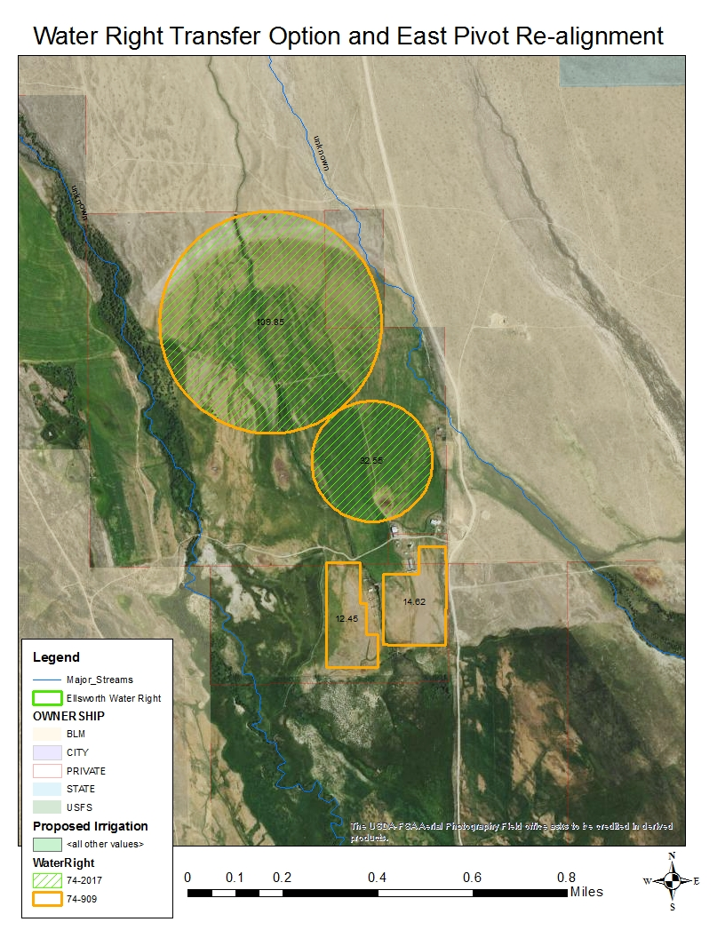
Phase II –2020
Additional irrigation upgrades
Put spring water into pipeline, eliminating open ditches and allowing surface flow back to Eighteenmile Creek
Eliminate irrigation on BLM administered land

Slide 13
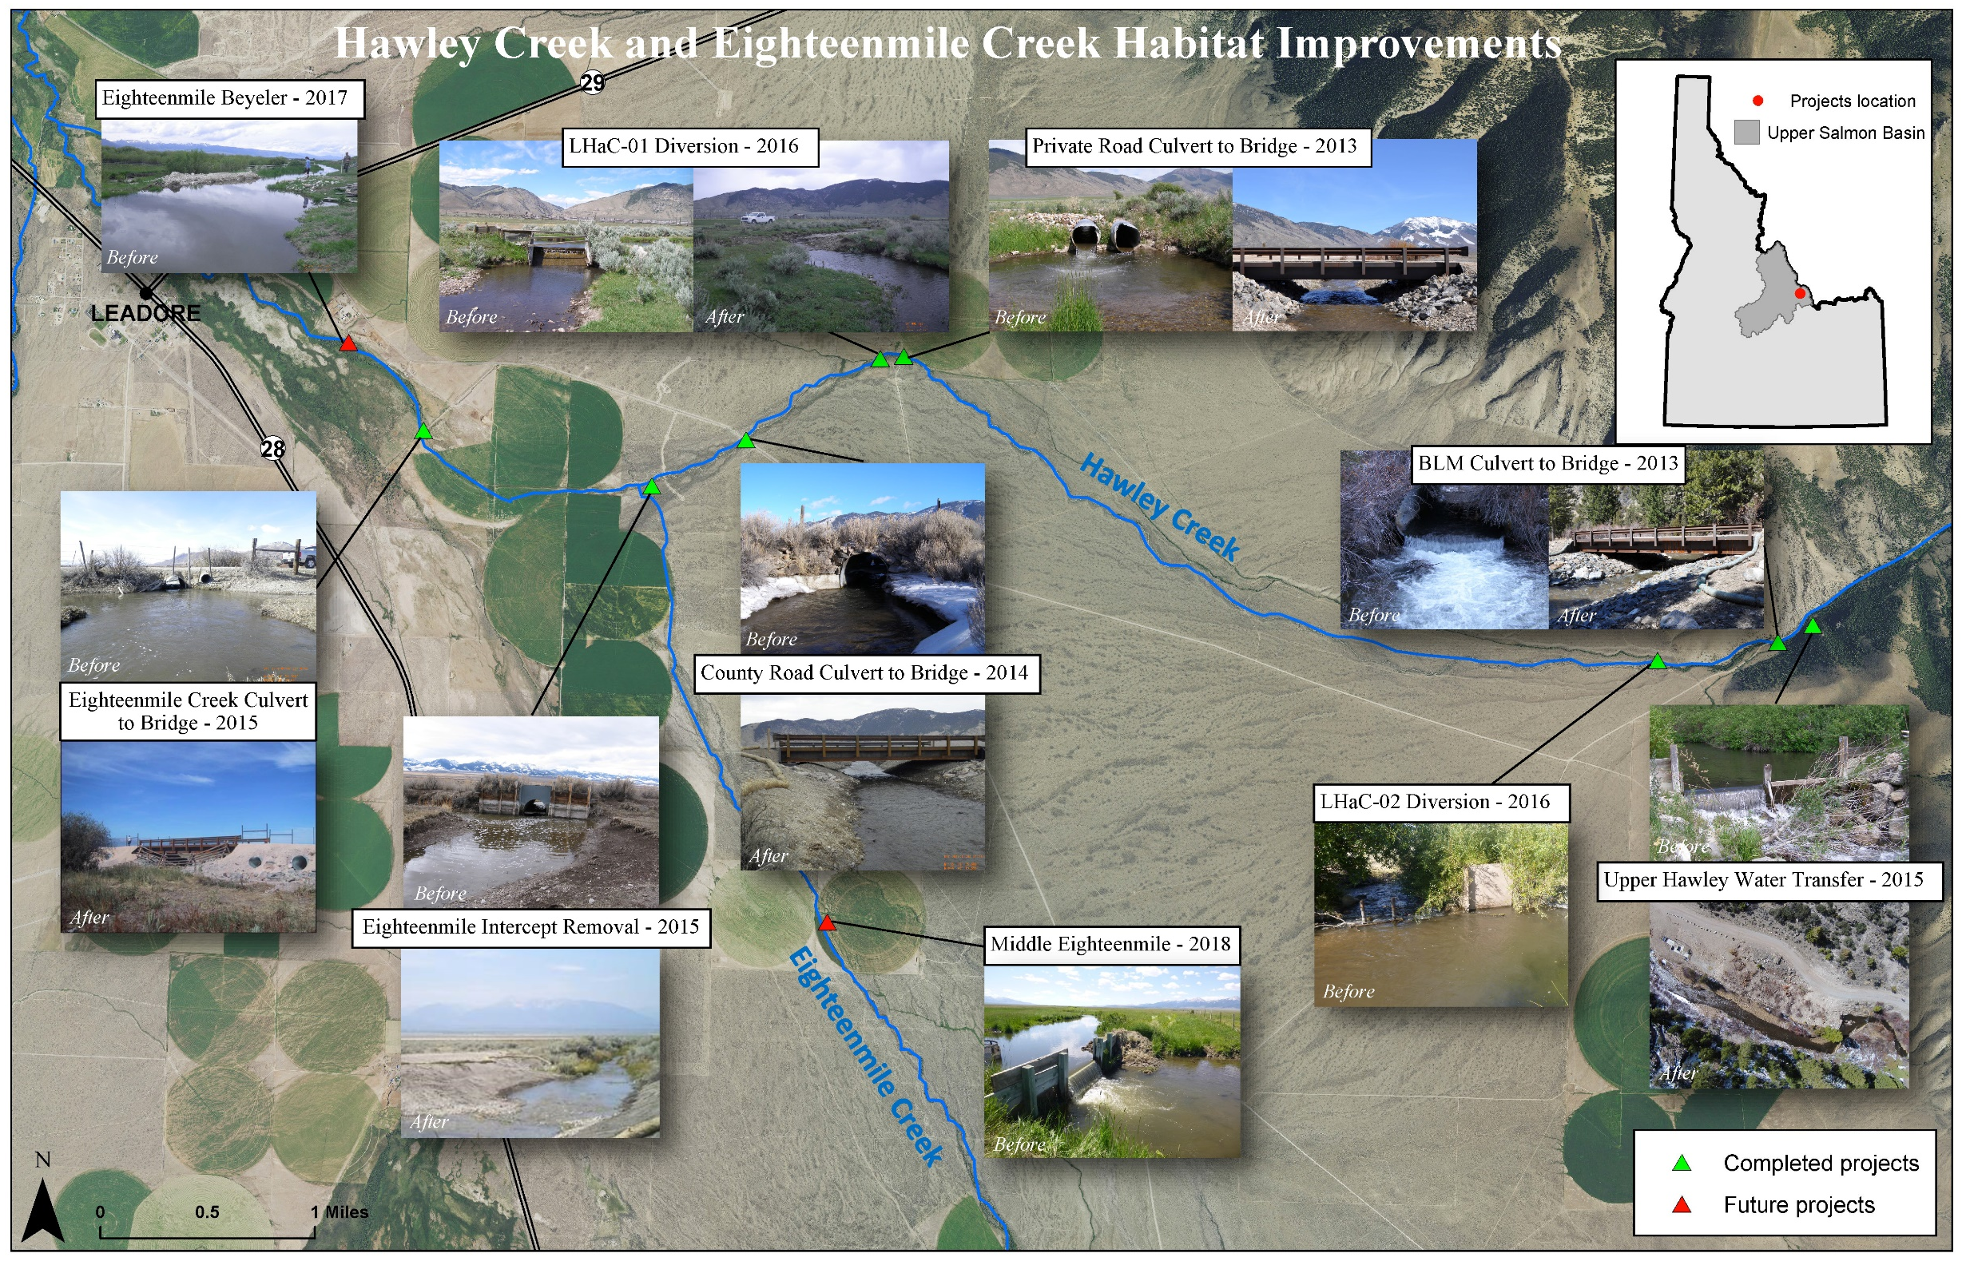

Slide 14
