Slide 1
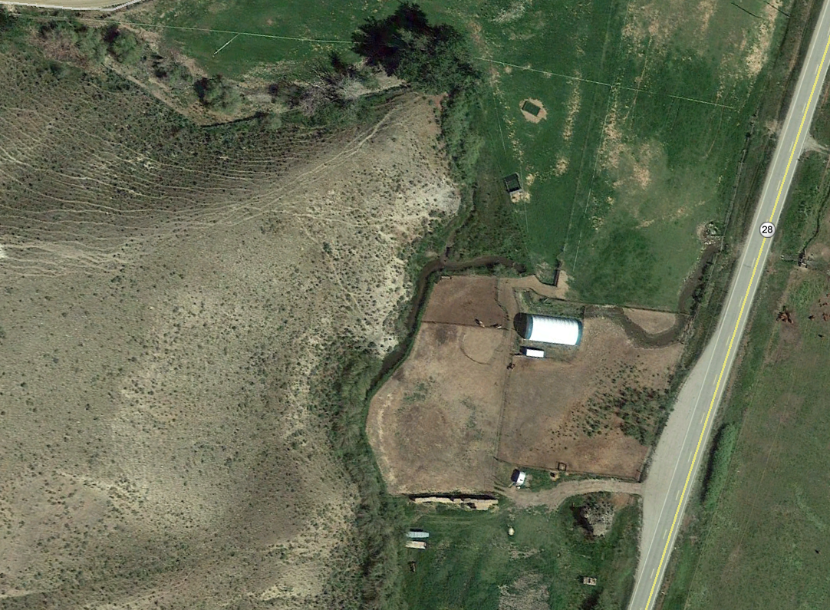
Little Sawmill Creek Restoration Project
Watershed Advisory Committee
March 8, 2018
Lemhi Soil and Water
Conservation District

Slide 2
Dual Project Sponsorship
Lemhi Soil and Water
Conservation District
Restoration actions
Irrigation actions

Slide 3
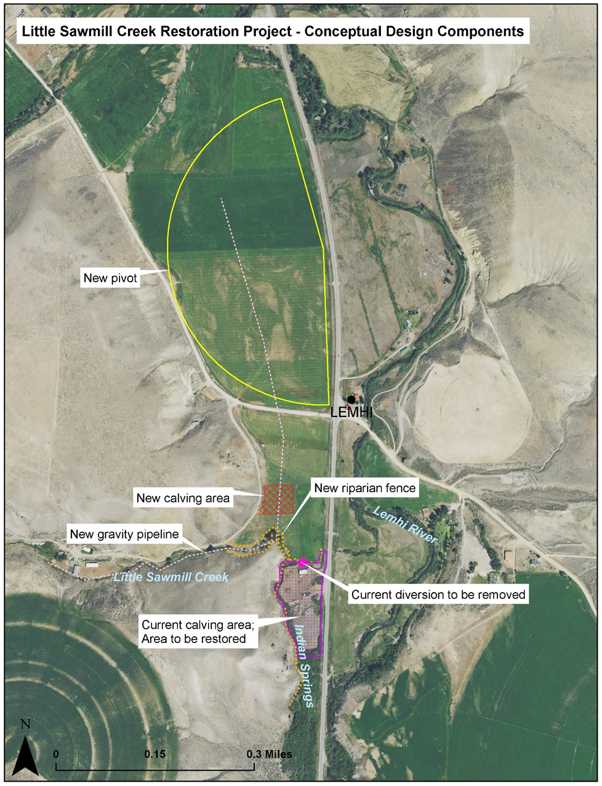
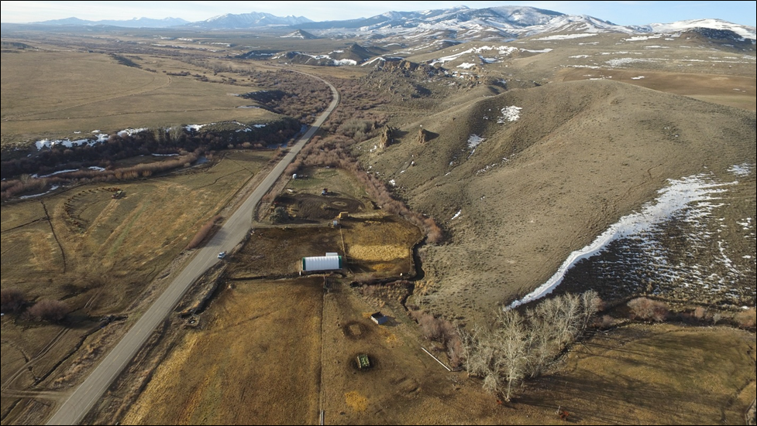
Lemhi River
Indian Springs
Area to be restored
Little Sawmill Creek

Slide 4
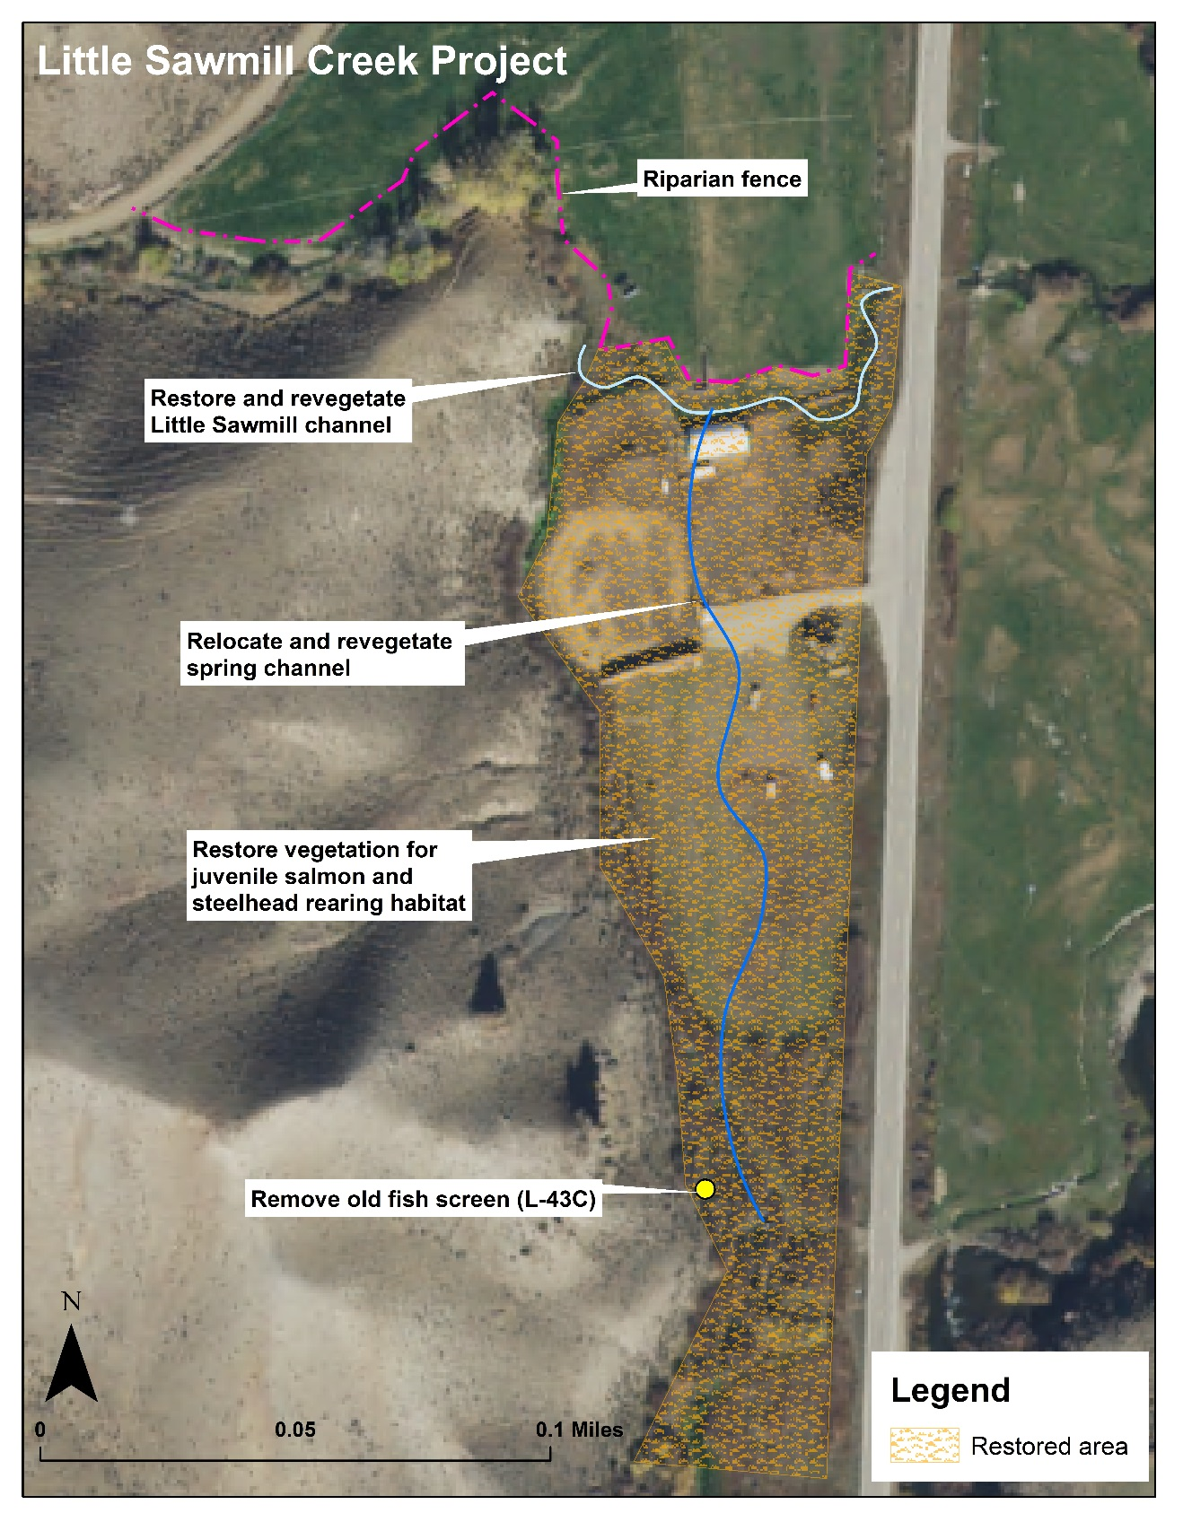
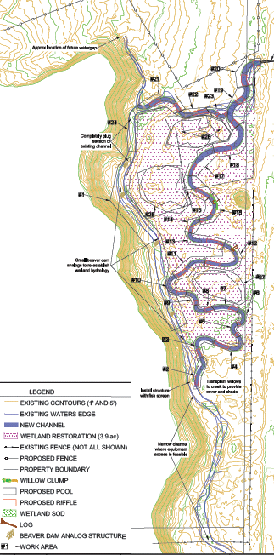
Restoration actions
Restore and exclude livestock from current calving facility location
Restore and revegetate 0.21 mi of Little Sawmill Creek channel
Revegetate and relocate 0.09 mi of Indian Springs to add sinuosity
Install riparian fence with a setback of 35 feet on the north side of Little Sawmill Creek
Remove old fish screen (L-43C) from Indian Springs
Notes:
Emphasize loss of production ground- 4.8 acres

Slide 5
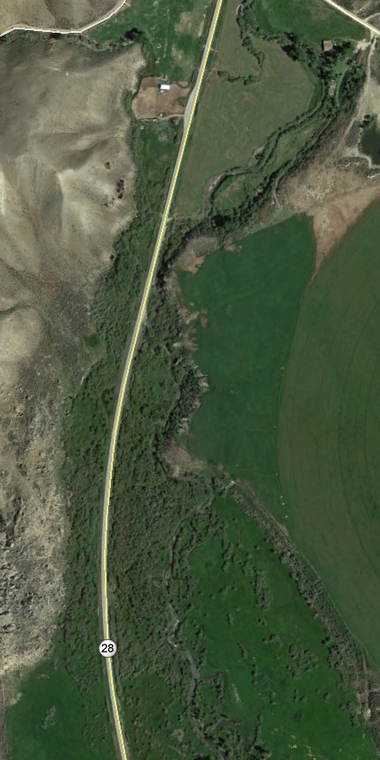
Little Sawmill Creek
Most of Little Sawmill Creek is not a priority for fish
Goal is to gain fish access to 0.4 miles of juvenile Chinook and steelhead rearing habitat in Indian Springs
Lemhi River
Indian Springs
And to improve conditions on lower Little Sawmill Creek to encourage fish to enter Indian Springs

Slide 6
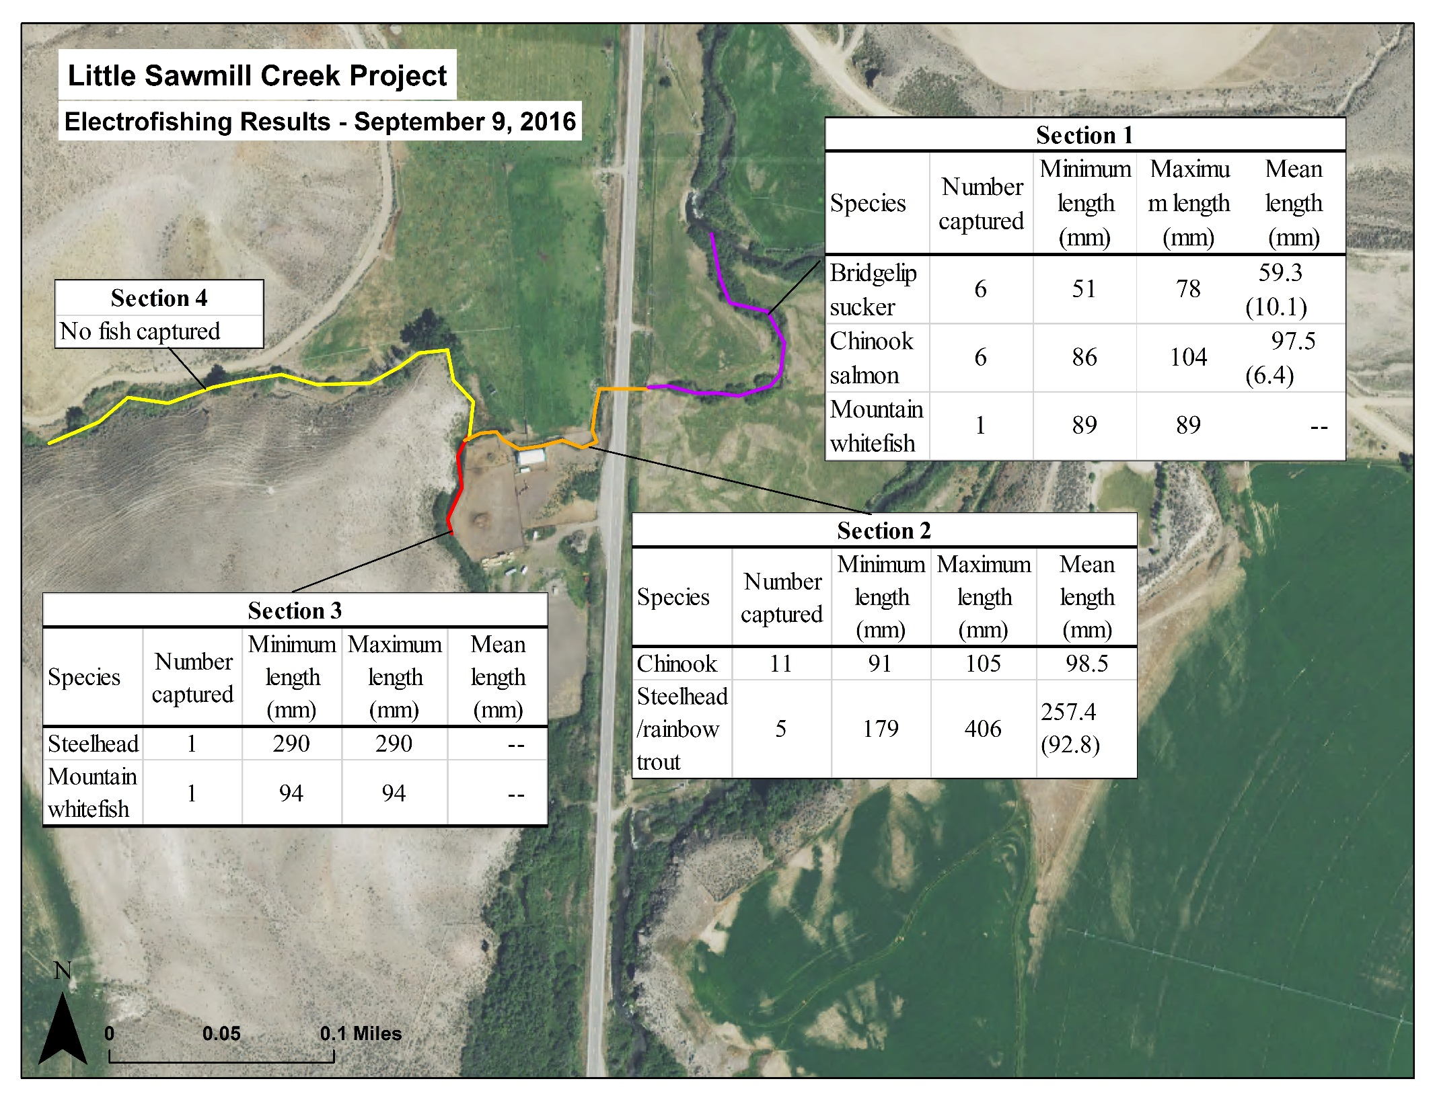
Fish data
IDFG electrofished project area September 9, 2016

Slide 7
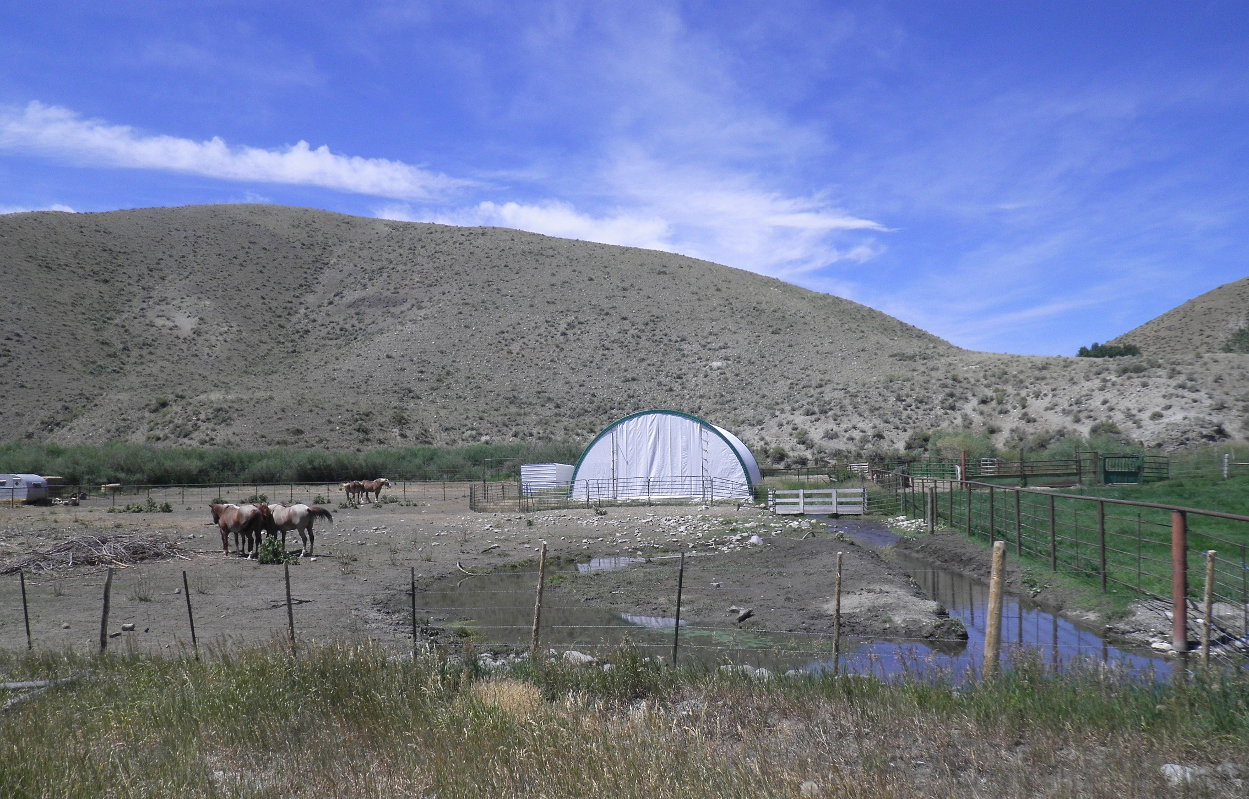
Current conditions
Little Sawmill Creek
200 head of cattle spend 2 months on the lot
6 horses spend 5 months
Notes:
You can see this from Hwy 28- project started looking at what we could do to improve this- grew from there

Slide 8
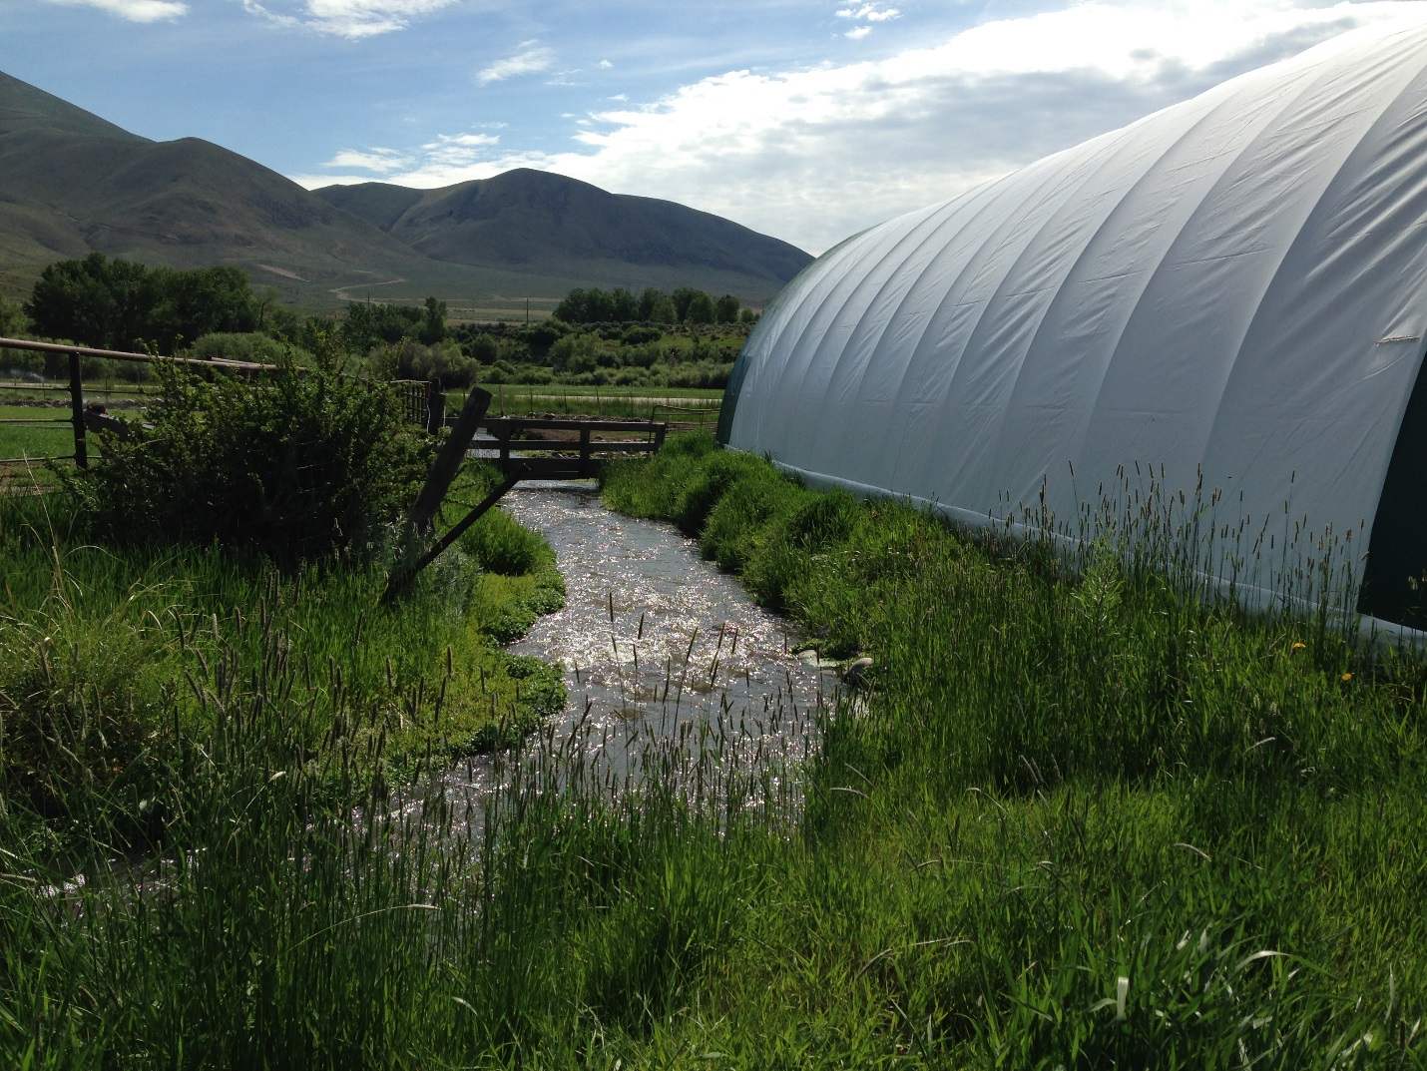
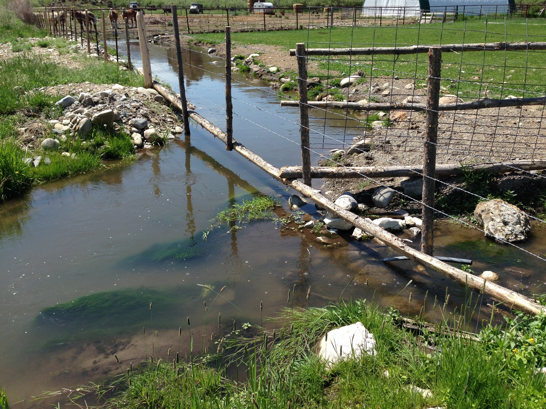
Current conditions
Notes:
You can see this from Hwy 28- project started looking at what we could do to improve this- grew from there

Slide 9
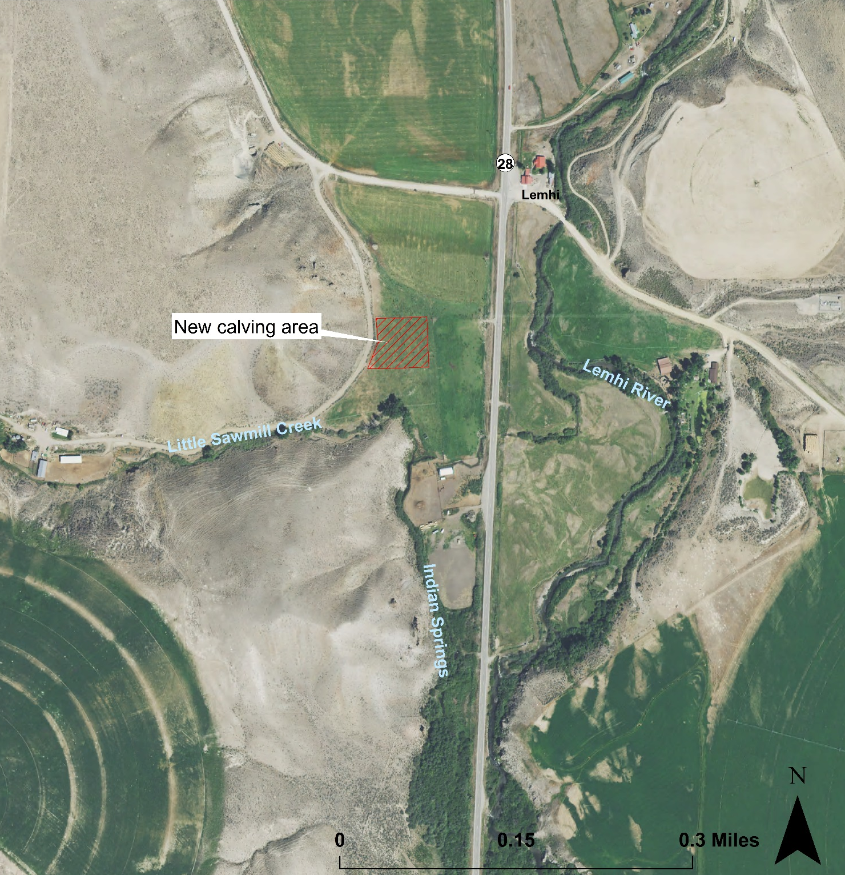
Project actions – Calving facility
Relocate calving barn, feedlot and corrals to a new location at least 150 feet away from Little Sawmill Creek
Move all existing infrastructure associated with the calving facility to the new location

Slide 10
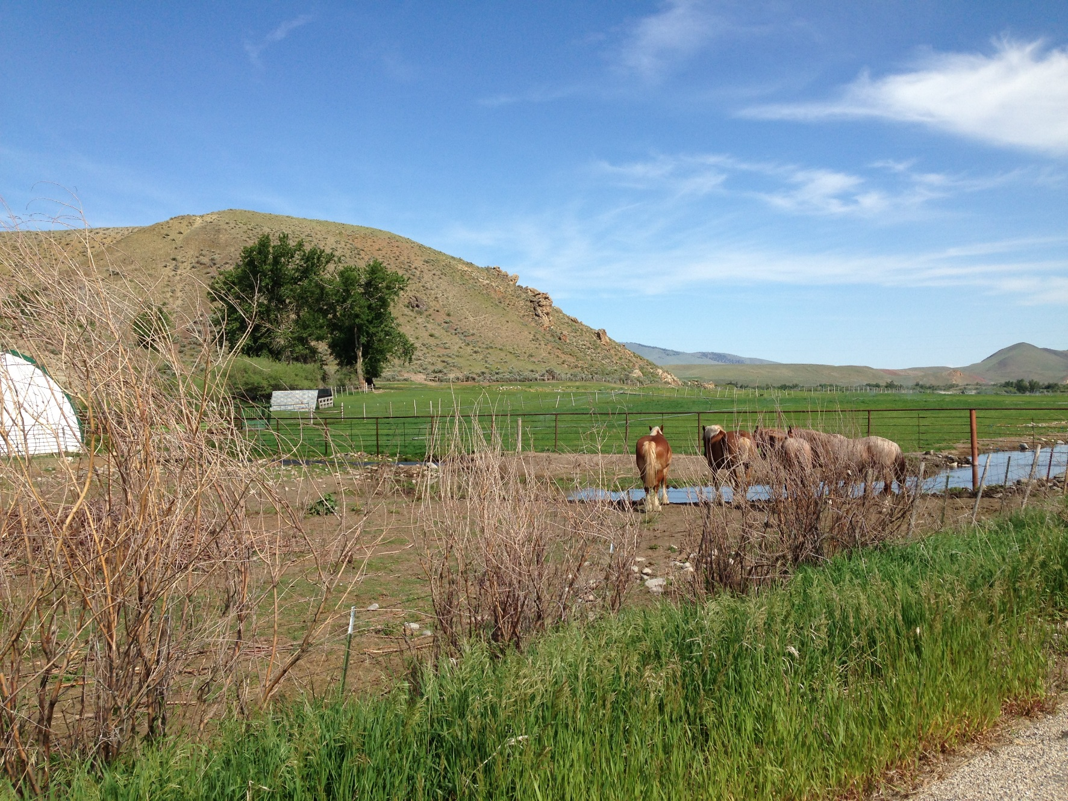
Project actions – Calving facility
New calving facility location in the background
Current calving facility and Little Sawmill Creek in the foreground

Slide 11
Reducing sediment and nutrient loads in Little Sawmill Creek and the Lemhi River
Best Management Practice Load Reduction Estimations provided by Darcy Sharp, Idaho DEQ
Project Name, Location and Parameters | Calculation/Estimation Method | Load Reduction
Moving calving facility | STEPL model | Sediment = 16.2 tons Nitrogen = 859.3 lbs Phosphorus = 197.2 lbs
Restoring 400 feet of eroding streambanks | Direct Volume Calculation | Sediment = 8.3 tons Nitrogen = 26.7 lbs Phosphorus = 13.3 lbs
Total sediment and nutrient load reduction estimations |  | Sediment = 24.5 tons Nitrogen = 886 lbs Phosphorus = 210.5 lbs
Notes:
Note this does not include Velma’s piece

Slide 12
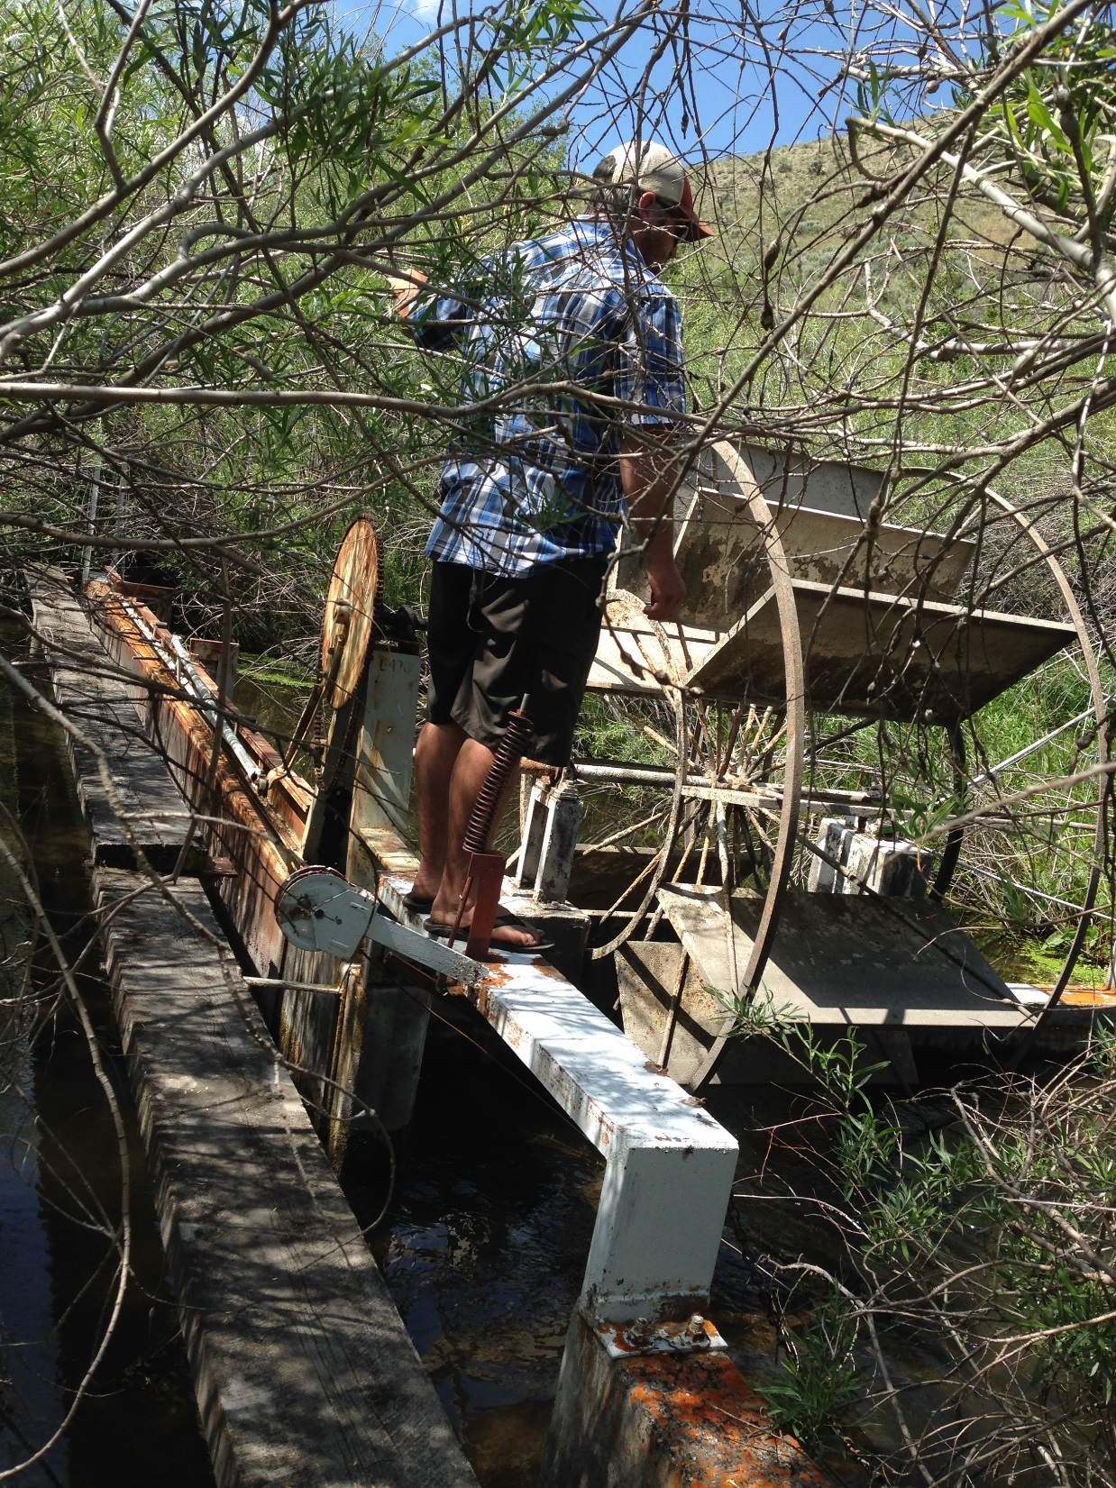
L-43C will be removed

Slide 13
Project actions - Irrigation
Provide a new pivot on the north field
Provide a new gravity pipeline adjacent to Little Sawmill Creek and connect to a new mainline system
Provide a new pump station and pump water to a pipeline under the highway to irrigate when there is not sufficient water to irrigate from Little Sawmill Creek
The landowners will leave one of the spring inputs into Little Sawmill Creek in the stream for fish above the confluence of Indian Springs

Slide 14
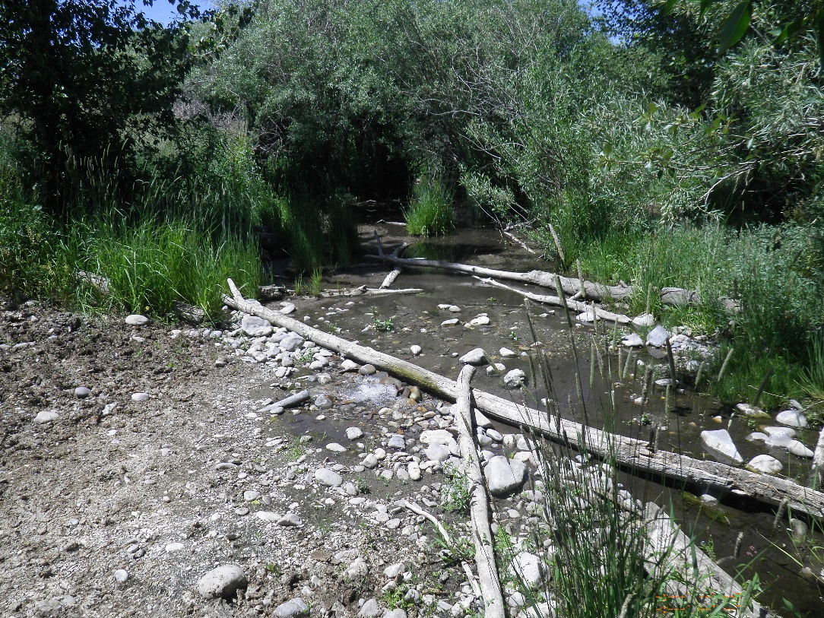
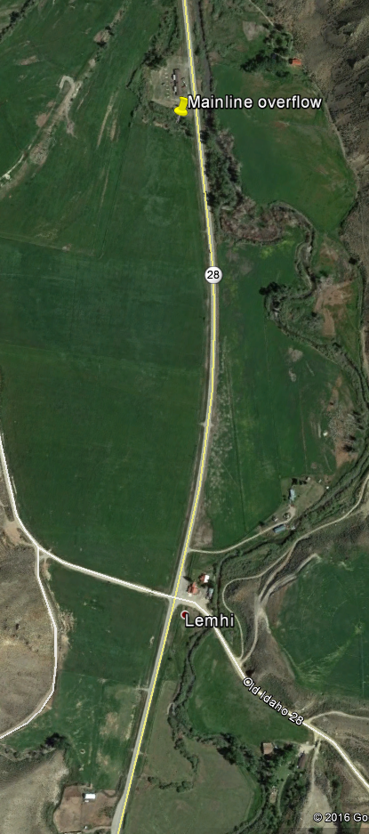
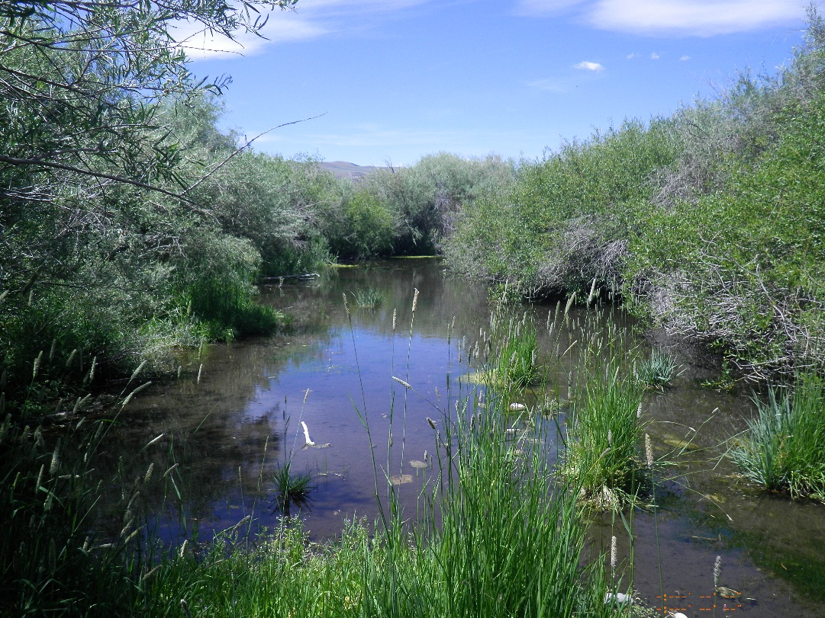
Project actions - Irrigation
End of mainline currently overflowing into spring at north end of property
Mainline will be left in place and end of it will be capped
Study area for potential future project to address spring complex

Slide 15
Project Benefits and Outcomes
Reduce fecal coliform bacteria levels in Little Sawmill Creek and the Lemhi River by moving a calving facility off of Little Sawmill Creek.
Increase juvenile salmon and steelhead rearing habitat by restoring and revegetating Indian Springs and Little Sawmill Creek.
Improve fish passage by eliminating a fish passage barrier, thereby opening 0.4 mi of habitat in Indian Springs.
Reduce sediment loads and fecal coliform bacteria input by moving a calving facility off of Little Sawmill Creek, restoring the area, and installing riparian fencing.
Reduce stream temperature by keeping additional flow in Indian Springs through irrigation efficiencies.

Slide 16
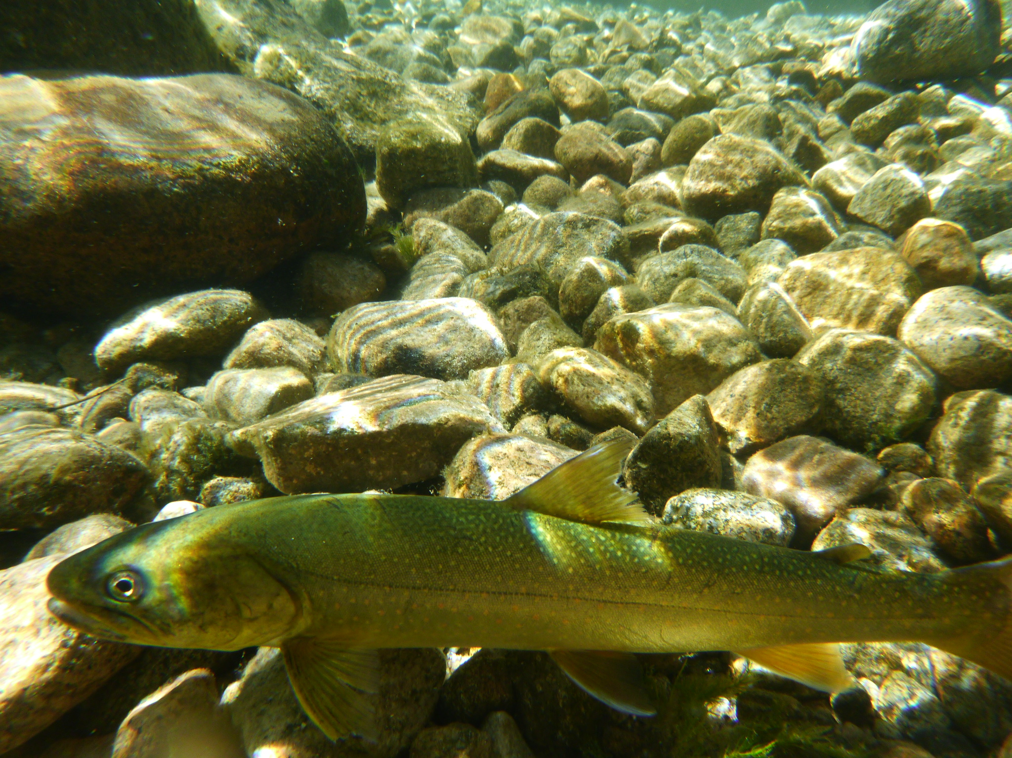
Questions?

